Slide 1
Optical spectroscopic observations of NEAs at the “Guillermo Haro” Astrophysical Observatory
J.R.Valdés ⁽¹⁾, J.Guichard ^{(1,2)}, S.Camacho ⁽²⁾, A.Ojeda ⁽¹⁾, R.Mújica ⁽¹⁾, A.Márquez ⁽¹⁾
(1) Instituto Nacional de Astrofísica, Óptica y Electrónica (INAOE)
(2) Centro Regional para la Enseñanza de la Ciencia y la Tecnología Espacial para América Latina y el Caribe (CRECTEALC)

Slide 2
OAGH (Cananea, Sonora. México)
OAGH is one of the five astronomical observatories in México
2.1m Ritchey-Chrétien télescope + Boller & Chivens Spectrograph.

Slide 3
Instrumental Set-up
Low-resolution diffraction grating of 50 l/mm
Dispersion of about 10Å
Spectral coverage between 4200Å and 9500Å
Slit width of 400 μm, that with an image scale of 8.18 arcsec/mm corresponds to 3.2 arcsec in the sky.
CCD E2V42-40 (2048 x 2048 pixels)

Slide 4
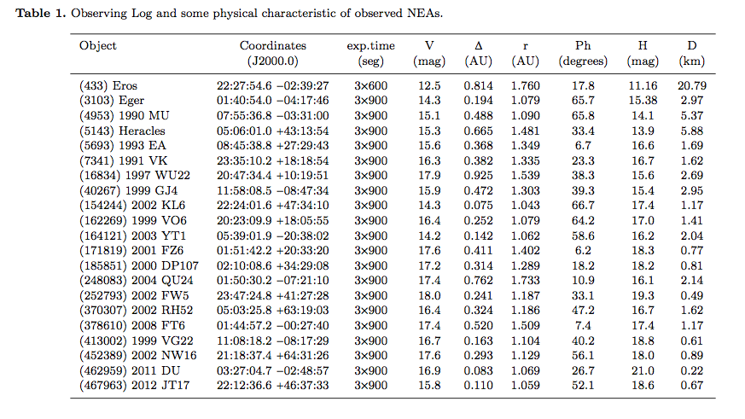
Selection of targets
Using the Minor Planet & Comet Ephemeris Service of the Minor Planet Center (http://www.minorplanetcenter.net/iau/MPEph/MPEph.html) we selected the NEAs that were in opposition

Slide 5
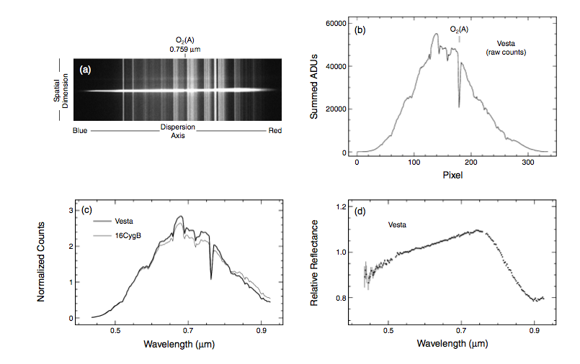
Reduction process of asteroid spectra
Bus et al.: Visible-Wavelength Spectroscopy of Asteroids. In Asteroids IV
We restrict the list of solar analogs to those stars that meet the following criteria: ΔTeff < 200K, Δlog(g)< 0.2, and Δ[Fe/H]< 0.2

Slide 6
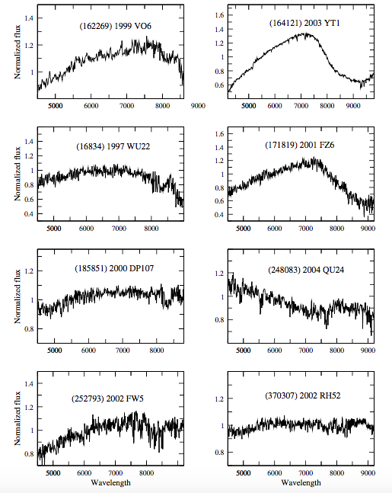
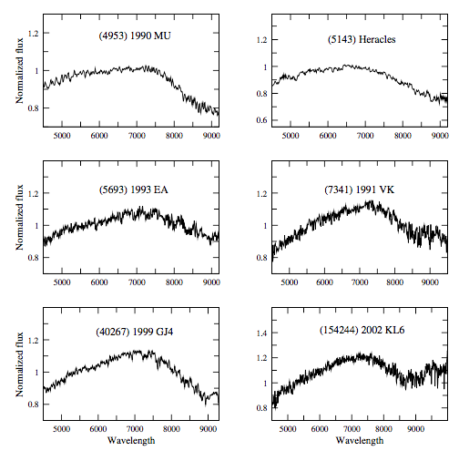
Reduction process of asteroid spectra

Slide 7
Taxonomic classification of observed NEAs
The main goal of this project is to determine the taxonomic class (taxonomic complex) to which the observed NEAs belong (Bus & Binzel 2002. Icarus, 158, 146, DeMeo et al. 2009. Icarus, 202, 160.)
We propose a system that takes into account the following properties of the objects:
1. The value of the “spectral distance (Dx)”, calculated with respect to:
The mean spectra of the 24 taxonomic classes of DeMeo, et al. (2009)
B) 1341 individual asteroid spectra from the Phase II of the Small Main-Belt Asteroid Spectroscopic Survey (SMASSII, Binzel et al. 2001, in Lunar Planetary Science XXXII, No. 1663; Bus & Binzel 2002, Icarus, 158, 106)
2. The value of albedo, ρν (when it is available).
3. The orbital properties of observed objects.

Slide 8
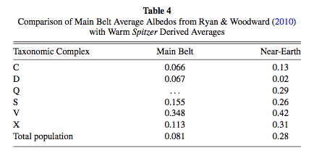
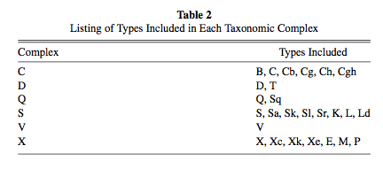
Taxonomic classification of observed NEAs
Stuart & Einzel 2004. Icarus. 170. 295
Thomas et al. 2011. AJ. 142. 85.

Slide 9
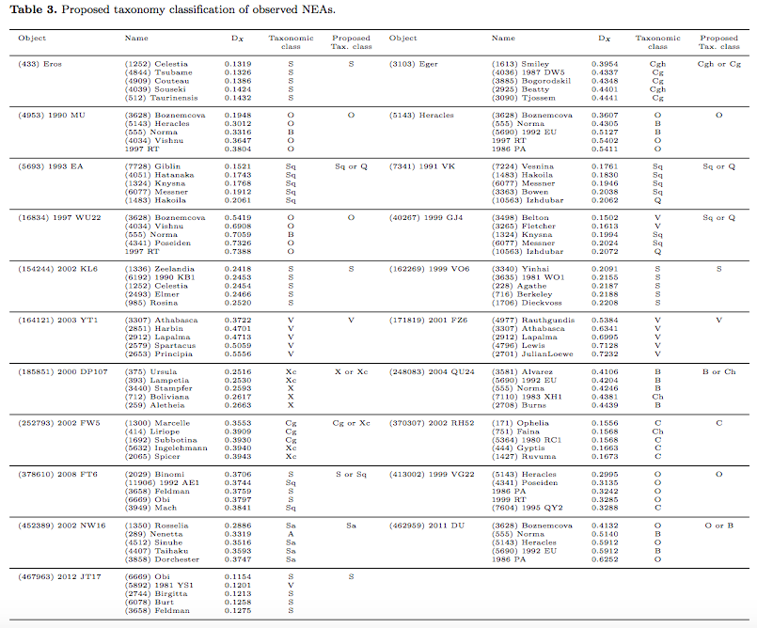
Taxonomic classification of observed NEAs
Complex S (6)
Complex C (3)
Complex O (5)
Complex Q (3)
Complex V (2)
Complex X (1)

Slide 10
Future work
We have more that 150 asteroids observed during 2017B semestre: NEAs (54) and MB asteroids from different families (96), for which it is still necessary to determine their taxonomic classification.
We have three observing runs in 2018A, and six observing runs in 2018B. At the end of 2018 we will probably have more that 300 optical spectra to reduce.
We are about to finish the update process of the historical Tonantzintla Schmidt camera. It will be a telescope, dedicated full-time, to astrometric and photometric observations of NEAs and MB asteroids

