Slide 1
UNOOSA and Planetary Defence
Romana Kofler, Programme Officer
Committee, Policy and Legal Affairs Section,
UNOOSA

Slide 2
Our Work
Main programmes and platforms
Secretariat to COPUOS
Works with MS, IGOs, NGOs (space-related)
Programme on Space Applications
UN-wide coordination - UN-Space
UN Register of Space Objects
UN-SPIDER
International Committee on Global Navigation Satellite Systems (ICG)
Space Mission Planning Advisory Group (SMPAG)…
More info: www.unoosa.org

Slide 3
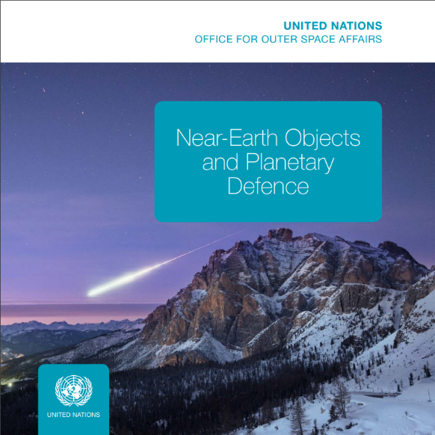
UNOOSA and NEOs
Given the global consequences of a NEO impact and the resources required to prevent a collision, UNOOSA and COPUOS have been actively involved in the international discourse and dialogue, raising awareness and promoting global cooperation on NEO-related issues.

Slide 4
Developments since the 10th SMPAG MEETING
UNOOSA, IAWN, SMPAG Brochure: Near-Earth Objects and Planetary Defence (ST/SPACE/73), published June 2018, see www.unoosa.org
Acta Astronautica paper, as a follow-up to PDC 2017, on the work of IAWN, SMPAG and UN in the area of NEOs and planetary defence
Attempt to rename the agenda item of the Scientific and Technical Subcommittee on NEOs to “Near-Earth objects and planetary defence”.

Slide 7
From UNISPACE III to UNISPACE+50 in 2018
UNISPACE III in 1999 paves the way towards establishing SMPAG and IAWN – key mechanisms at a global level for strengthening the coordination in the area of planetary defence and preparing for an international coordinated response to the threats posed to Earth by NEOs
UNISPACE+50 in 2018: UNOOSA closely cooperates with both IAWN and SMPAG, and besides its mandate as a secretariat to SMPAG has an observer status to both entities, while also supporting IAWN in information dissemination
GOAL: to ensure that all countries, in particular developing nations with limited capacity to monitor, predict and mitigate a NEO impact, are aware of potential risks and to ensure effectiveness of emergency response and the subsequent disaster management.

Slide 8
UNISPACE+50, 18-21 June 2018
UNISPACE+50 in June 2018 included a symposium, a COPUOS High- level segment, side events, and a week-long exhibition.
The symposium panels gave stakeholders the opportunity to take note and discuss various relevant issues in the areas of Space and Civil Society, Space and Industries, Space and Women and Space and Youth
COPUOS high level segment allowed Member States to articulate their views on relevant space issues and commit to the development of “Space2030” Agenda
Major step for global space governance and towards the successful fulfilment of SDG targets and Space2030
400 Participants at the Symposium, 800 Participants at the High-level Segment
HIGHLIGHTS
29 heads or high ranking representatives of Space Agencies attended
UNOOSA signed
several agreements with governments, space agencies and private companies
Live in-flight call with astronauts on the International Space Station

Slide 9
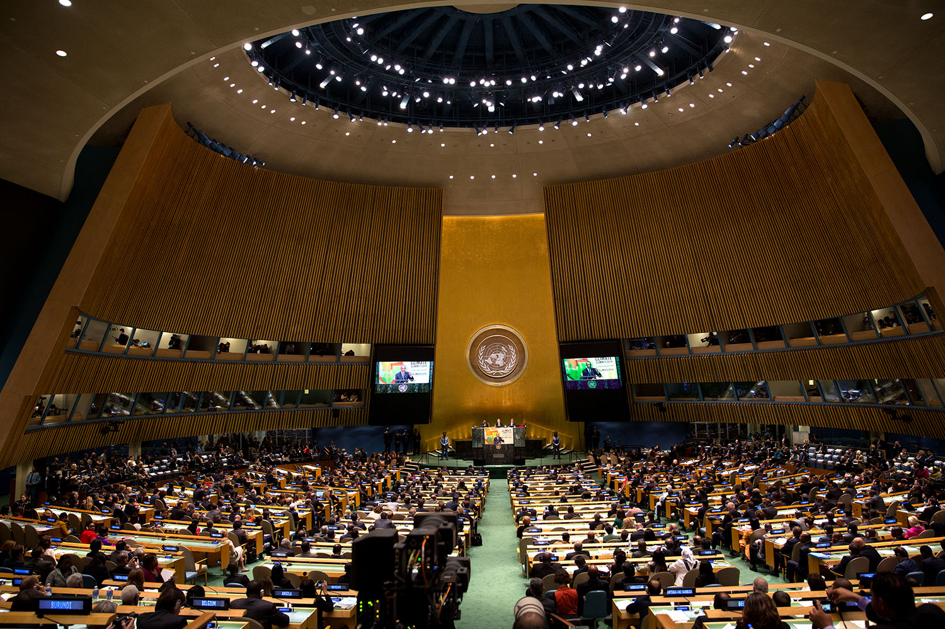
Dedicated resolution “Fiftieth anniversary of the first United Nations Conference on the Exploration and Peaceful Uses of Outer Space: space as a driver of sustainable development“ endorsed by UN COPUOS for adoption at 2018 UN GA
Invites COPUOS to continue to develop, a “Space2030” agenda and implementation plan and to provide the UNGA with the outcome of its work for consideration by the Assembly at its seventy-fifth session in 2020

Slide 10
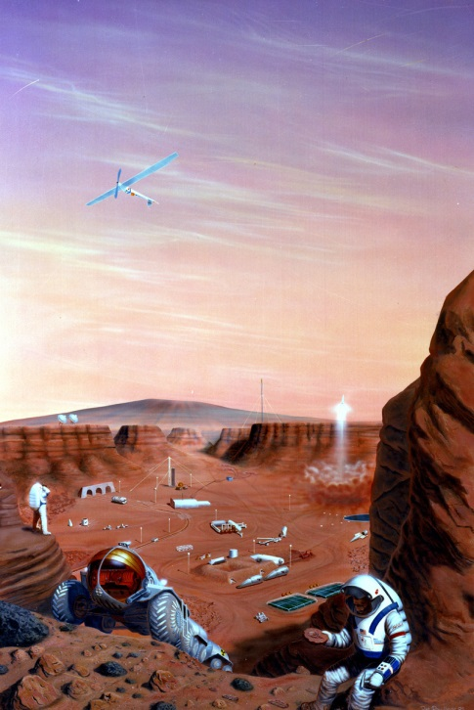
UNOOSA
The entry point to Space in the UN-System
Space2030

Slide 11
“Space2030” and planetary defence
“Space2030” consists of 4 pillars:
Space Society: Refers to a society that carries our its core functions while making optimal use of space based technologies, applications and services
Space Accessibility: Addresses equal and non-discriminatory access to outer space for all regardless of a country’s scientific, technological and economic development
Space Diplomacy: Addresses cooperation among nations in using space technologies and applications to address common challenges facing humanity to build constructive, knowledge based partnerships.
Space Economy: Addresses matters related to space technologies and infrastructure, benefits of space economy for global sustainable development, and addresses the economic rationale for space activities and potential for the cooperation of private and public entities
$$↓$$
NEOs & Planetary defence - an area crucial to ensuring human security (Space Society pillar), hence the United Nations continues to facilitate the processes for developing an international response.

Slide 12
“Space2030”, SDGs and planetary defence
BUILDING RESILIENT SOCIETIES through better coordination and forging of global partnerships is one of the key challenges in the 21st century
$$↓$$
SPACE SOCIETY pillar – COPUOS work: Focus on resiliency, including matters related to the ability to depend on space systems and to respond to the impact of events such as adverse space weather, natural disasters and the threat posed by NEOs
In order to strengthen preparedness in case of a potential NEO impact, there should be increased planetary defence efforts and raised awareness among Member States, in particular those without capabilities in that area.
UNOOSA to work together with IAWN and SMPAG through UNOOSA’s UN-SPIDER, as part of technical advisory missions on disaster preparedness and emergency response and as part of the Office’s capacity-building activities.
This is also related to one of the activities of IAWN concerning informing relevant parties, such as emergency response agencies.
Proceed to defining an approach for interaction with UNOOSA and COPUOS in the event that a possible impactor is detected.

Slide 13
Newly established COPUOS Working Group on “Space2030”
In view of the draft resolution entitled "Fiftieth anniversary of the first United Nations Conference on the Exploration and Peaceful Uses of Outer Space: space as a driver of sustainable development", contained in A/AC.105/L.313, endorsed by the Committee at the 61st session, the Committee decided:
On a NEW AGENDA ITEM entitled "'Space2030' agenda", to remain on the Committee's agenda until the sixty-third session of the Committee, in 2020.
The Committee agreed on the establishment of a Working Group under that item.
WG to hold intersessional consultations the week of 8-12 October 2018 at the VIC, to establish its workplan and method of work.
The meeting will start on Monday, 8 October at 10.00hrs in C-building, Conference room C3.
COPUOS member States invited to provide focal points for the work of the WG

Slide 14
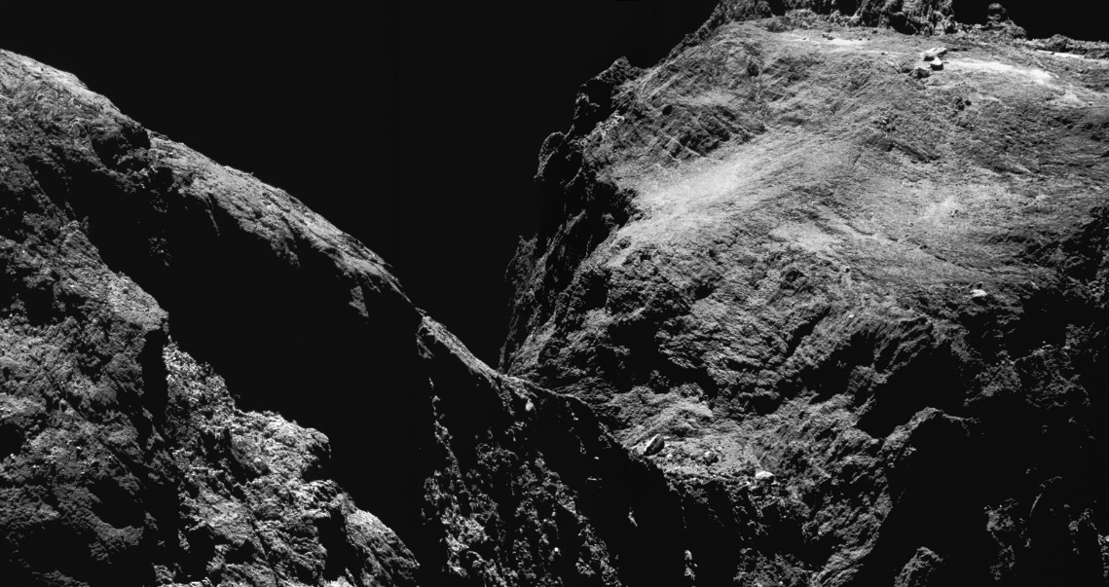
Space resources in the context of COPUOS, Legal Subcommittee
2017: New agenda item: “General exchange of views on potential legal models for activities in exploration, exploitation and utilization of space resources”
Indicated the need for a broad debate about the implications of space resource activities as well as for a greater understanding among States of the principles set out in the Outer Space Treaty.
Ensuring that concerns of all States were taken into account, thereby promoting peace and security among nations.
SMPAG Ad Hoc Working Group on legal issues
(est.2016)

Slide 15
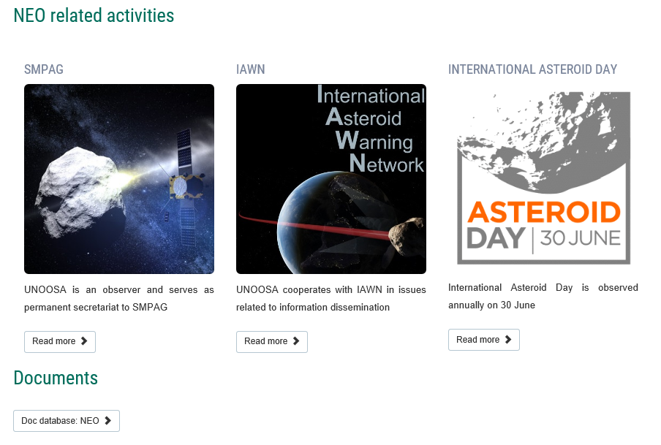
SMPAG and IAWN in the context of COPUOS, Scientific and Technical Subcommittee
Since 2014, SMPAG and IAWN participate in the sessions of the Scientific and Technical Subcommittee of COPUOS and report annually to the Subcommittee on the progress of their work on planetary defence
All documents are contained in UNOOSA NEO data base at www.unoosa.org under TOPICS/ Our Work/ Near-Earth Objects

Slide 16
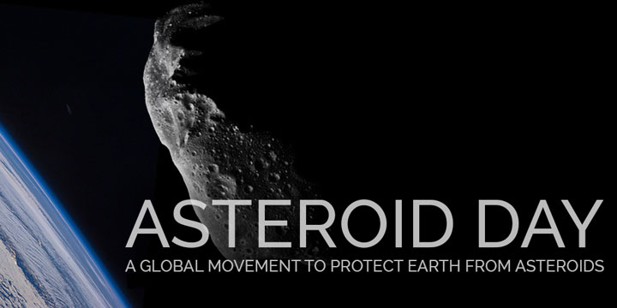
International Asteroid Day
Proclaimed by UN GA Resolution 71/90
To raise awareness globally about the NEOs, their potential harmful impacts and the efforts in the area of planetary defense by SMPAG, IAWN and supported by the Office for Outer Space Affairs.
Encourages reflection on the impact hazard of asteroids and the global work undertaken in this area facilitated by UNOOSA, including work by COPUOS, IAWN, SMPAG and UN Member States.
June 30, International Asteroid Day

