Slide 1
IAWN Website A Quick Tour

Slide 2
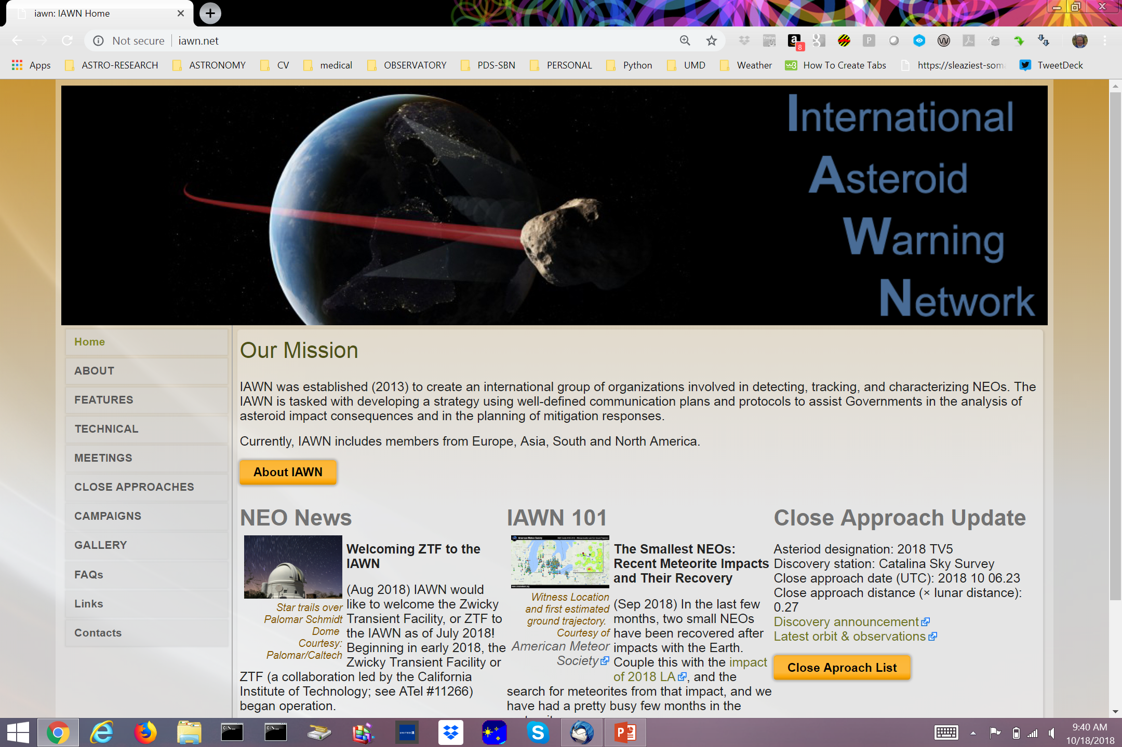
iawn.net
Auto updates from alerts sent out meeting criteria

Slide 3
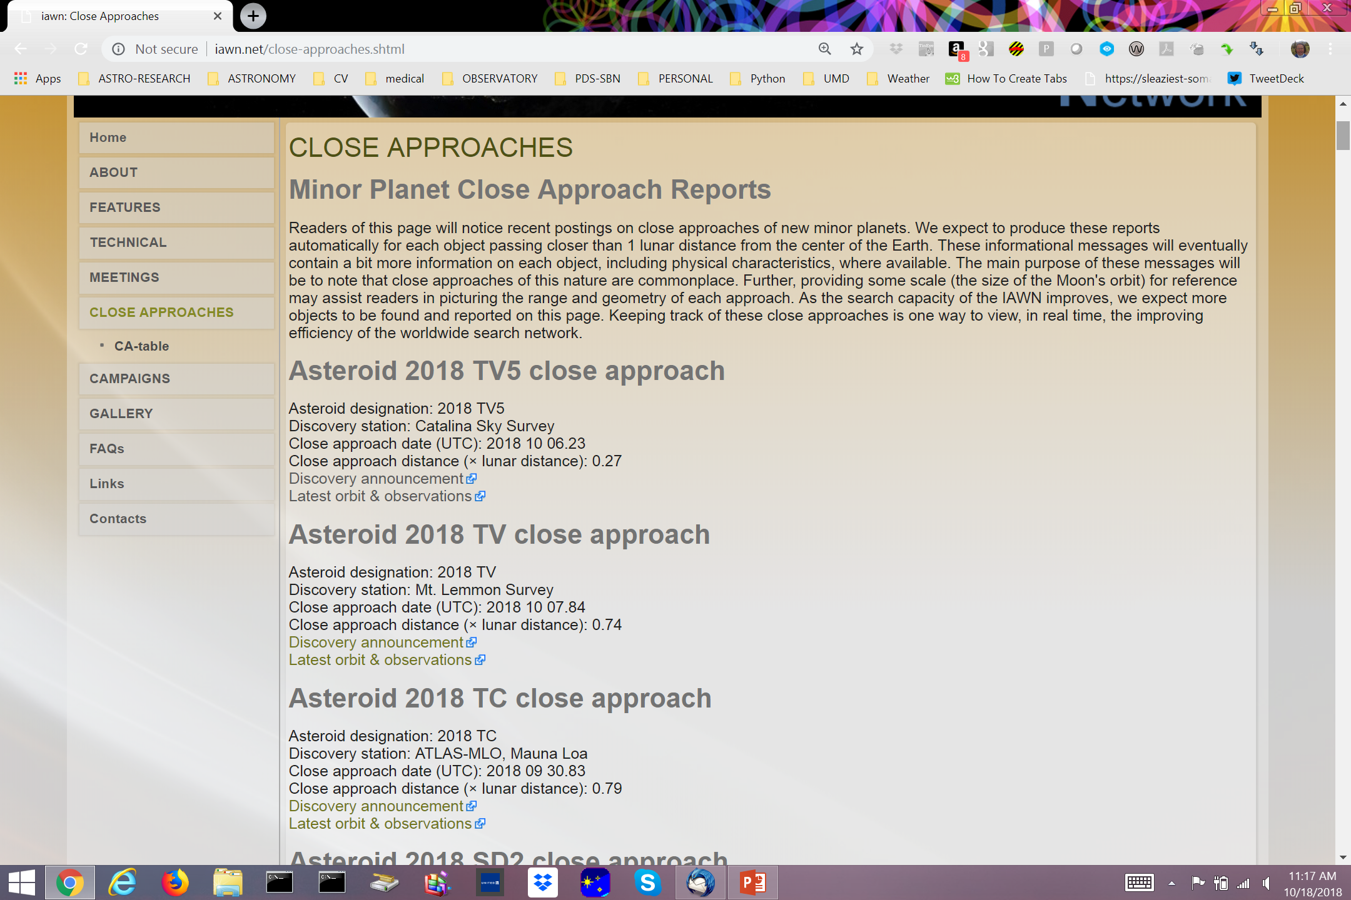
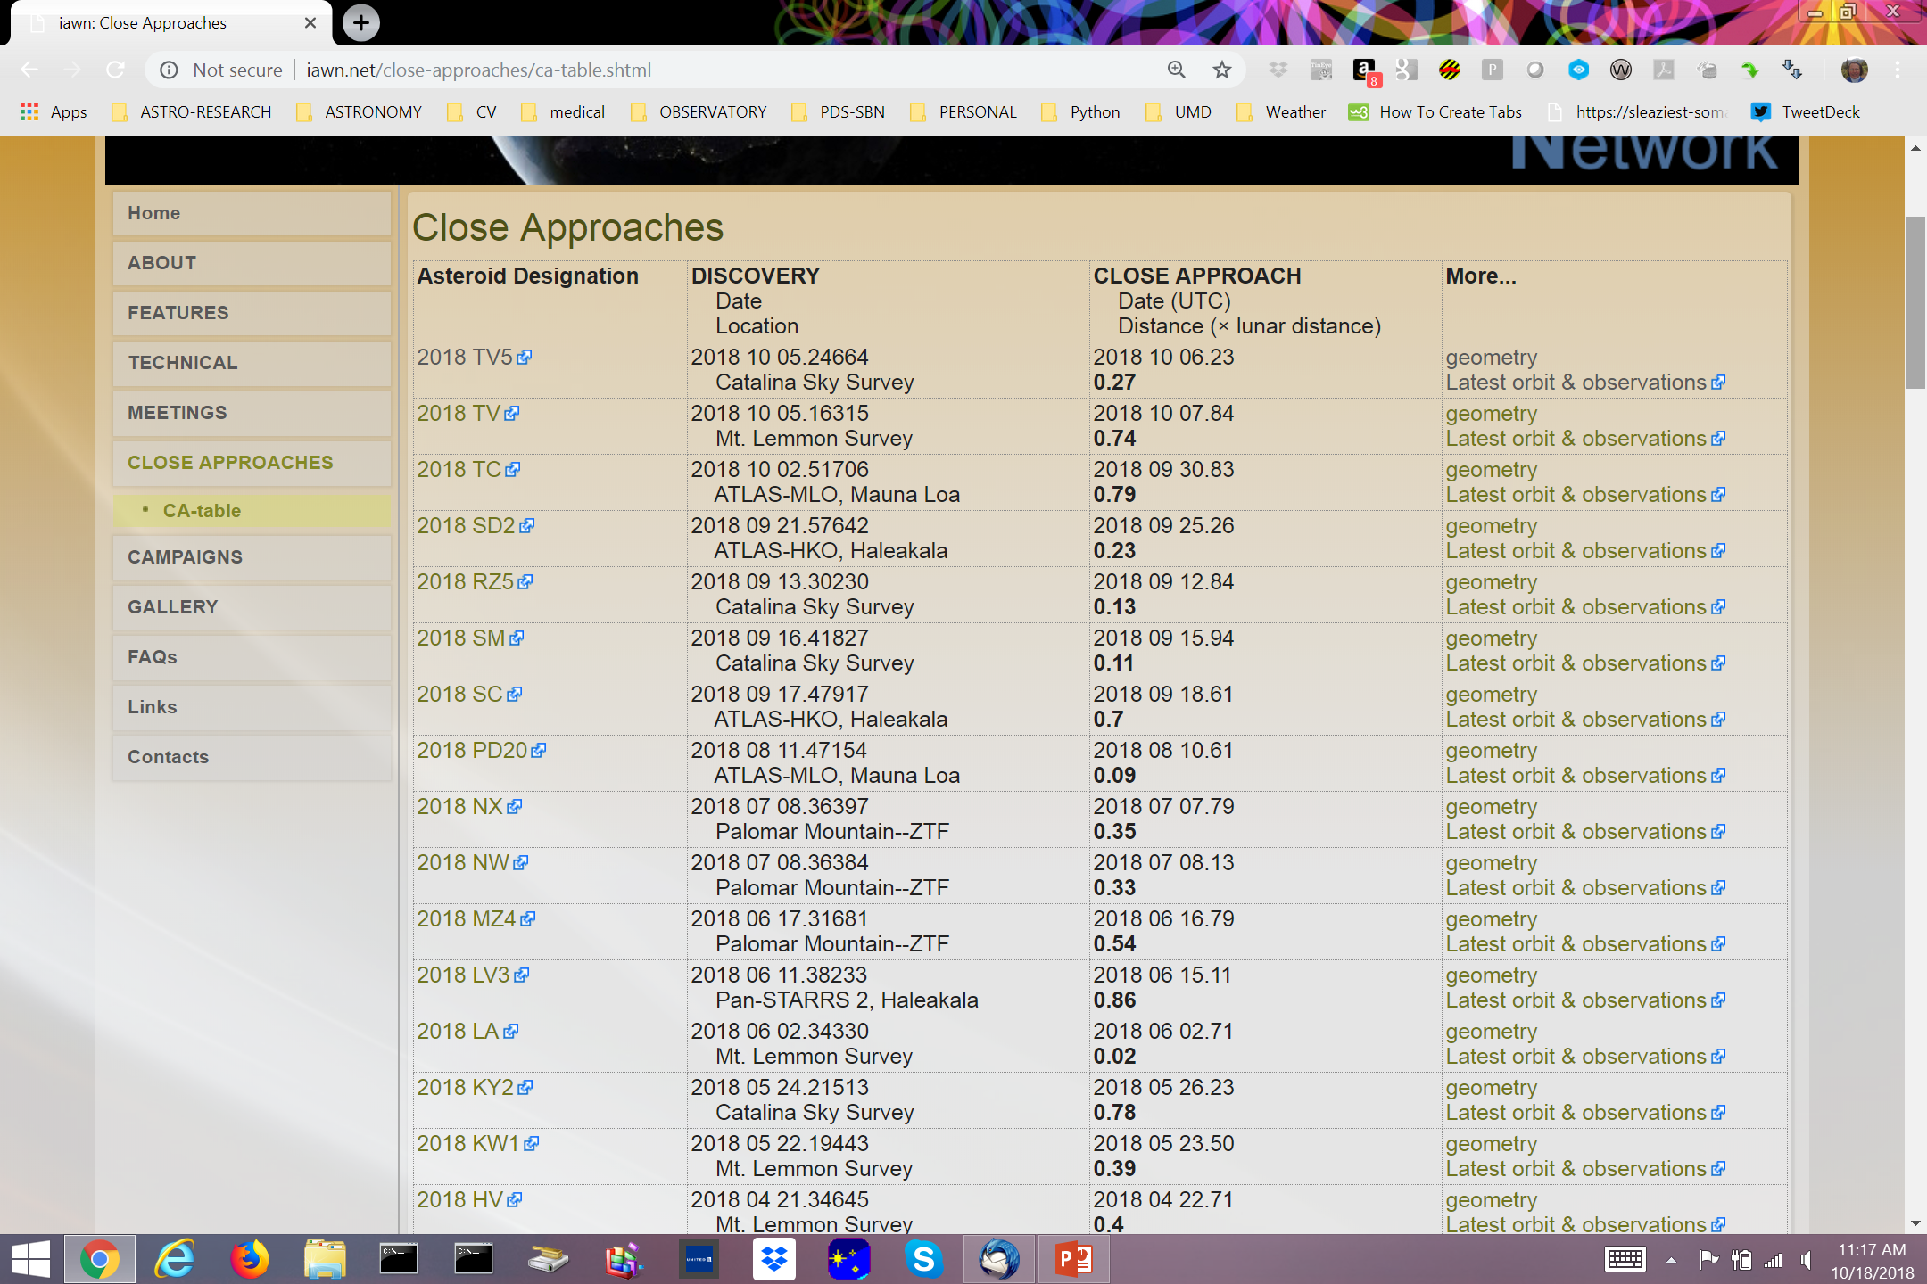
Close Approaches
Two views – paragraph (as done on original IAWN site) and tabular
Both link to Discovery Announcement, Latest Orbit & Observations at MPC
Table also links to Geometry info

Slide 4
Geometry
Plots are auto-generated when object is added to the close approach list (or when orbit becomes available)
Offers easy first-glimpse of observing conditions
Plots include:
Heliocentric & Geocentric Dist.
Solar Elong. and Phase angle
Predicted Brightness
Orbit (oblique view)
Orbit (Earth co-rotation view)

Slide 5
iawn.net
Changing articles currently in Features & Technical sections, but could also link to a Campaign

Slide 6
Features

Slide 7
Technical

Slide 8
About

Slide 9
Meetings

Slide 10
Campaigns
Site for distribution of information and collection of observing plans for a PHO
Used the return of 2012 TC4 as a “test case” to simulate progress following a newly discovered PHO

Slide 11
Content
Goal: To provide informed content explaining NEO Observations and Populations to the community
Tim Spahr, SBN IAWN content manager
Input from IAWN participants encouraged!
Assets
News from your region
Feedback appreciated!

Slide 12
Design Perspectives
Logos
What logos should we use?
On page of Members or across site (branded)?
Philosophy
Simple
Accessible
(some host requirements)

Slide 13
Campaign Example - 2012 TC4

Slide 14
Observation Status Page

Slide 15
Observation Status – Text Updates

Slide 16
Observing plan inputs

Slide 17
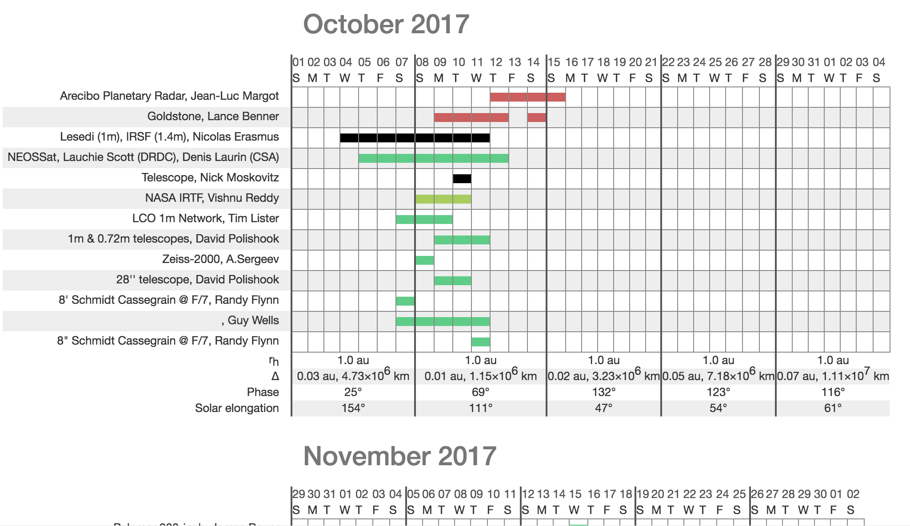
Observation Plan Log

