Slide 1
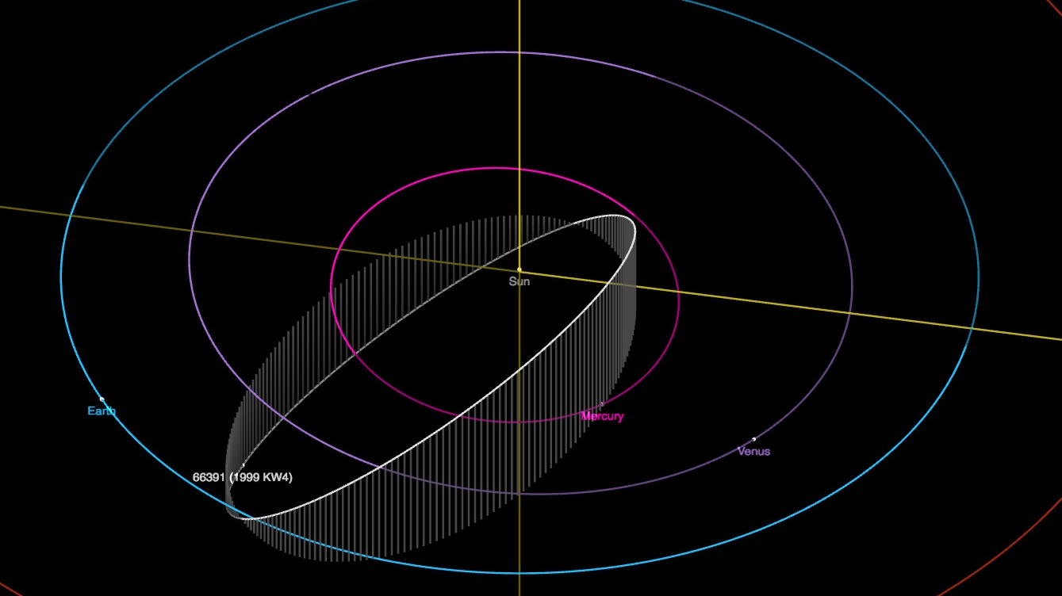
1999 KW₄ Observing Campaign Status
1999 KW₄ on 27 April 2019
Earth distance: 0.361 AU
Sun distance: 0.768 AU
28 days until close approach
Rob Landis

Slide 2
1999 KW₄
Previous meeting in February 2019 in Vienna, IAWN signatories agreed to make 1999 KW₄, a binary NEA, the next observing campaign target
An exercise to see what resources might be brought to bear on a relatively short notice
While 1999 KW₄ is relatively well-characterized binary system, could serve as a reasonable analog to prepare for other binary NEAs as well as fine-tuning plans to observe/support DART impact into Didymos system
IAWN has set up observing campaign webpage
Logistics
Points of contact
Disciplines
Assets
http://www.iawn.net/obscamp/1999KW4/

Slide 3
1999 KW₄
Science coordination - Mike Kelley (NASA HQ)
Direct imaging – Marco Micheli (ESA)
VLT SPHERES (O. Hainaut (ESO) et al.)
HST WFC3 (A. Storrs (Towson Univ.) et al.)
Gemini South and North Alopeke & Zorro (S. Howell, NASA ARC)
Photometric lightcurve – Petr Pravec (Ondřejov Observatory)
KMTNet, OWL-net, various (Hong-Kyu Moon (KASI) et al.)
2.1-m, 0.77-m (Jose Valdes (INAOE))
LCO network (T. Lister (LCO))
0.61-m/1.0-m (Masa Ishiguru (Seoul Nat’l Univ.) et al.)
0.65-m (P. Pravec, Ondřejov Obs’y)
others …
Radar – Patrick Taylor (LPI)
Arecibo (P. Taylor (LPI) et al.)
Goldstone (L. Banner (JPL) et al. and Green Bank)
Spectroscopy – Vishnu Reddy (Univ. of Arizona)
NASA IRTF (V. Reddy et al.)
Modeling – Jessie Dotson (NASA ARC)
DD time has been requested;
proposals have been submitted

Slide 4
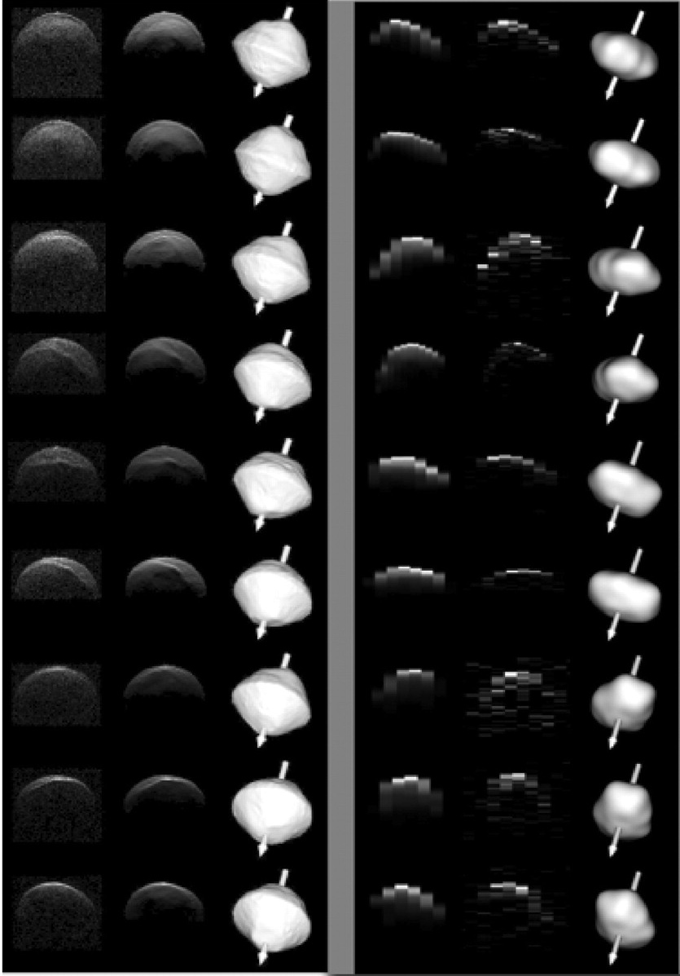
(66391) 1999 KW₄ – at a glance
Discovery (LINEAR) | 20 May 1999
Provisional Designation | 1999 KW₄ (closest known binary to Sun)
Perihelion | 0.2000 AU (Mercury crosser)
Aphelion | 1.0845 AU
Heliocentric semi-major axis (a) | 0.6422 AU
Eccentricity (e) | 0.6886
Orbital period (about the Sun) | 188 days
Orbital heliocentric inclination (i) | 38.884°
Rotational period | 2.7650 hours (primary body)
Orbital period of moonlet | ~17.4 hours
Diameter of primary | ~1.3 km (complex ‘muffin’ shape)
Diameter of moonlet | ~0.5 km (elongated triaxial ellipsoid)
System mass | 2.488 ± 0.054 × 10¹² kg
Density | ~2 g/cm³ (50% porosity)
Spectral type | S-type
Next close approach | 2036

Slide 5
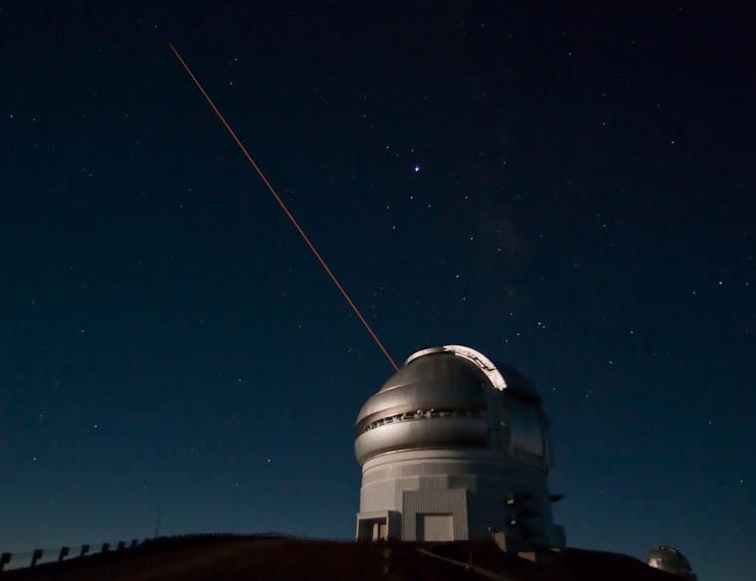
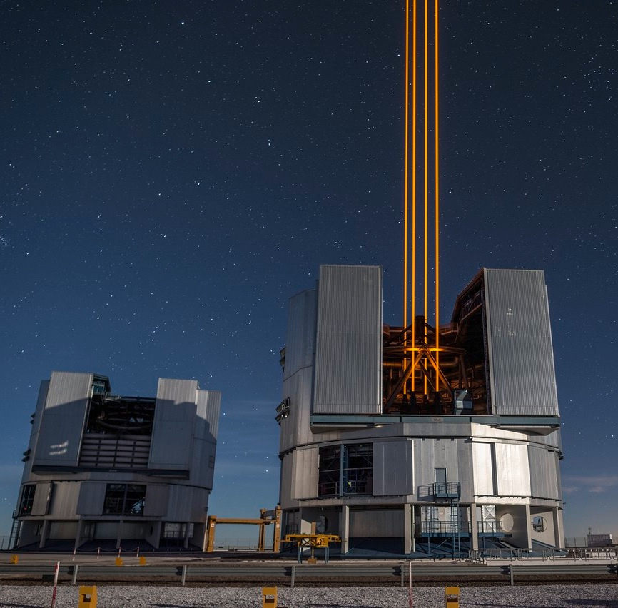
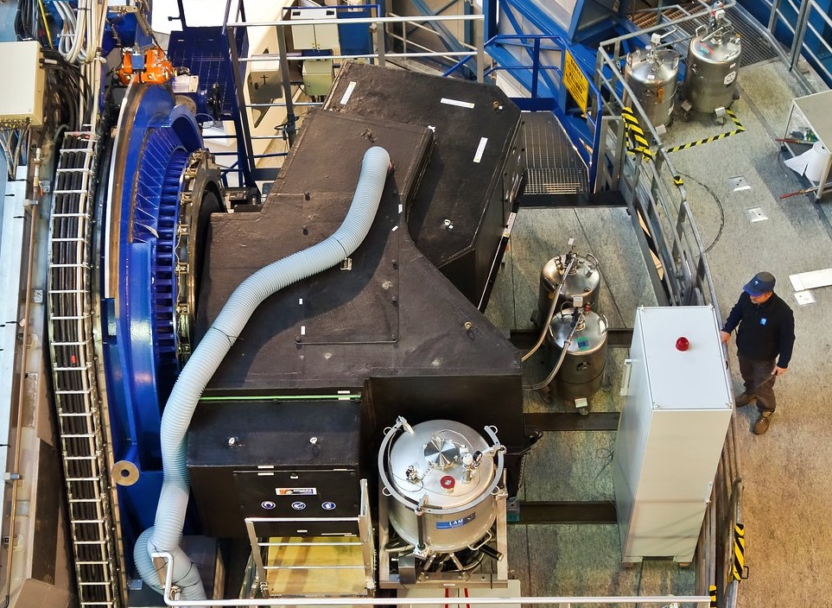
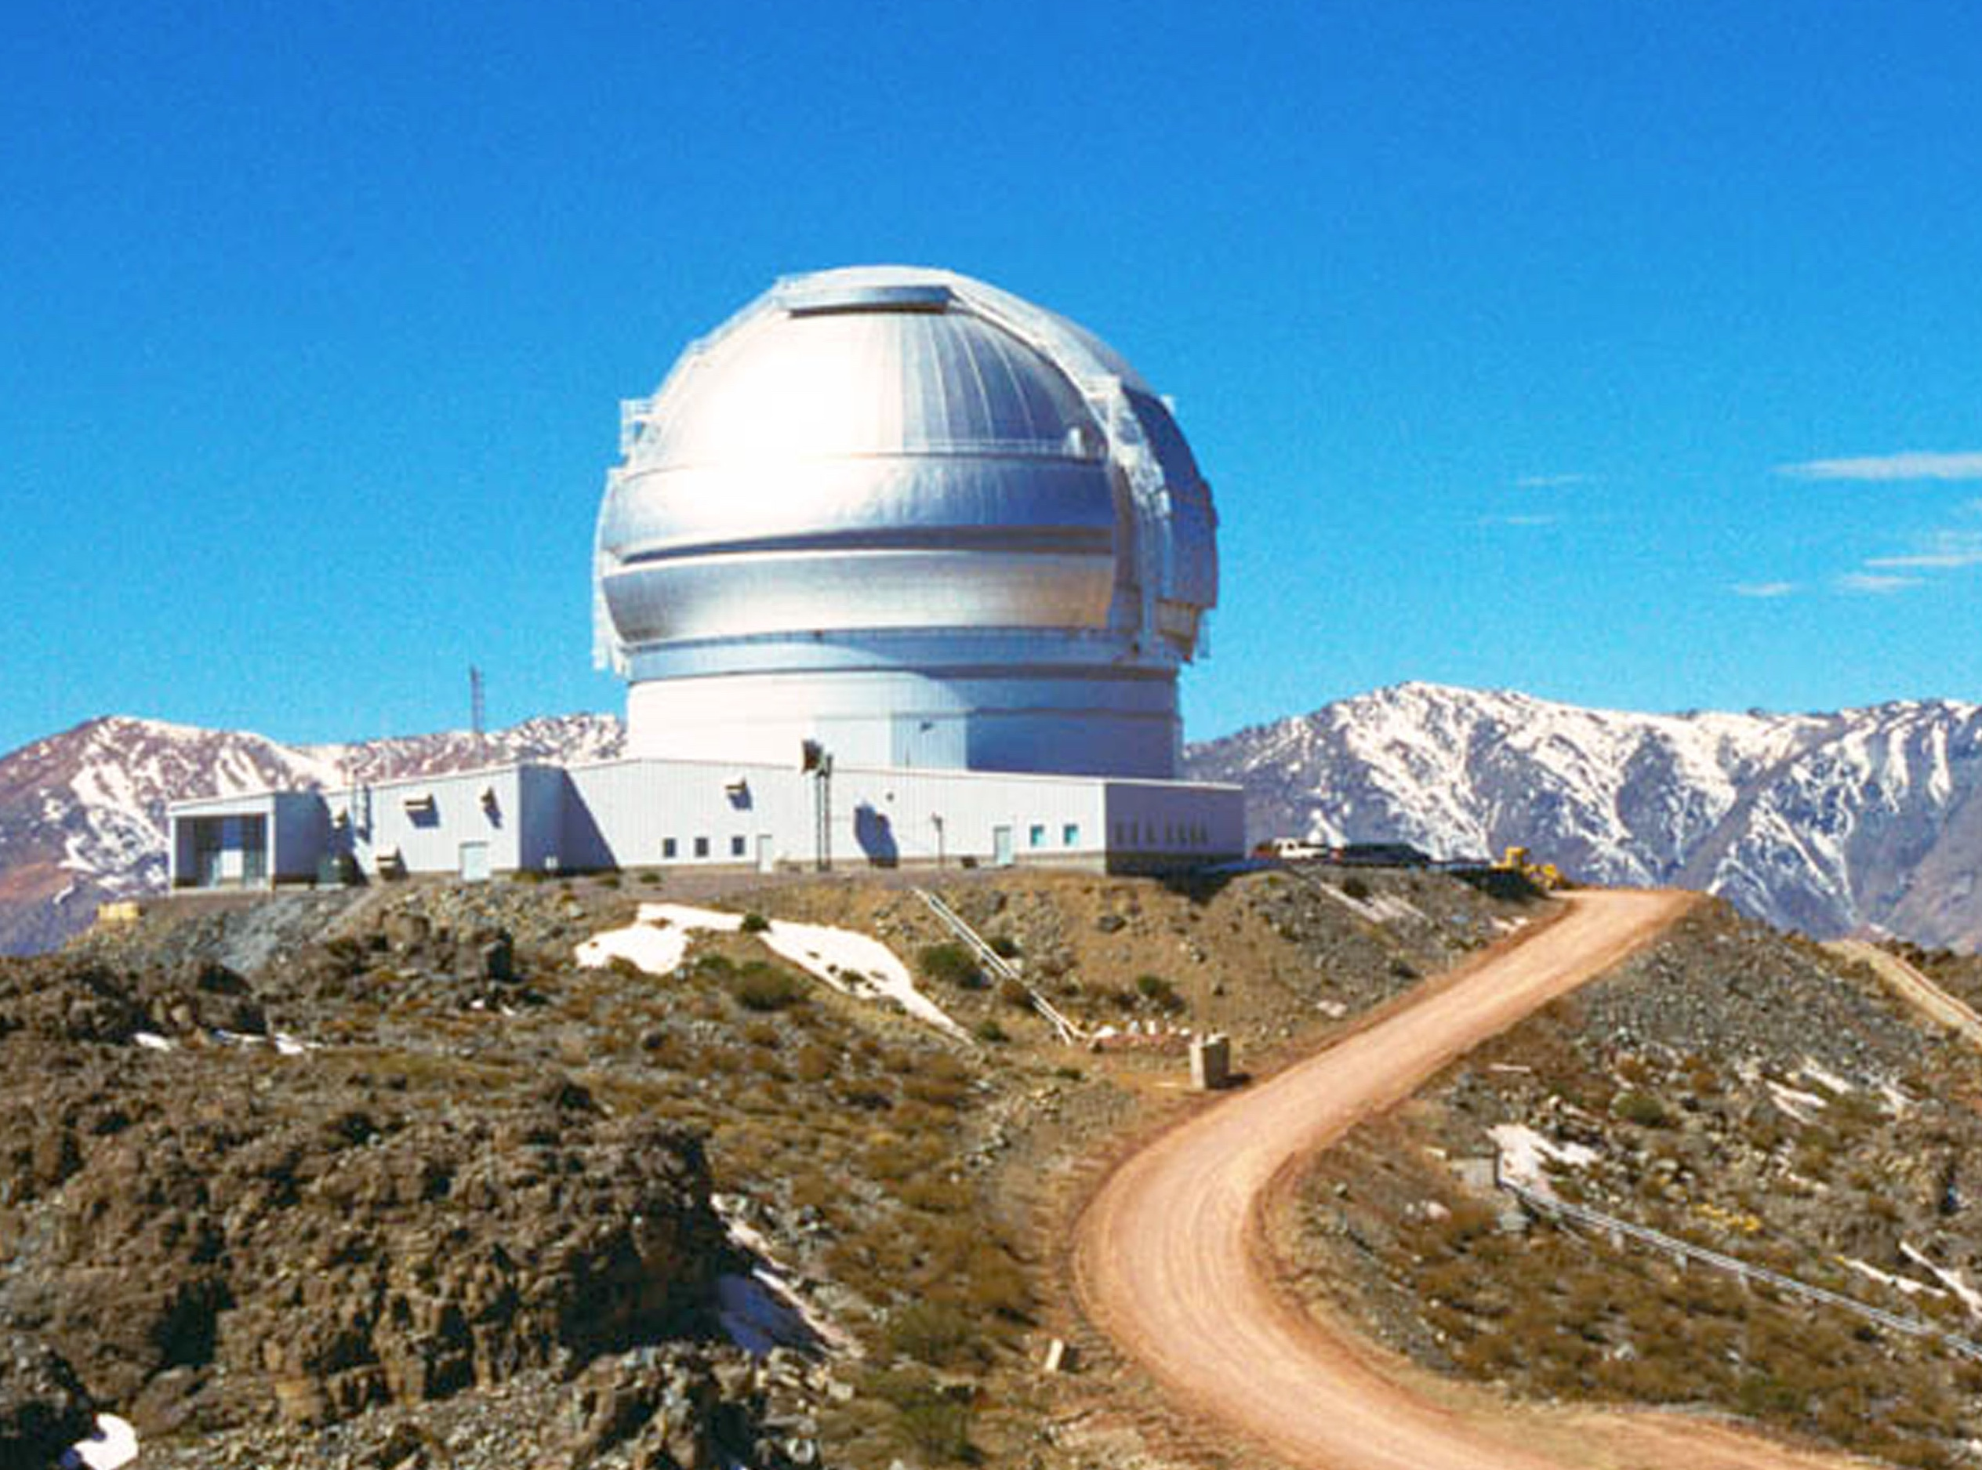
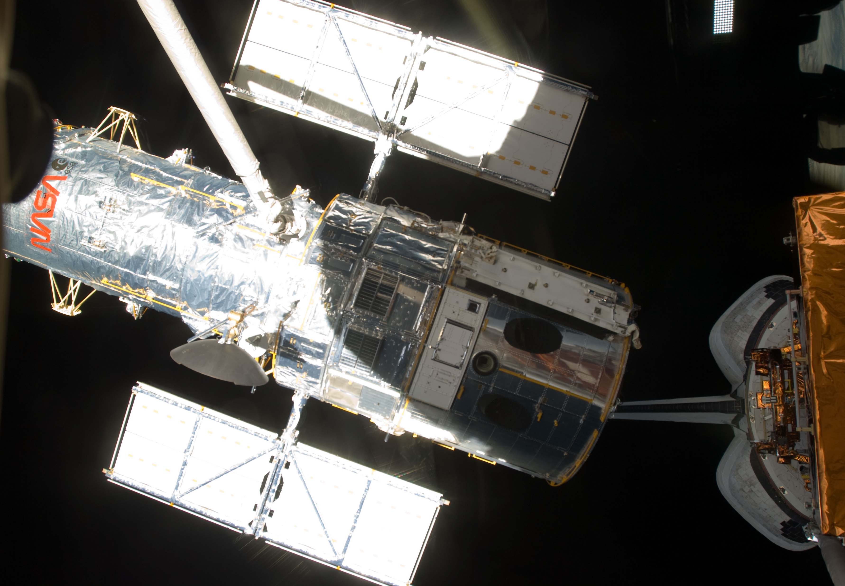
1999 KW₄ (Direct Imaging)
VLT
(SPHERE)
Gemini North
(‘Alopeke)
216 Kleopatra
(speckle interferometry)
HST
(WFC3)
Gemini South
(Zorro)
(DD time requested)

Slide 6
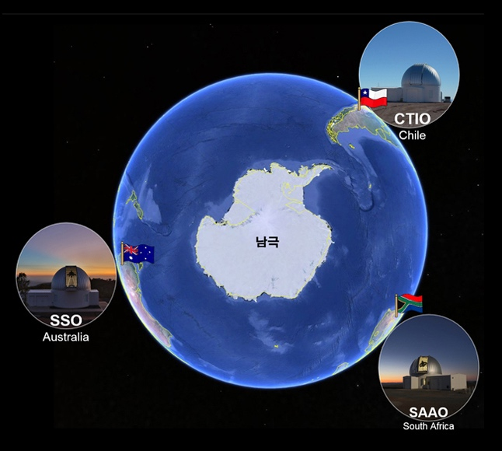
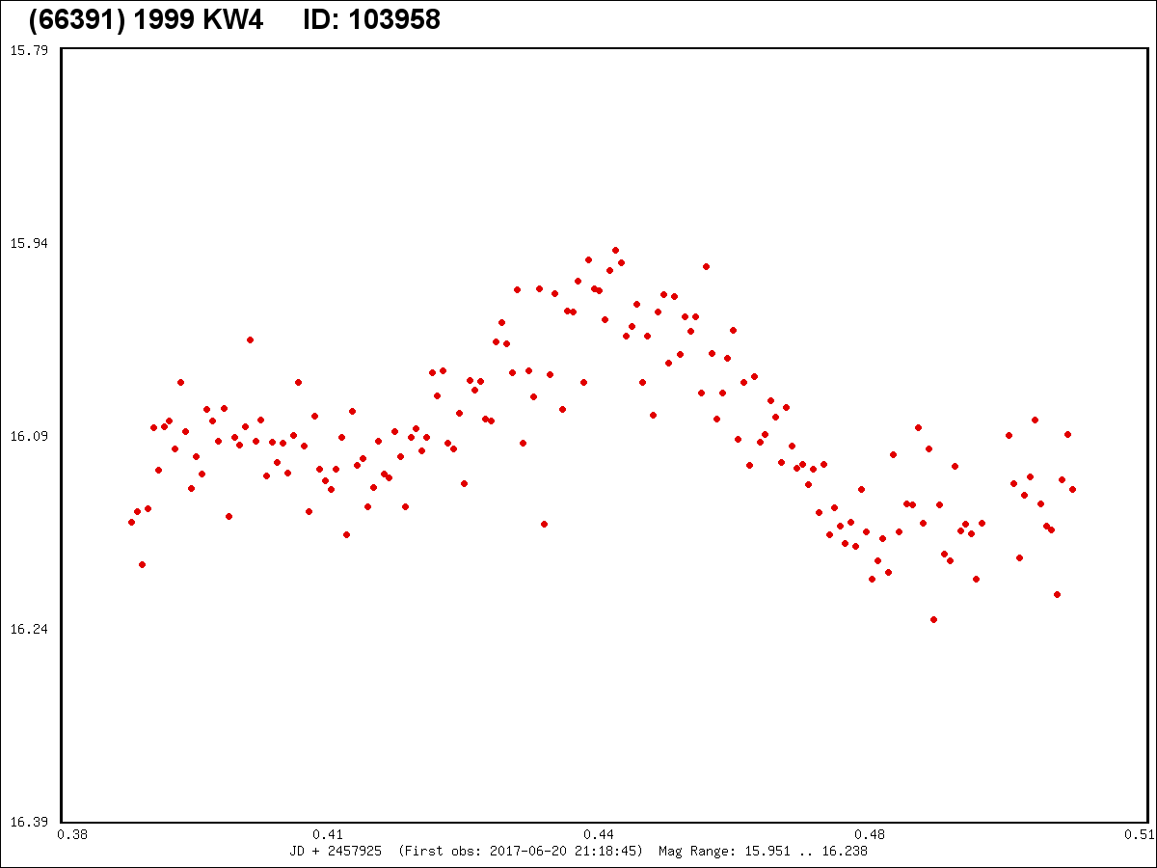
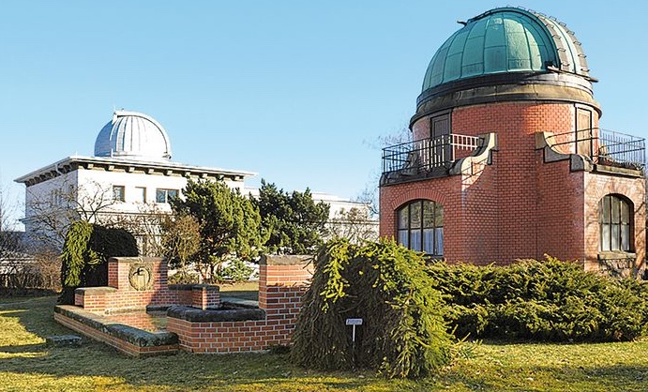
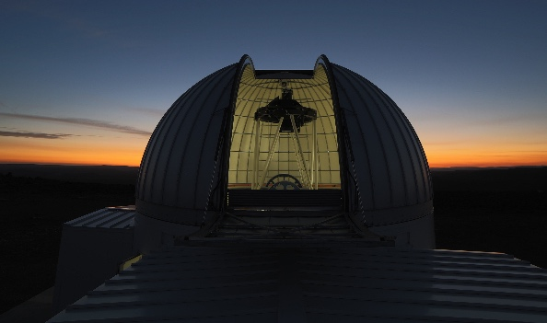
1999 KW₄ (Photometric lightcurves)
KASI
KMTNet
OWL-Net
LOAO
SOAO
LCO
Ondřejov Observatory (Czech Republic)
National Institute of Astrophysics, Optics & Electronics (Mexico)
And others …

Slide 7
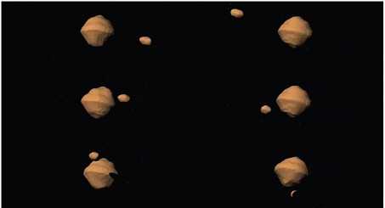
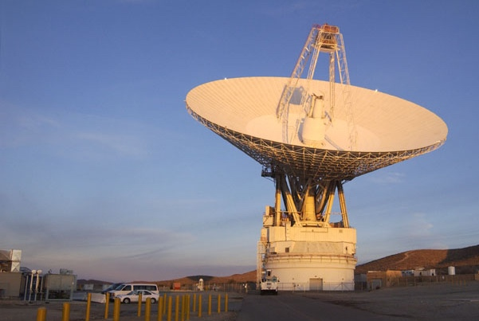
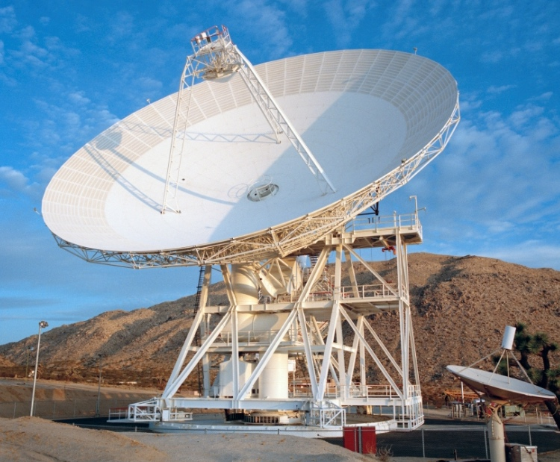
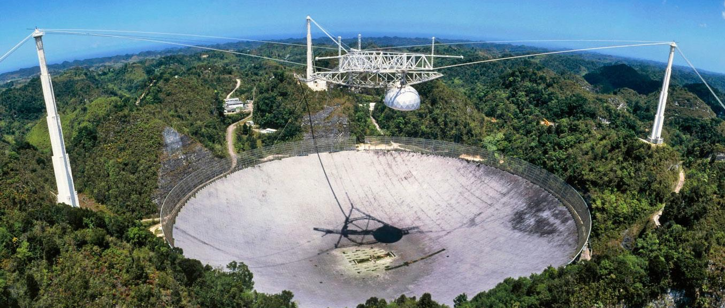
1999 KW₄ (Planetary Radar)
DSS-14 (Goldstone 70-m)
Klystron (install late-May?)
DSS-13 (34-m)
Bi-static with Green Bank
Arecibo
DSS-14
DSS-13

Slide 8
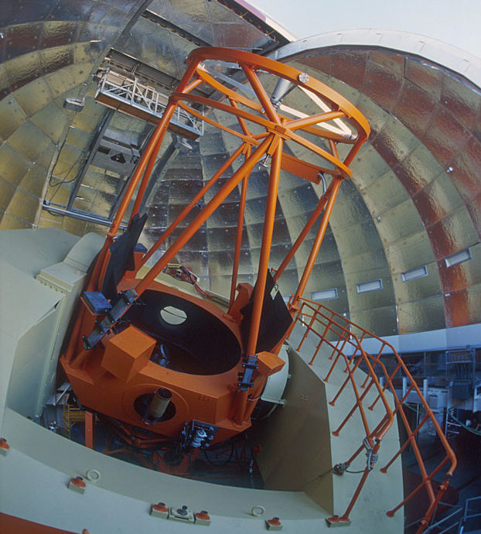
1999 KW₄ (Spectroscopy)
NASA IRTF
Observations will made from the NASA IRTF
May 27th and May 30th HST
Prism mode observations (0.7-2.5 µm) with SpeX
Observations will be made remotely from Arizona
Goal is to reduce the data in near-real time and get composition information to Jessie Dotson

Slide 9
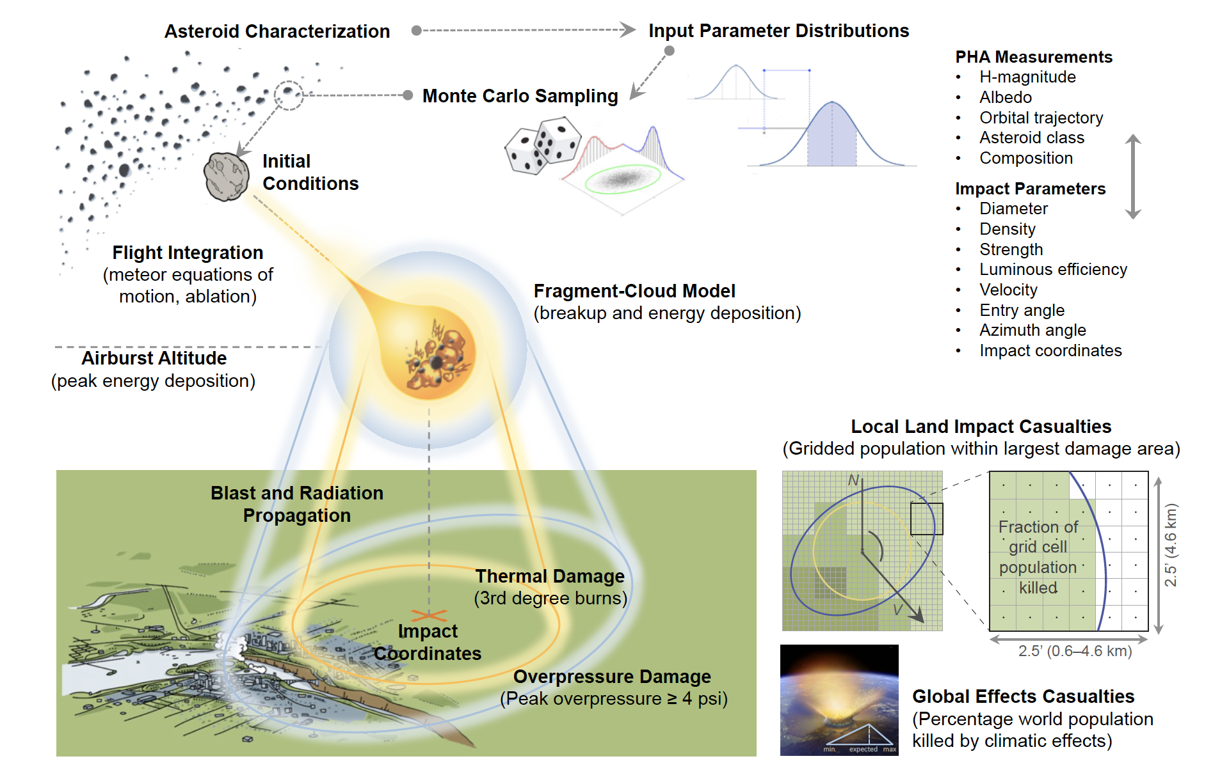
1999 KW₄
Probabilistic Asteroid Impact Risk Model
The PAIR model will be used to perform a risk assessment of a hypothetical impactor based on available characterization of 1999 KW₄ at 3 points during the exercise:
Prior to the exercise, assuming we know H.
Immediately following close approach using the results from rapid analysis.
A month after close approach utilizing the final observation results.
Mathias, Wheeler, & Dotson (2017)
(Exercise, Knowledge Capture, Modeling, Lessons Learned)

Slide 10
