Slide 1
SMPAG/IAWN Work Item 5.6

Slide 2
SMPAG Work Items
5.1. Criteria and thresholds for impact response actions (NASA)
5.2. Mitigation Mission Types and Technologies to be considered (UKSA)
5.3 Mapping of threat scenarios to mission types (ESA)
5.4. Reference missions for different NEO threat scenarios (ASI)
5.5 A plan for action in case of a credible threat (NASA/IAA)
5.6 Communication guidelines in case of a credible threat (NASA)
5.7 Roadmap for future work on planetary defense (DLR)

Slide 3
5.6 COMMUNICATION GUIDELINES IN CASE OF A CREDIBLE THREAT
Lead (NASA with support by IAWN, UNOOSA, ESA, all)
Rationale
For potential asteroid impact hazards it is essential that communications be clear, correct, consistent, and concise. The development of communication guidelines will help provide a template that IAWN and SMPAG can quickly reference. The guidelines are intended for use by members of SMPAG on the nature of, and methods for, communicating to the public and governmental decision makers.
Notifications, Alerts, Alert Levels
Internal to NASA, we’ve had several discussions on alerts and alert levels to include all items (i.e., from close approach events up through a [larger] impact prediction itself) as alerts – starting with Alert Level 1 (close approach).
We have tentatively agreed to consider the first so-called levels to be classified as Notifications. We suggest there be only one type of Notification:
- Close approaches (i.e., within the geosynchronous belt of satellites)

Slide 4
IAWN/SMPAG:
5.6
Communication Guidelines (in the event of a credible threat per IAWN)
If an object 10-meters or greater in size has a 1% or greater probability of impact, IAWN shall warn of the pending impact on the IAWN webpage (http://www.iawn.net ) and JPL sentry page (http://neo.jpl.nasa.gov/risks ). A one page description suffices.
If such an object is on impact trajectory, NASA’s Center For NEO Studies (CNEOS) and ESA’s Near-Earth Object Dynamic Site (NEODyS) shall independently prepare appropriately relevant maps of the Earth impact sites with time of impact.
Content of the page:
Designation
Facts (discovery, size estimate, composition)
Impact location
(example – next pages)
IAWN spokesman informs UNOOSA
UNOOSA informs appropriate entities and member states of the credible threat

Slide 5
Example Notification Sheet: Close Approach (NASA)
Small Asteroid to Pass Close to the Earth on 1-2 Dec 2018
A very small asteroid discovered on 29 November is on a path which will bring it very close to Earth on the evening of 1 Dec. but, there is no chance that the asteroid could impact our planet. ~3 meters (15 feet) in size, the object is predicted to pass within the so-called geosynchronous orbit of communications and weather satellites, about 36,000 kilometers above the equator.
The asteroid, designated by the Minor Planet Center as 2018 WV1, will pass about 8300 km inside the orbit of the geosynchronous satellites about half an hour before it reaches its closest point to Earth, which will occur on 2 Dec at 3:10 UTC, at slightly less than 27,000 km above the Earth’s surface. After that, the asteroid will head back out into a new orbit about the Sun, as this close pass by Earth will greatly change its previous orbital path.
2018 WV1 was discovered by the Catalina Sky Survey, a project based at the University of Arizona in Tucson. This new object is very small, and even though it will approach very close to Earth, it will still not be bright enough to be visible in the small amateur telescopes. At this small size, even if 2018 WV1 had hit Earth, our planet’s atmosphere would likely have broken it up and created only a bright meteor and perhaps a few small meteorites.
(See URL for graphic:
https://cneos.jpl.nasa.gov/news/news202.html)

Slide 6
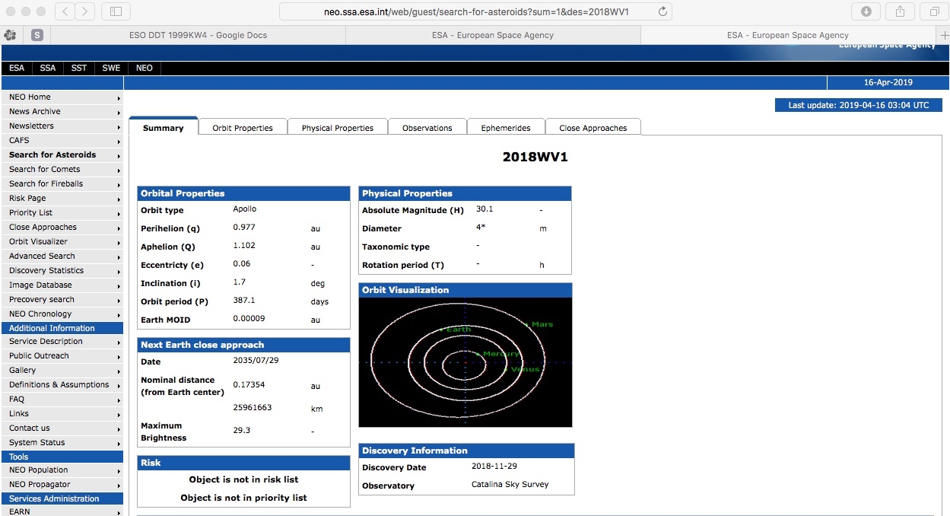
Example Notification Sheet: Close Approach (ESA)

Slide 7
Example Notification Sheet: Close Approach (ESA)

Slide 8
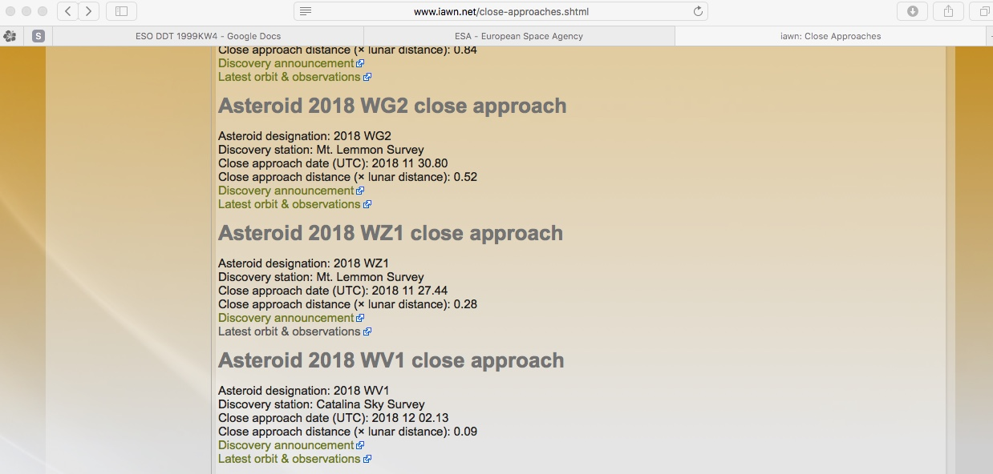
Example Notification: Close Approach (IAWN)

Slide 9
Discussion
Should the IAWN notification be something more than what it currently is (i.e., brief mention – and, in this case seemingly buried)?
Judgment call
Should it be more ‘journalistic?’
Other considerations

Slide 10
Level 1 Alert ( ≥ 1% probability of impact)
Level 1 alert: identification of a 1% or greater probability of impact
Provide: Asteroid name/designation
Asteroid characteristics – size (metric and standard), brightness, etc.
Discovery details (observatory, follow-up, characteristics [if known], next observations)
(current) Predicted orbit
Next observations
Expected date of next impact risk update
Names and contact information for spokespeople or URLs for more information from responsible orgs
IAWN has notified the Space Mission Planning Advisory Group (SMPAG), the international organization responsible for preparing a global response to a possible asteroid impact IAWN and SMPAG are endorsed by the United Nations and coordinate their activities with the United Nations Office of Outer Space Affairs (unoosa.org) in Vienna, Austria.

Slide 11
Example Alert Level 1 Message
A small asteroid, provisionally designated 2017 XYZ) was discovered on 31 Nov 2017 by Pan-STARRS located atop Halekakala (Maui), Hawaii and reported to the Minor Planet Center. Additional follow-up observations by the Catalina Sky Survey, the University of Hawaii 2.2-meter, and the Large Altazimuth Telescope (BTA-6) 6-meter telescopes have confirmed the orbit of 2017 XYZ.
2017 XYZ is observed to be approximately 120 meters in size. Based on current calculations, the asteroid has a 1% probability of impact predicted to occur on 31 Sep 2028 in the Eastern Pacific Ocean near the northern coast of Mexico between 13:05 and 18:30 UTC.
Future observations are planned with the planetary radar systems located in Goldstone and Arecibo on 1 April 2018. Further radar observations will precisely determine the orbit of 2017 XYZ.
The International Asteroid Warning Network (IAWN) has informed the Space Mission Planning Advisory Group (SMPAG), currently chaired by the European Space Agency.
Basic facts RE: discovery, follow-up, etc.
example
Current predicted details
example
Next Observations
example
IAWN & SMPAG (trusted sources of information, etc.)

Slide 12
NEO Alert Process
Survey,
Detect,
& Report
Publish/
Update
Results
Correlate, Determine
Rough Orbit
Observations and
Update Orbit
Radar
Planetary Defense
Officer (NASA)
Possible
New PHO?
Iterate
No
Routine
Processing
Publish
Results
Resolve
Result
Differences
Publish
Results
Yes
Yes
Alerts to PDCO
MPC - PHO of interest
MPC -possible close approach
CNEOS - reports potential for impact
CNEOS -publishes probability of impact
Potential
Impact?
Impact
Still
Possible?
No
No
Yes
Precision Orbit
and Follow Up
Observations
Survey Systems
Minor Planet Center
Ctr NEO Studies @ JPL *
* In parallel with NEODyS

Slide 13
NEO Alert Process
Planetary Defense
Officer (NASA)
IAWN
SMPAG
supported by
ESA (NEODyS)
NASA (CNEOS)
SMPAG members
convene to formulate recommendations
Notional
Notional
Notional
UN
SMPAG member agencies vet, and agree to, recommendations
SMPAG recommendations briefed to member states
UN announcement
(UNCOPUOS, UNOOSA)
Member states inform
UN of recommended
actions to be taken
YES
Member states agree
to support SMPAG
recommendations
Action
NO

Slide 14
Discussion
Should the IAWN have unique stationery/watermark/heading?
Who (what orgs) should be listed as POCs?
How is this convened and decision made to announce a Level 1 alert?
. . .

Slide 15
Level 2 Alert ( > 10% probability of impact)
Level 2 alert: identification of a 10% or greater probability of impact
Provide: Asteroid name/designation
Date of original notification (i.e., on xx/yy/zz date IAWN issued a Level 1 alert …with a 1% probability)
(updated) Asteroid characteristics – size (metric and standard), brightness, etc.
(updated) Details (observatory(ies), follow-up, characteristics [if known], next observations)
(updated) Predicted orbit and impact predictions
Members of the international Space Mission Planning Advisory Group (SMPAG) are proceeding with a plan to develop a mission to deflect (asteroid designation) off its orbital path, should observers determine that impact is certain, the deflection mission will be ready to launch
- OR -

Slide 16
Level 2 Impact Alert (con’t) ( > 10% probability of impact)
Provide (con’t):
- OR -
Based on follow-up observations of the asteroid since then, experts now predict that the asteroid will impact Earth on day/month/year. The international Space Mission Planning Advisory Group (SMPAG) has determined that this impact can be prevented by launching a mission to deflect the asteroid off its orbital path, so that it passes by Earth on day/month/year. The (name the space agency or agencies that will be building and launching the deflection mission) will build a spacecraft (or multiple spacecraft) that will be launched on day/month/year. (Will there be a reconnaissance mission before the deflection mission?) This spacecraft will arrive at the asteroid in month/year and will use the (identify deflection method) method (has the method been demonstrated?) to deflect the asteroid off its impact course with Earth.
Expected date of next impact risk update
Names and contact information for spokespeople or URLs for those responsible … more info
IAWN has notified the Space Mission Planning Advisory Group (SMPAG), the international organization responsible for preparing a global response to a possible asteroid impact IAWN and SMPAG are endorsed by the United Nations and coordinate their activities with the United Nations Office of Outer Space Affairs (unoosa.org) in Vienna, Austria.

Slide 17
Discussion
Additional individuals or orgs listed as POCs?
How is this convened and decision made to announce a Level 2 alert?
. . .

Slide 18
Example Alert Level 2 Message
A small asteroid, provisionally designated 2017 XYZ was discovered on 31 Nov 2017 by Pan-STARRS located atop Halekakala (Maui), Hawaii. The International Asteroid Warning Network (IAWN) initiated the original message on 2017 XYZ on 2 Dec 2017.
New observations of 2017 XYZ is observed to be approximately 120 meters in size. Based on current calculations, the asteroid has a 11% probability (slightly greater than 1-in-10 chance) of impact will be on 31 Sep 2028 in the Eastern Pacific Ocean near the northern coast of Mexico between 12:10 and 13:13 UTC.
Radar observations from both Goldstone and Arecibo seem to show 2017 XYZ as a rocky rubble pile asteroid.
The Space Mission Planning Advisory Group (SMPAG) are proceeding with a plan to develop a mission to deflect asteroid 2017 XYZ off its orbital path, should observers determine that impact is certain. The deflection mission will be ready to launch not later than 1 Dec 2023.
Future observations are planned with both the planetary radar systems located in Goldstone and Arecibo as well as other ground-based optical telescopes on 3 March 2021. Further radar observations will precisely determine the orbit of 2017 XYZ.
The IAWN has informed SMPAG, currently chaired by the European Space Agency.
Basic facts RE: discovery, follow-up, etc.; original IAWN msg
New/updated predicted details
Example
SMPAG notified
Next Observations
IAWN & SMPAG

Slide 19
Level 3 Impact Alert (Preparation for Impact)
IAWN would issue this in coordination with emergency management agencies … more discussion
To be utilized when deflection is not an option and/or the deflection campaign failed, and when a mitigation civil defense plan is in place.
IAWN Provides:
Date, time and location of impact
Asteroid name/designation
Asteroid characteristics – size (metric and standard), type (spectral), structural (solid, rubble pile, other)
Predicted asteroid trajectory/angle of entry
Type of impact – atmospheric impact over water or over land, surface impact on water or on land
Predicted energy release
Geographic range and gradation of effects
Impact mitigation measures in place (evacuation, shutdowns, etc.)
Civil Defense measure (i.e., tell people what they can/should do)
Authoritative source(s) for more information (who’s in charge of what)

Slide 20
Example Alert Level 3 Impact Message
A small asteroid, provisionally designated 2017 XYZ) was discovered on 31 Nov 2017 by Pan-STARRS located atop Halekakala (Maui), Hawaii. The International Asteroid Warning Network (IAWN) initiated the original message on 2017 XYZ on 2 Dec 2017.
Two kinetic impactor missions were launched in February 2020 in an effort to alter the trajectory of 2017 XYZ. The JAXA mission Tenjin impacted the asteroid on 3 March 2024, splitting into two fragments. One fragment was ~30 meters and the remaining 90-meter fragment was subsequently struck by the NASA DART-2 mission. This later impact created multiple 10-20 meter sized fragments that are now inbound in the northern Pacific Ocean, ~200 kilometers south of the Aleutian Island archipelago.
Based on current calculations, the first of the 2017 XYZ fragments will impact the Earth’s atmosphere beginning at 12:21 UTC at 48°North latitude, 170° West longitude extending almost due eastward to 166° West longitude. The impacts should pose no hazard to cities and will appear as a series of Chelyabinsk-like bolides across the sky, impacting harmlessly into the northern Pacific Ocean.
IAWN and SMPAG are endorsed by the United Nations and coordinate their activities with the United Nations Office of Outer Space Affairs (unoosa.org) in Vienna, Austria. The IAWN has also informed UNOOSA.
Basic facts
example
New/updated predicted details
example
Discussion of expected effects (fireball, flash, damage to infrastructure) _
example
IAWN & SMPAG

Slide 21
Discussion
Additional individuals or orgs listed as POCs?
How is this convened and decision made to announce a Level 3 alert?
In this scenario example, deliberately made it harmless. Should we consider drafting more serious/significant scenarios?

