Slide 1
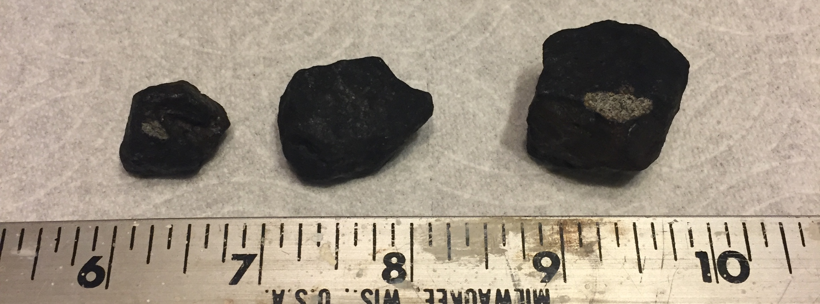
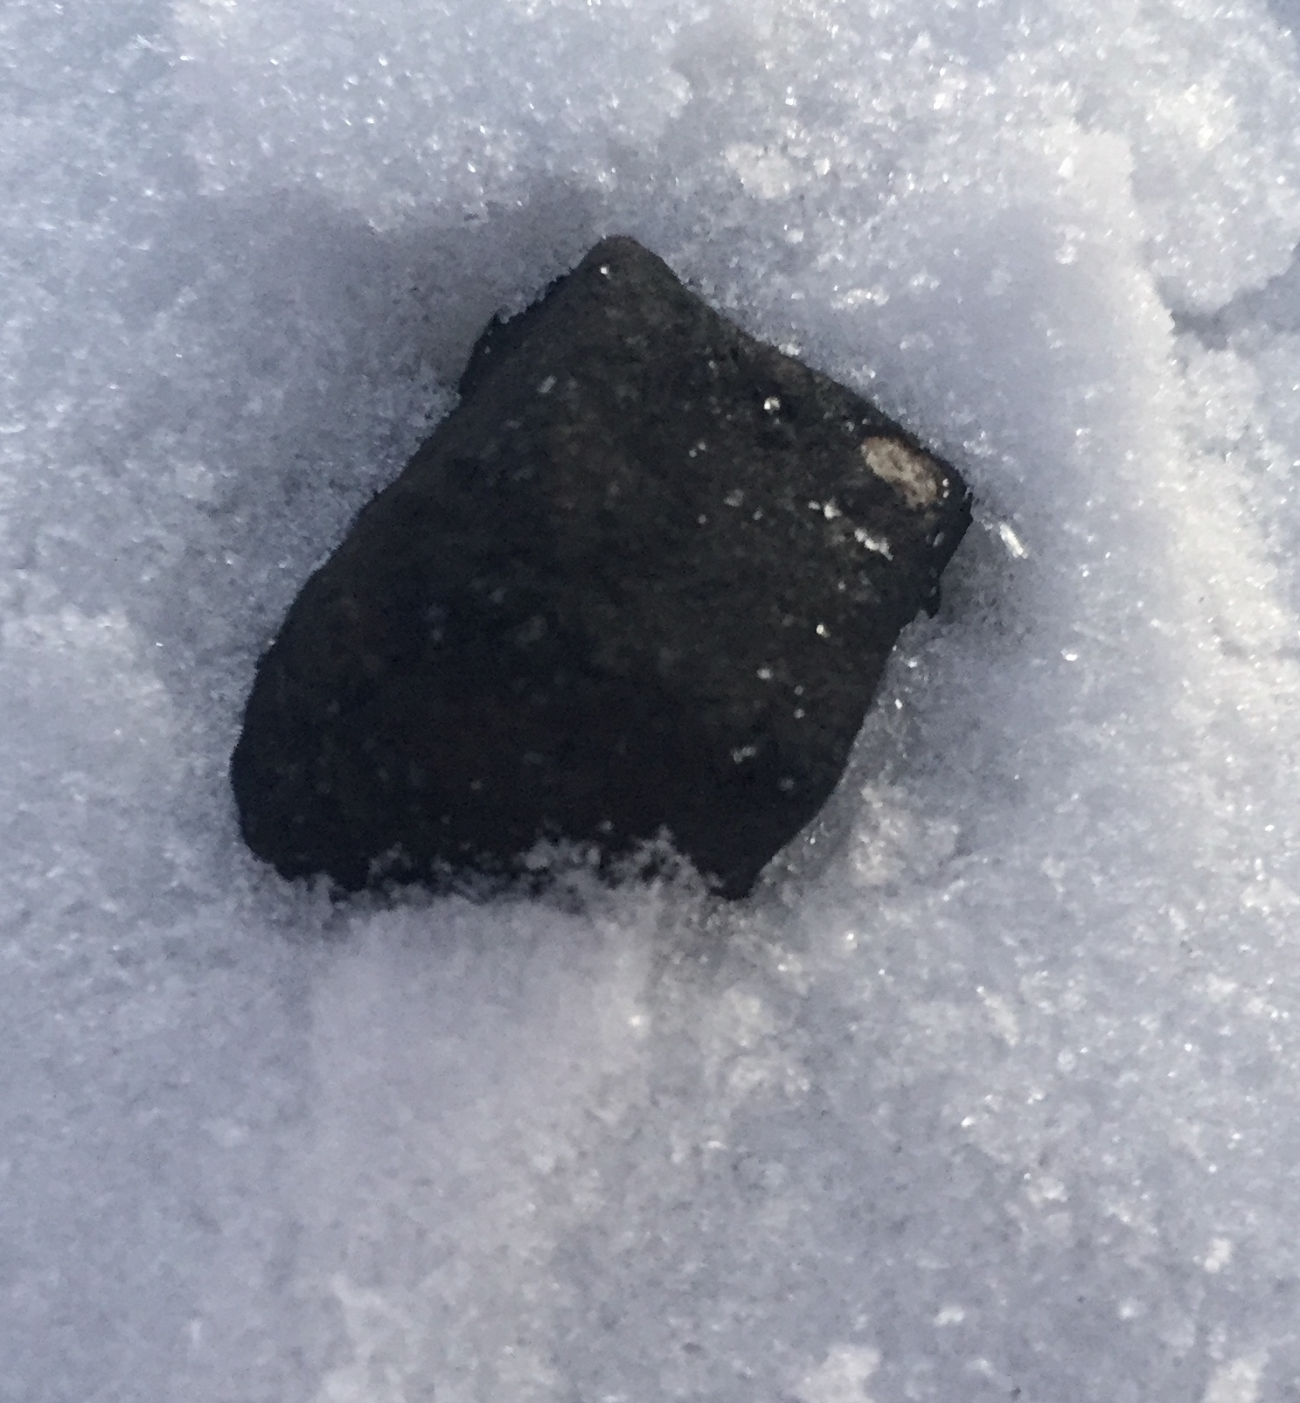
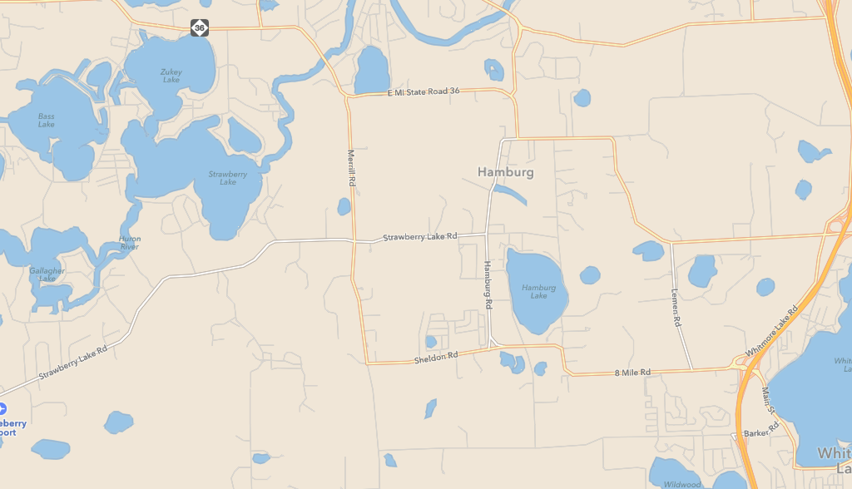
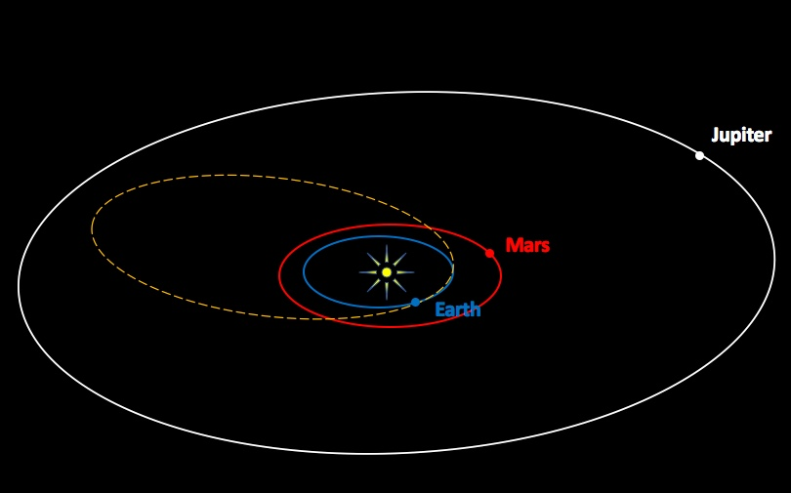
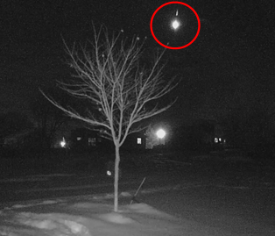
Michigan Bolide and Meteorites
The incoming trajectory was 21 degrees from zenith.
21º
On 16 January 2018 at 08:08:28 PM EST, the skies over southern Michigan were set ablaze when a meteoroid approximately 2 meters in size ripped through the atmosphere.
Todd Slisher, the director of Longway Planetarium, led teams that ulti-mately recovered 8 meteorites. One of which was pre-served in a freezer and arrived last week at JSC’s ARES lab for further study.
North
to
East Lansing
Strewn field (as indicated by NEXTRAD
S-band Doppler and air traffic control radar from the Detroit Metro Airport). Many meteorites were recovered on Hamburg & Strawberry Lakes.
Based on the local final trajectory to the Earth, an approxi-mate orbit indicates the meteoroid’s final orbit crossed the paths of Earth and Mars
Bolide as
seen from a
home security camera from Zeeland, 120 miles west of the fall.
U.S. 23
Whitmore
Lake
8 Mile Rd

