Slide 1
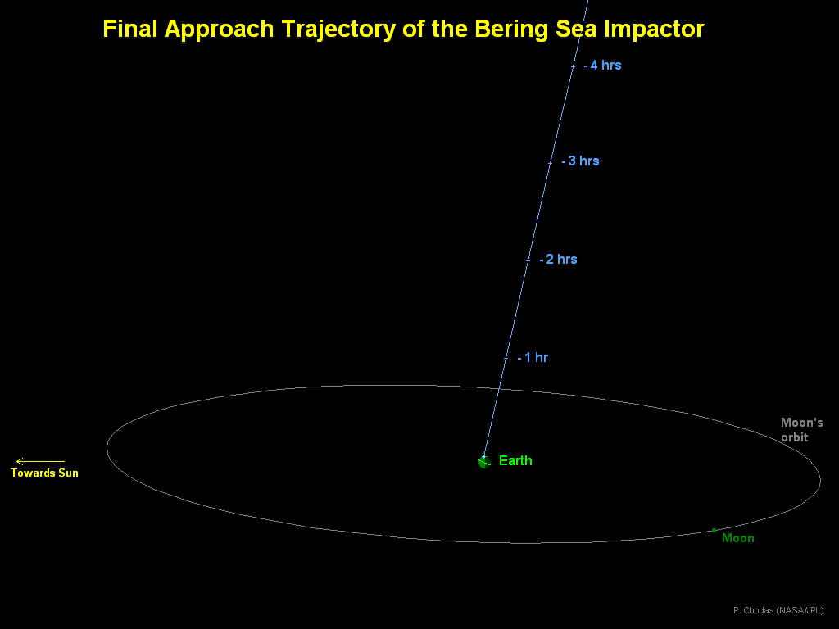
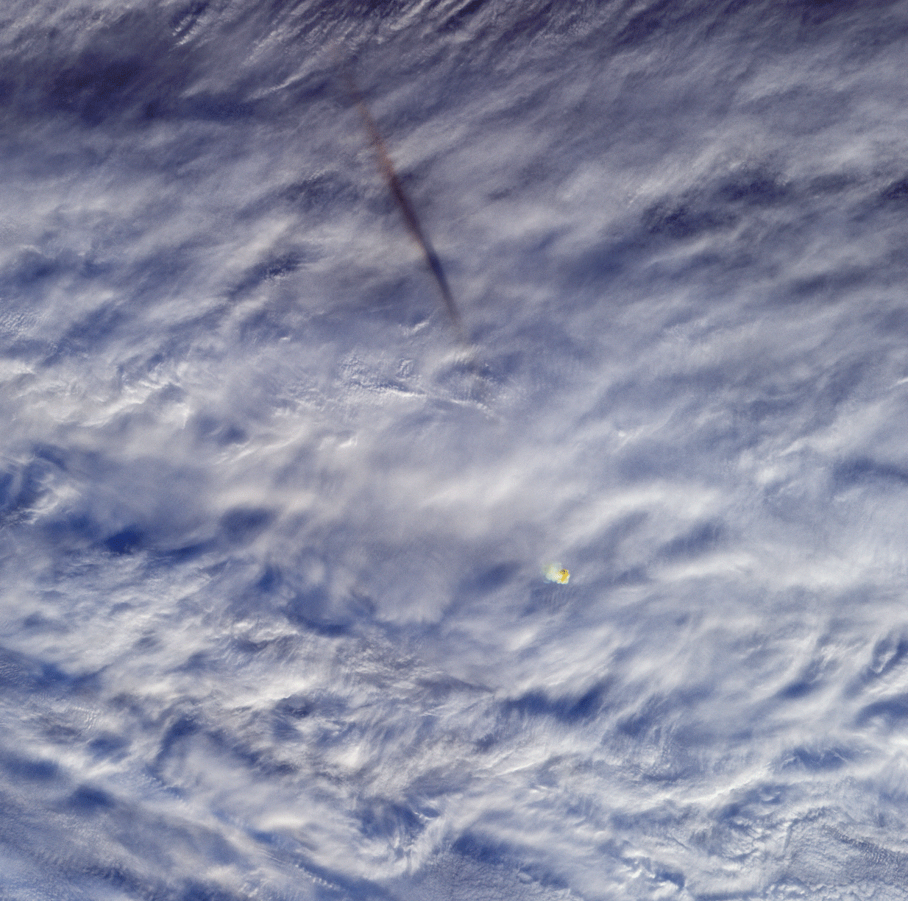
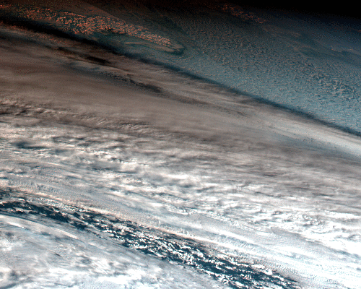
Bering Sea Impact, 18 Dec 2018
173 kton event
Terra Multi-angle Imaging SpectroRadiometer (MISR) instrument
Japanese Himawari 8 GEO WX Sat

Slide 2
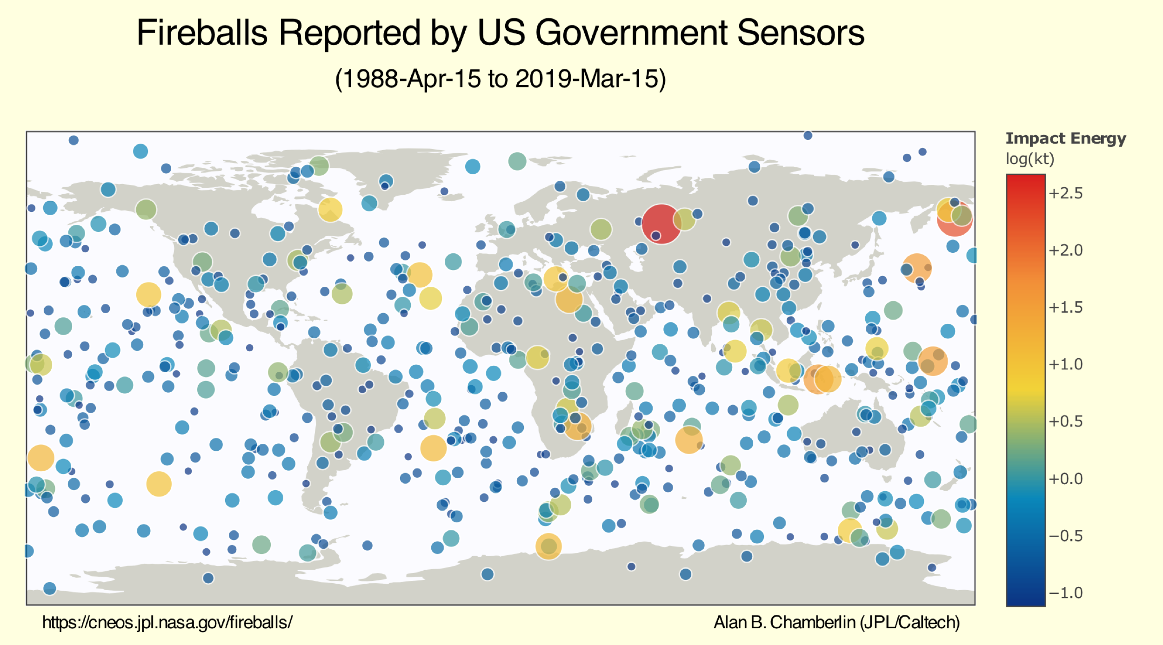
Chelyabinsk
Bering Sea

