Slide 1



IAWN MPC Update:
Processing Improvements and
Database Beta Distribution
J. (G.) Bauer, M. Holman, M. Payne, P. Veres, P. Lawton, A. Mamoutkine, T. Spahr, E. Warner, and the SBN/MPC team
Sept. 23, 2020
IAWN

Slide 2
The Minor Planet Center
The MPC is the world’s nerve center (IAU designated) for asteroid & comet observations.
The MPC collects, processes, distributes all positional measurements, orbits, and discovery information for all minor planets and comets (and some natural satellites too).
The MPC alerts the PDCO and elements of the International Asteroid Warning Network of any potential for impact by newly discovered NEOs.
The MPC helps coordinate worldwide observers.
MPC has become a functional sub-node of the Small Bodies Node of the NASA Planetary Data System, which intermediates between the MPC and NASA’s PDCO, the MPC’s primary source of funding

Slide 3
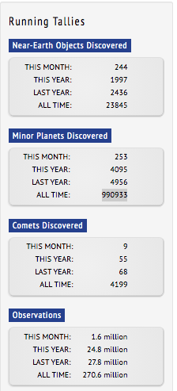
MPC Update
Present Operations
  Staffing and COVID 19
  NEOCP highlights
  New Processing elements/products
Processing Pipeline Improvements
  In development
  Recent milestones
Community

Slide 4
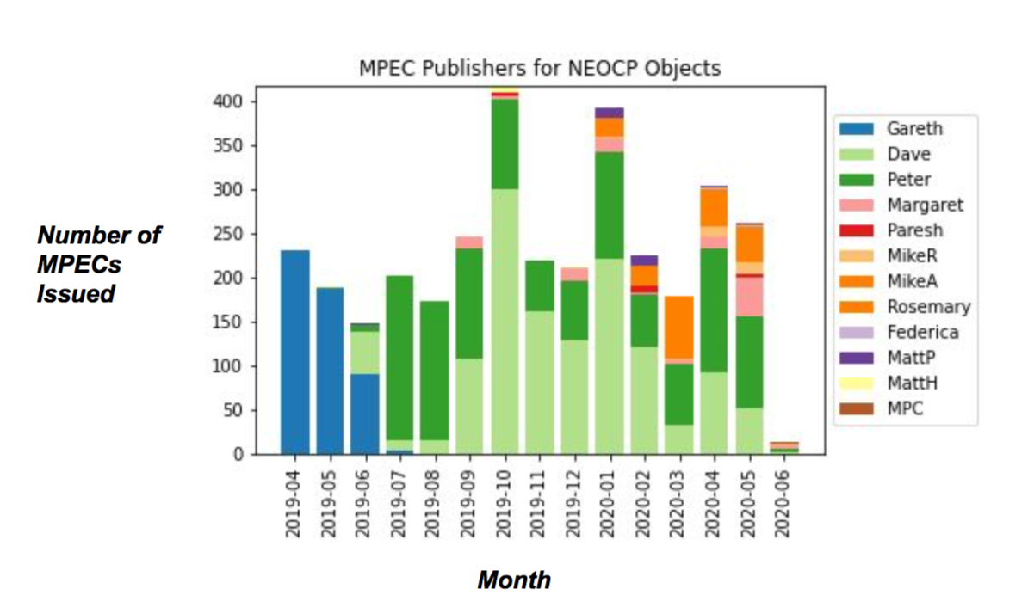
Present MPC Operations
Full complement of new hires.
COVID19 impact strongly mitigated:
  Staff works remotely, continuing regular operations.
  Cross-training complete for NEOCP/PCCP operations.
Operations continued through G William’s retirement (in mid Feb.), but GW still affiliated with host institution.

Slide 5
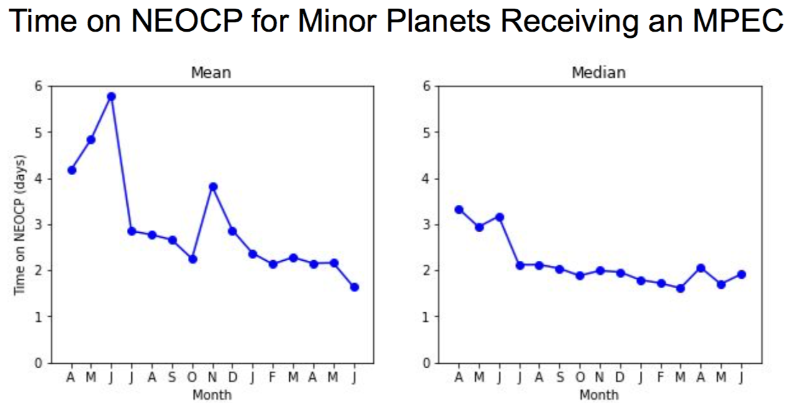
Present MPC Operations II
2019
2020
2019
2020
Time to MPECs reducing owing to cross-training and partway-transition to more automated pipeline processing.

Slide 6
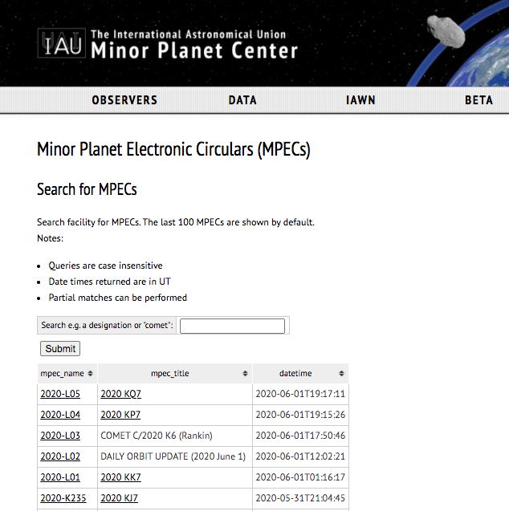
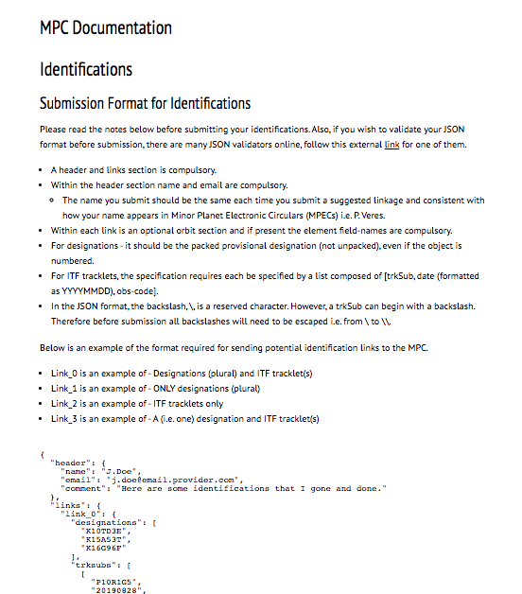
MPC Beta Page

Slide 7
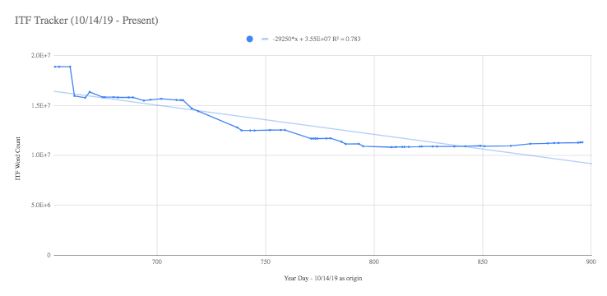
MPC Beta Page

Slide 8
In addition to many new MPC products previously mentioned:
Cometary Activity Observations
  Regularize Cometary reporting
  Further automation of PCCP processing
MPC Pointings Database Submissions & Queries
  Decreases duplication of phase space coverage in NEO follow-up
Observation Disposition Search Page
  https://www.minorplanetcenter.net/beta/wamo.html
  Identification and reference for published data
  Other disposition possibilities, e.g. ITF
  Simply “we have it” or “we don’t” for unprocessed data
Other products include New Observatory code request form, information on previous NEOCP objects.

Slide 9
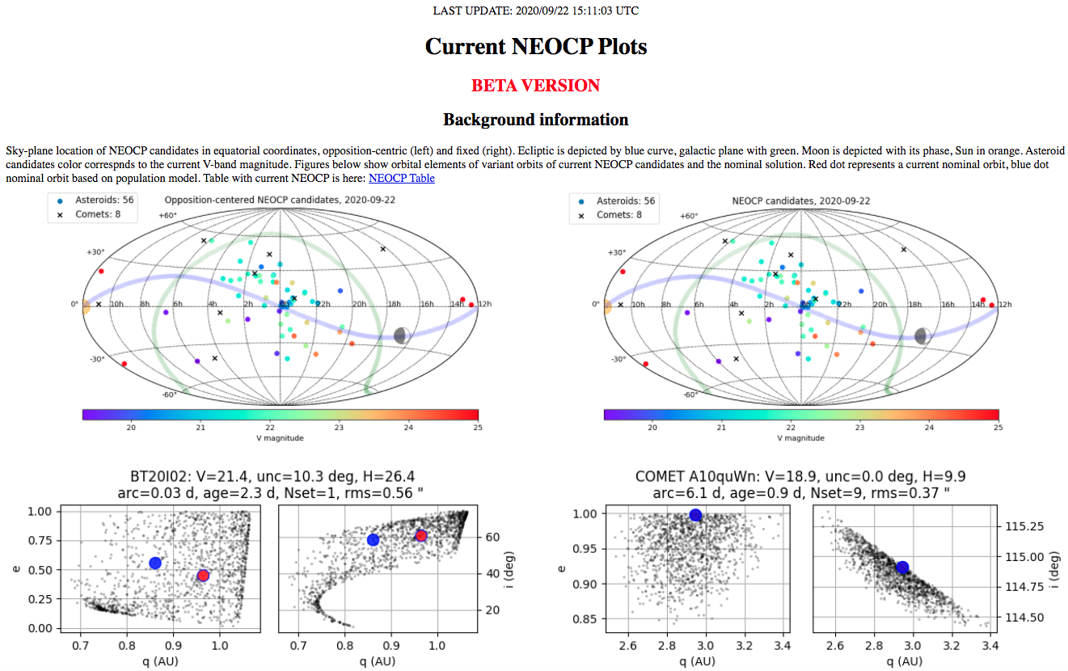
https://minorplanetcenter.net/mpcops/neocp/neocp_plots/
https://www.cfa.harvard.edu/~pveres/neocp.html
https://www.cfa.harvard.edu/~pveres/skyplane.html

Slide 10
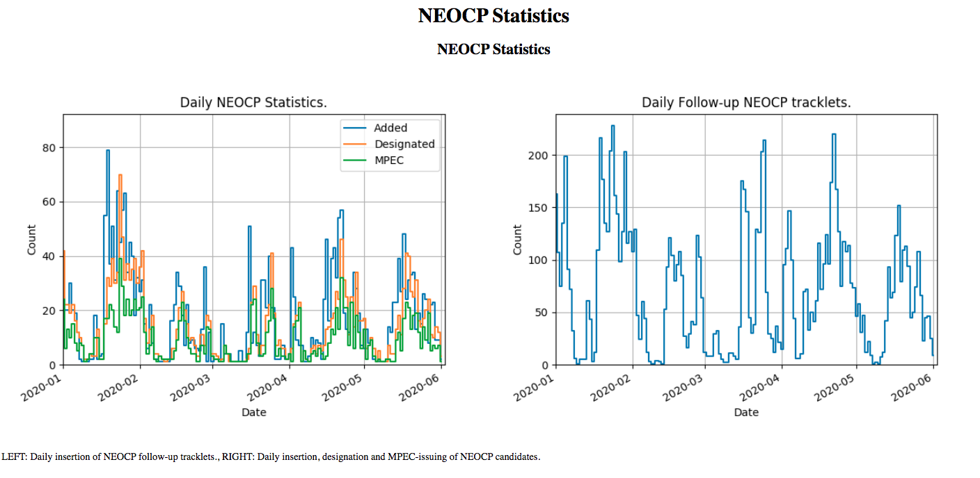
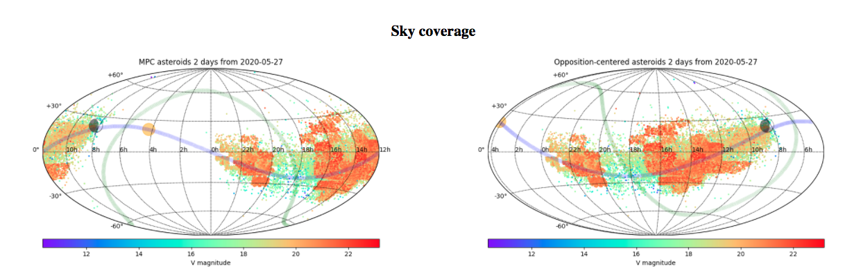
https://www.cfa.harvard.edu/~pveres/stats.html

Slide 11
Preparing for MPC Database Distribution:
Working towards live Postgres DB as primary means of distributing products to active NEO observers.
Several new SBN products derived from the database.
Recent hardware upgrades at the SBN
  Dedicated MPC DB server
  Failover server at the PSI subnode being prepared
Preparing for wider Postgres db public distribution
  Beta release copy available by request.

Slide 12
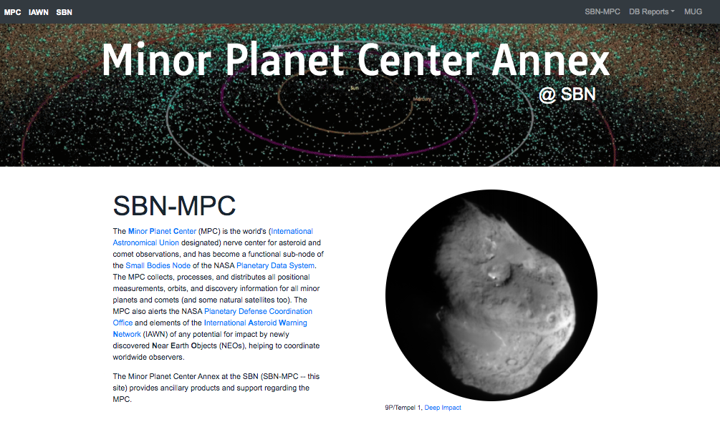
New Products on SBN-MPC webpages
https://sbnmpc.astro.umd.edu/

Slide 13
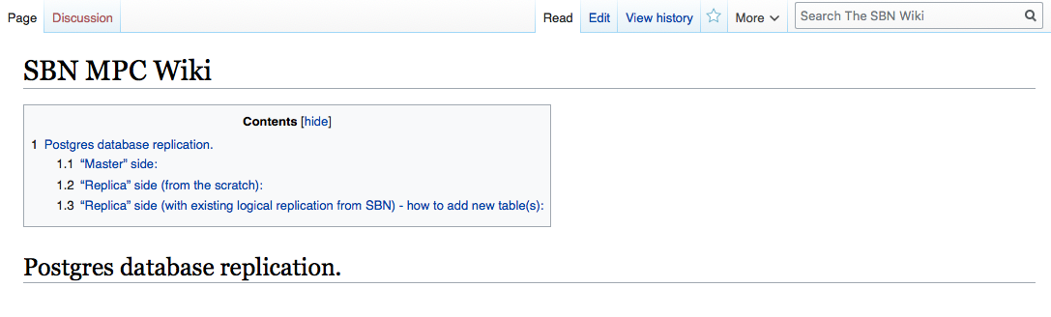
Wiki for MPC Postgres live copy, β distribution instructions
https://sbnwiki.astro.umd.edu/wiki/SBN_MPC_Wiki
Release of the MPC Database (“read-only”) live copy – Note that the public database schema is a beta release, and may be subject to change over the development period. Tables may be added, removed, or modified by the MPC.
Maria DB will be phased out.
Clear instructions on how to replicate the Postgres DB live copy.
Completing testing of distribution instruction set now…
Target to release select tables by end of the month.

Slide 14
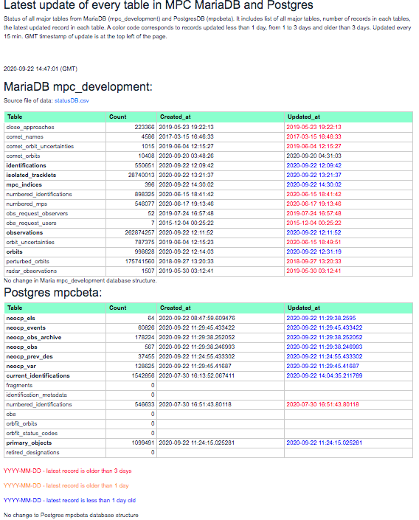
Database Status Tables

Slide 15
Database Status Tables
NEOCP and ID Tables

Slide 16
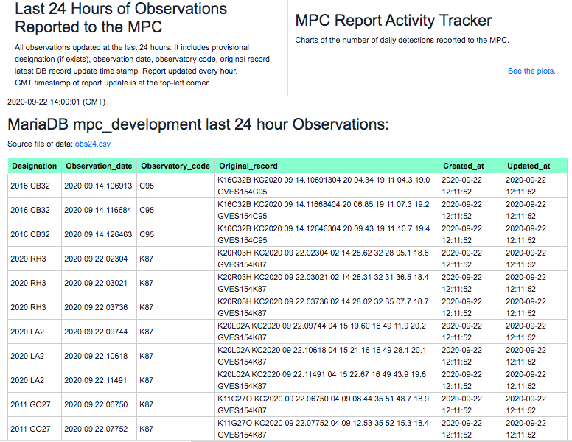
Table of All Observations Reported to the MPC within the last 24 hours
Tables are sortable, and available as csv files.

Slide 17
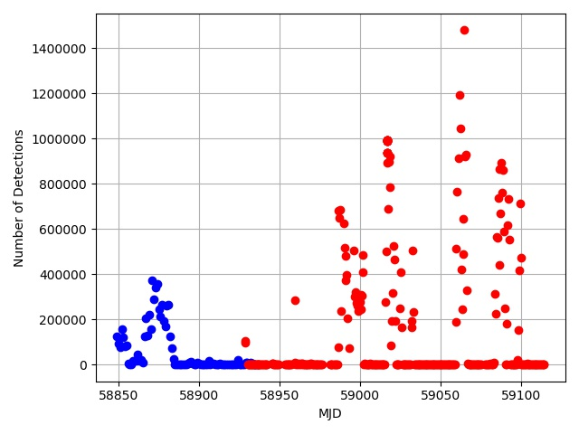
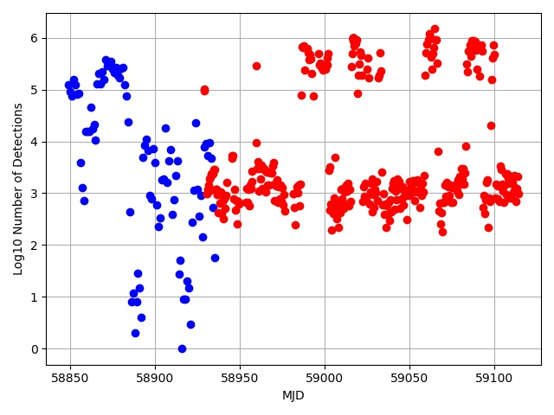
MPC-Reported Activity Tracker (MPC-RAT)
Jan. 1, 2020
Jan. 1, 2020

Slide 18
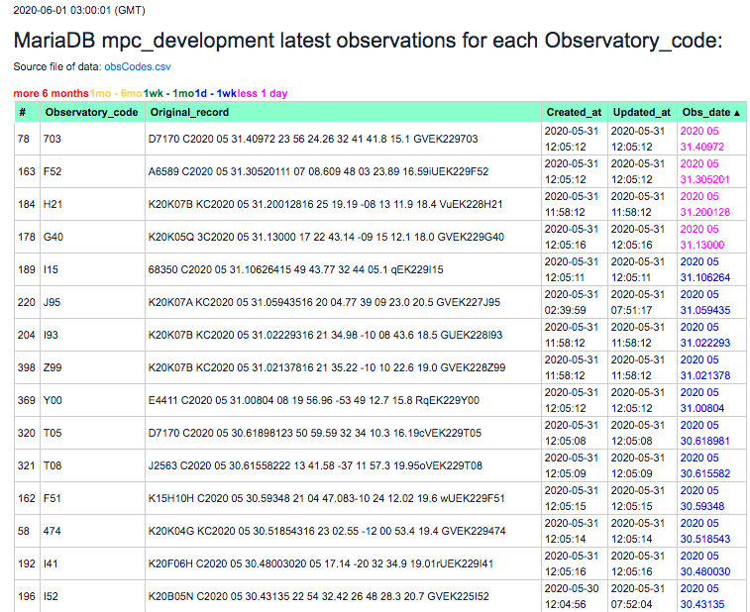
Latest Observations by Observatory Code
For observatories that have reported observations in the last 6 months.

Slide 19
Database-Centric Processing Pipeline:
“SE-lite” Development Approach
Short and Long-term Schedule with Milestones
Full inventories of products in current and future pipeline
End-to-end design of processing flows
Weekly meetings with SBN & SEs for tracking pipeline development
Database processing pipeline reviews

Slide 20
Mapping The MPC Eco-system
Draft
Management
Users
PDCO
CNEOS
Planetary Science Researchers
AAS
NEO ESA
Observer**
PDS SBN UMD
Finding,
Followup,
and/or
Precoveries
IAU
H-S
CfA
astroDB
AAS DPS
auspices
SpaceDys
astropy
com-
munity
IAA
media
observations
observations, orbits, designations
*observ
-atories
IAWN
MPC
public
orbits & designations
IPAC
MIAPP
*spacecraft
CBAT
SBN archive
SMPAG
MAST
ADS
Tamkin
Found
-ation
Advisory
SBAG
survey
repro-
cessing
(ex, NEAT)
?????
MPC UG
Not Comprehensive
Updating inventory of Inputs and Dependencies at the MPC, to determine which products to retire, and what to pull through into new DB centric Pipeline.

Slide 21
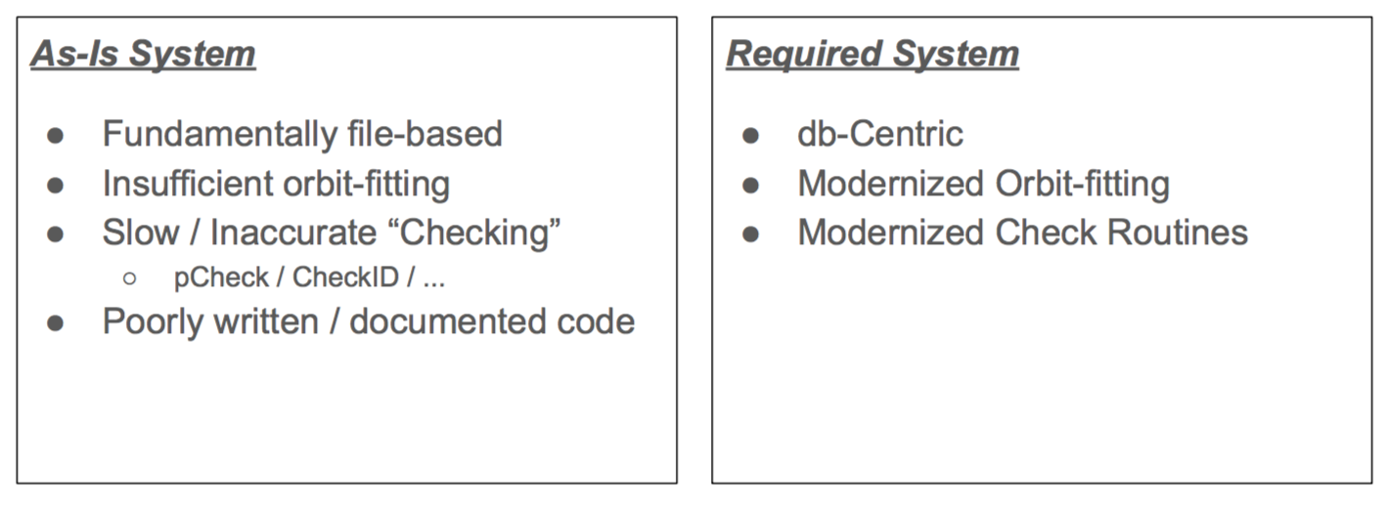
Database-Centric Processing Pipeline:
General Improvements
Accommodate the 10-100X increase in observations from NEOSM and VRO

Slide 22
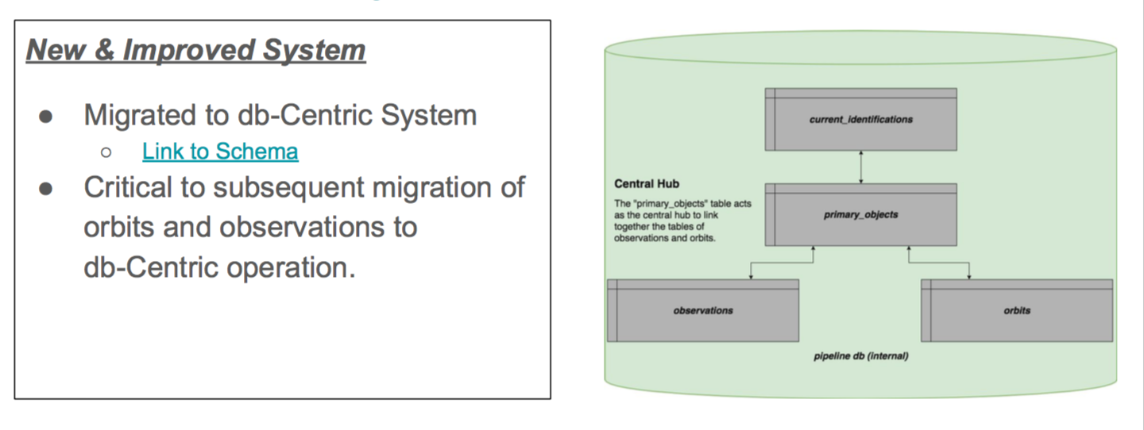
Database-Centric Processing Pipeline:
Centralized Identifications & Designations
Centrally organized single reference system and ID tables.

Slide 23
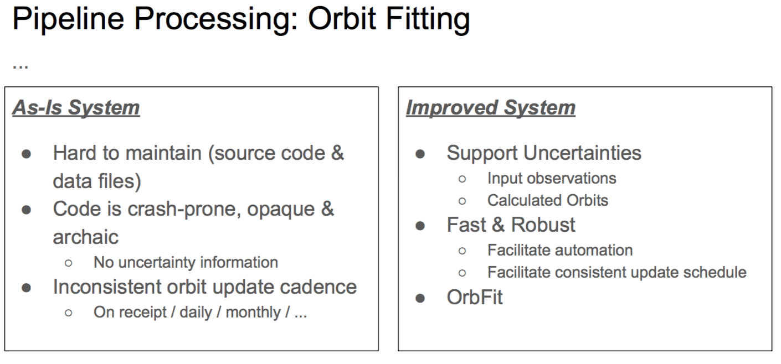
Database-Centric Processing Pipeline:
Orbit fitting improvements
Fully utilizes ADES format information.

Slide 24
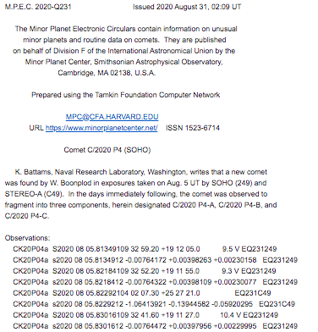
Some Recent Milestones
Postgres ID & NEOCP tables
  Used in processing
    Cross-ID related monthly products
    NEOCP/PCCP
Postgres Database
  Distribution
    Soft Beta – by request
    Wiki for setup
    Support pages
Resumption of Sungrazing Comet processing:

Slide 25
MPC Community
MPC/SBN participated in the virtual Small Bodies Assessment Group meeting in June.
The 7th MPC User’s Group (MUG) meeting took place on June 11th and 12th.
  Virtual Format
  Next meeting tentatively scheduled for December, likely virtual.
Database Schema Design review in mid-October.

Slide 26
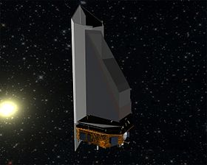

MPC Community
New Memorandums of Understanding (MOUs) in development:
  NEOSM
  RO/LSST

