Slide 1


Mission Accessible Near-Earth Object Survey
“Walk-on” Update
Teddy Kareta, on behalf of the MANOS team
Lowell Observatory

Slide 2
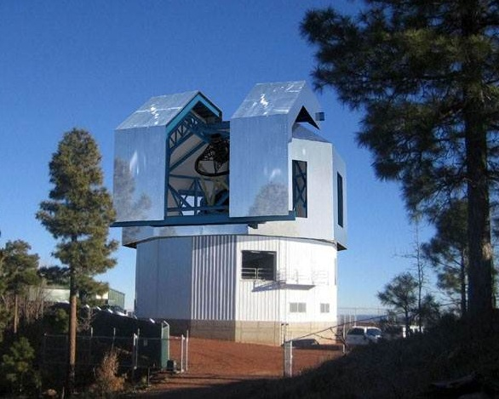
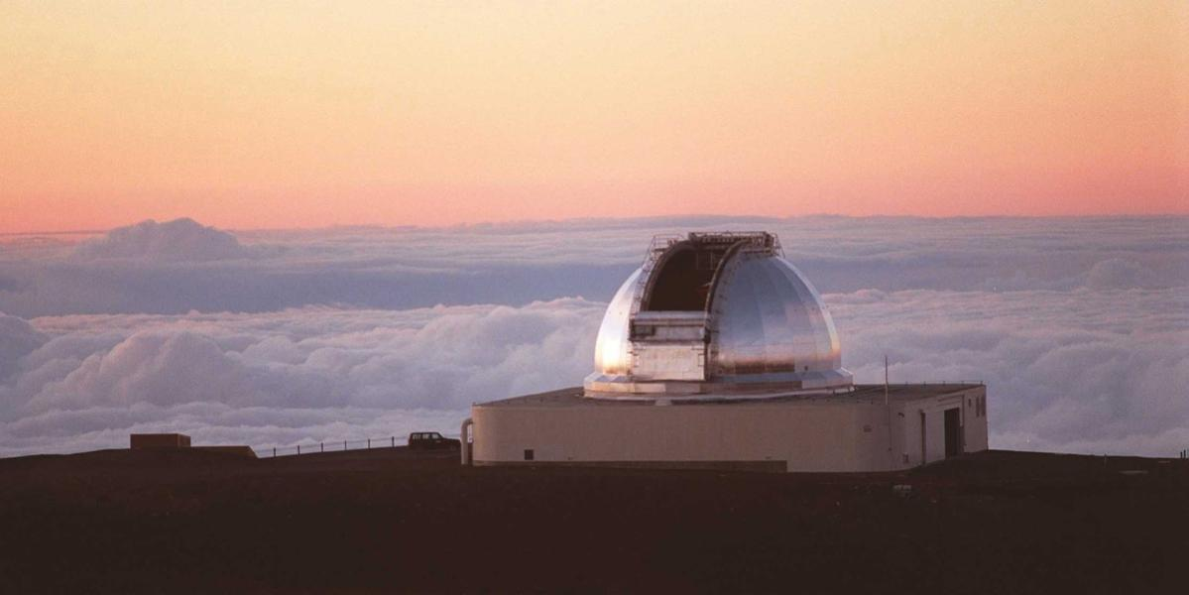
Two Recent Updates
MANOS is a physical characterization survey based at Lowell, primarily interested in the the properties of “mission accessible” (low delta-V) objects and in furthering their study.
Two Brief Updates:
Astrometric capabilities of the Lowell Discovery Telescope
Recent LDT+IRTF observations of 2024 PT5

Slide 3
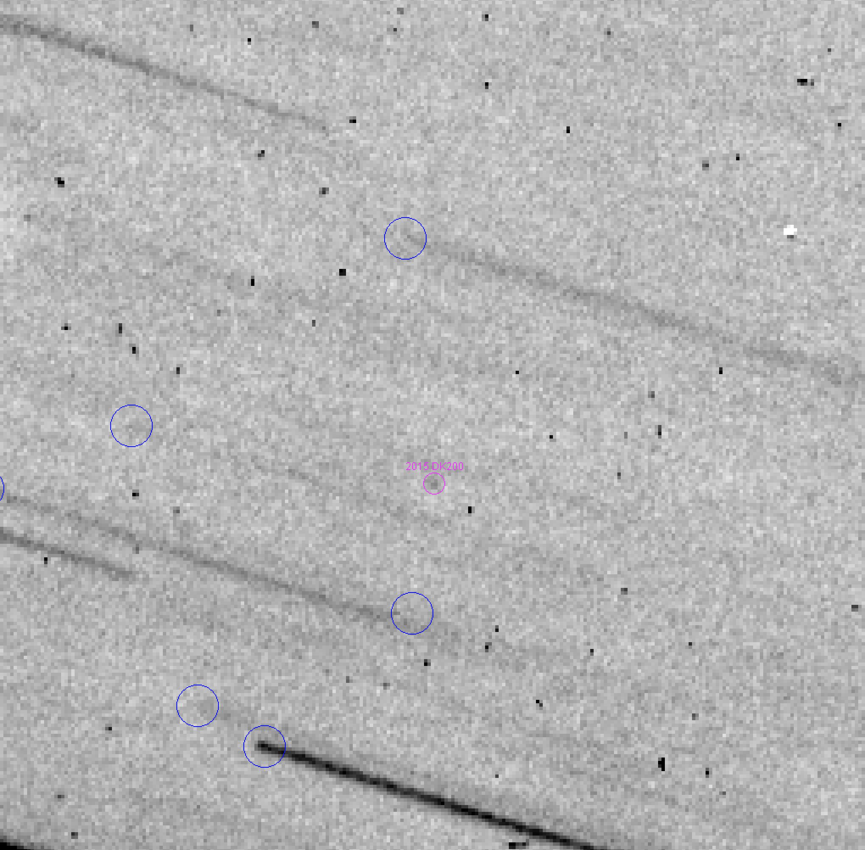
Astrometry of Fainter Targets
We have been aiming to obtain astrometry of fainter (m_{v} > 24) targets to both test the capabilities of the LDT and to facilitate arc extensions of Yarkovsky candidates to grow that population.
A recent example is this image stack
of 2015 DK200, astrometry of which
was accepted at m_{v} = 25.1.
We can achieve this depth in
good conditions in about half an hour,
providing a bridge between smaller
and larger facilities.

Slide 4
Some Summertime Astrometric Stats.
Over the months of July and August, 17 total new Yarkovsky detections¹ were made – some strong(>3σ), some less (≤3σ).
11 of these 17 included LDT observations.
8 of those were exclusively LDT observations.
We only went after 15 objects astrometrically in that time!
About half of the new Yarkovsky detections were solely due to the LDT, and about three-quarters of the objects we targeted from the Yarkovsky candidate list¹ resulted in a detection.
→ We are filling an existing gap and getting better at it.
¹Both Yarkovsky candidates and validation come via Davide Farnocchia.

Slide 5
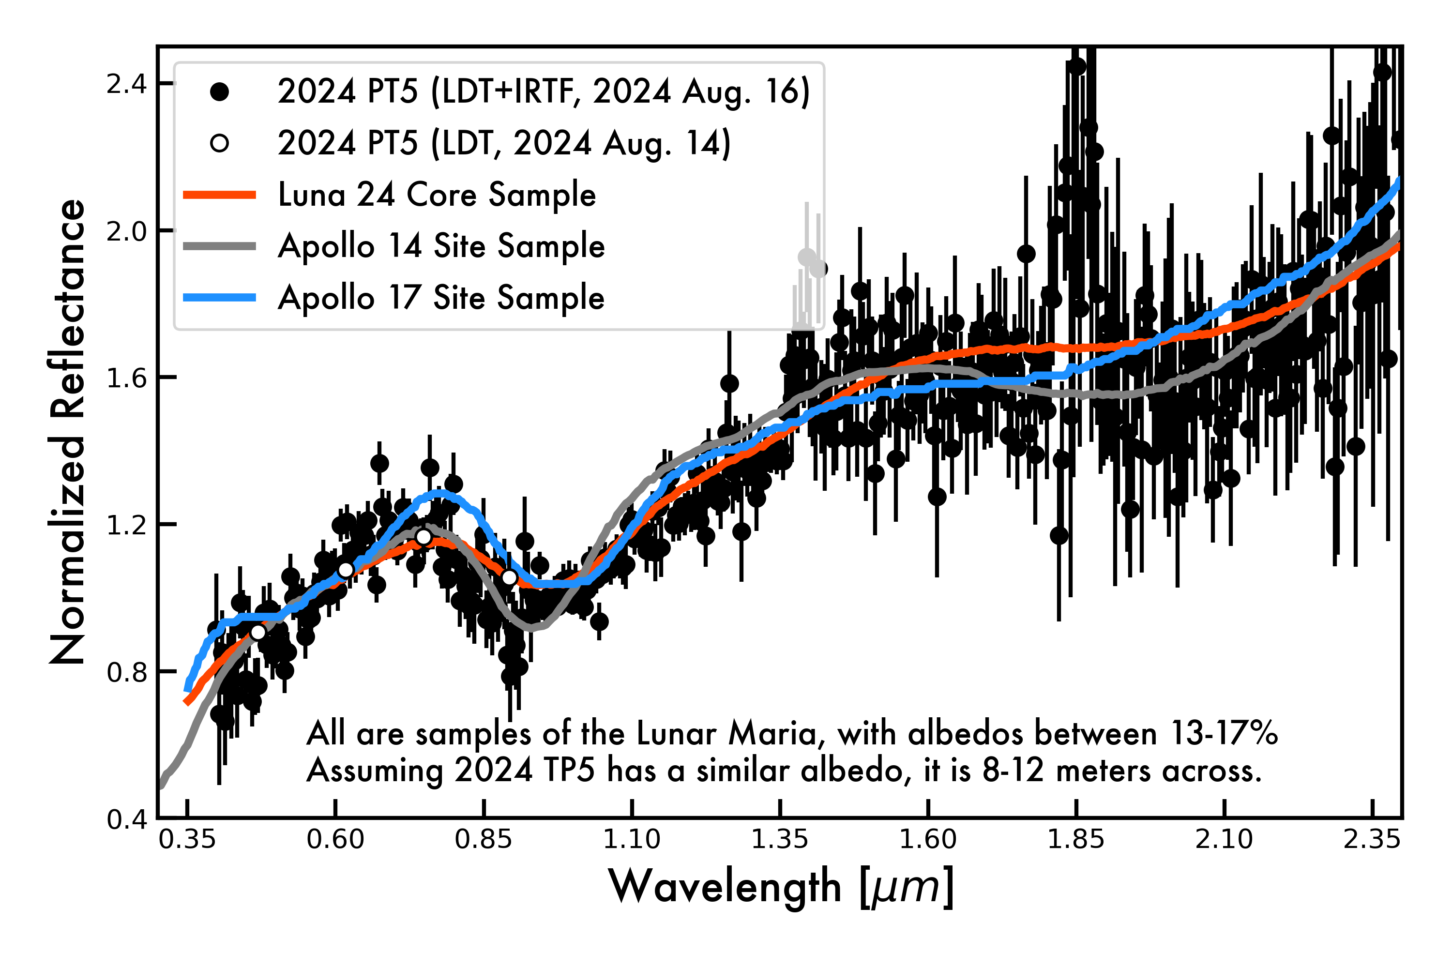
LDT/IRTF Observations of 2024 PT5
Discovered in mid-August with a very low v_{inf} (artifial or lunar in origin), combined LDT+IRTF ToOs activated to measure composition and discriminate origin scenarios.
Reflectance spectrum inconsistent with artificial objects and asteroids.
Surface is quite red, well matched by samples of the Moon. Maria vs. Highlands is hard to say.
Doesn’t have to just be the Maria.

Slide 6
Near-Earth Lunar Ejecta?
PT5 is the second NEO that is likely to be Lunar Ejecta based on composition after Kamoʻoalewa (Sharkey et al., 2021.)
One object is an outlier, two is a population – maybe? Hopefully?
We are working on modeling to figure out how to hunt for more and how many are out there.
Thanks! Email me at
tkareta @ lowell.edu
Doesn’t have to just be the Maria.

