Slide 1
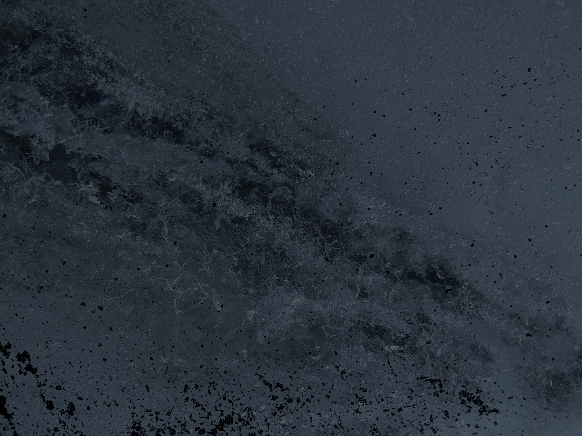
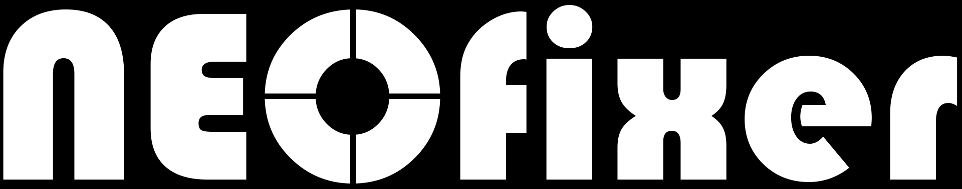





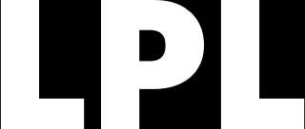
Overview and
New Features
IWAN Fall 2024
Alex R. Gibbs, Carson Fuls
Catalina Sky Survey
Lunar & Planetary Laboratory
University of Arizona

Slide 2
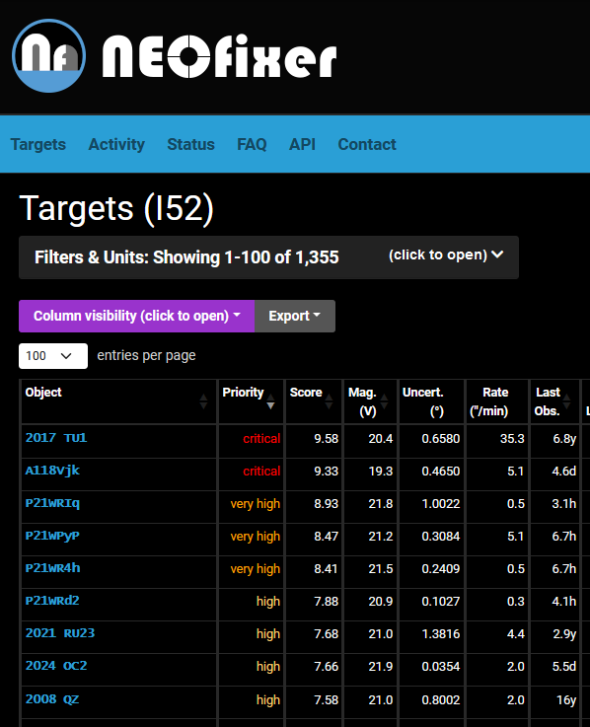
Make follow-up more efficient and beneficial, but easier
OVERVIEW
Prioritize OBJECTS
NEOs scored by many factors, especially planetary defense considerations
Customize TARGET LISTS
Customized for each user’s telescope so they can maximize the benefit of their observations
IMPROVE Coordination
Easy reporting of telescope activity discourages over observing by reducing the scores of objects
AID IN AUTOMATION
API provides an easy way to automate target selection, get observing parameters, and report activity

Slide 3
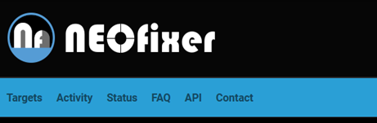
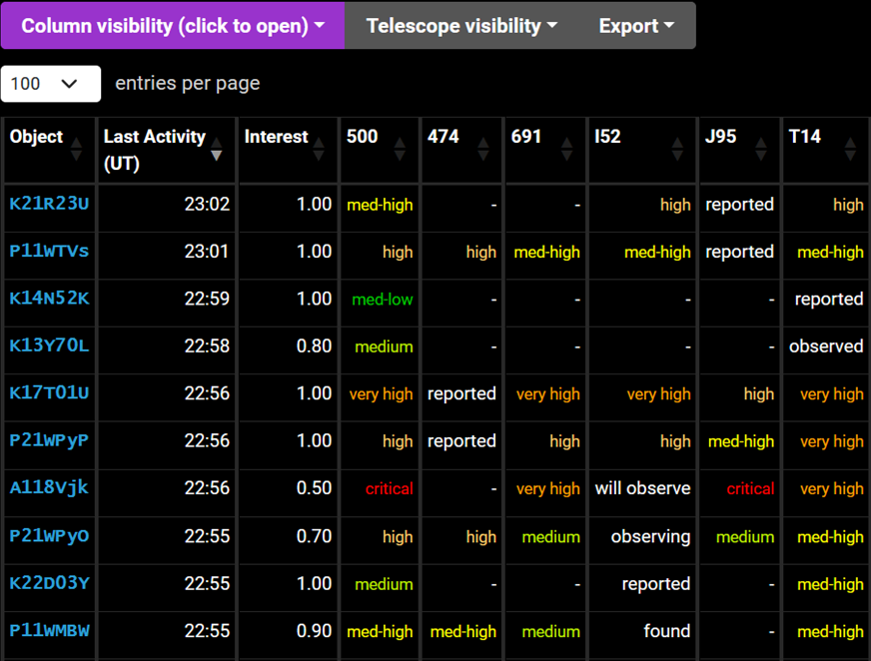
New NEOfixer features
NEW
Near-Earth comets
Near-Earth comets are included in NEOfixer, though some work remains
Follow-up Activity
The reported follow-up activity of observers is available on an “Activity” overview page and via the API. (No activity due to full Moon but added fake CSS reports.)
NEOCP ASTROMETRY UNCERTAINTIES
Uncertainties are being included in NEOCP astrometry for orbit determination
https://neofixer.arizona.edu

