Slide 1
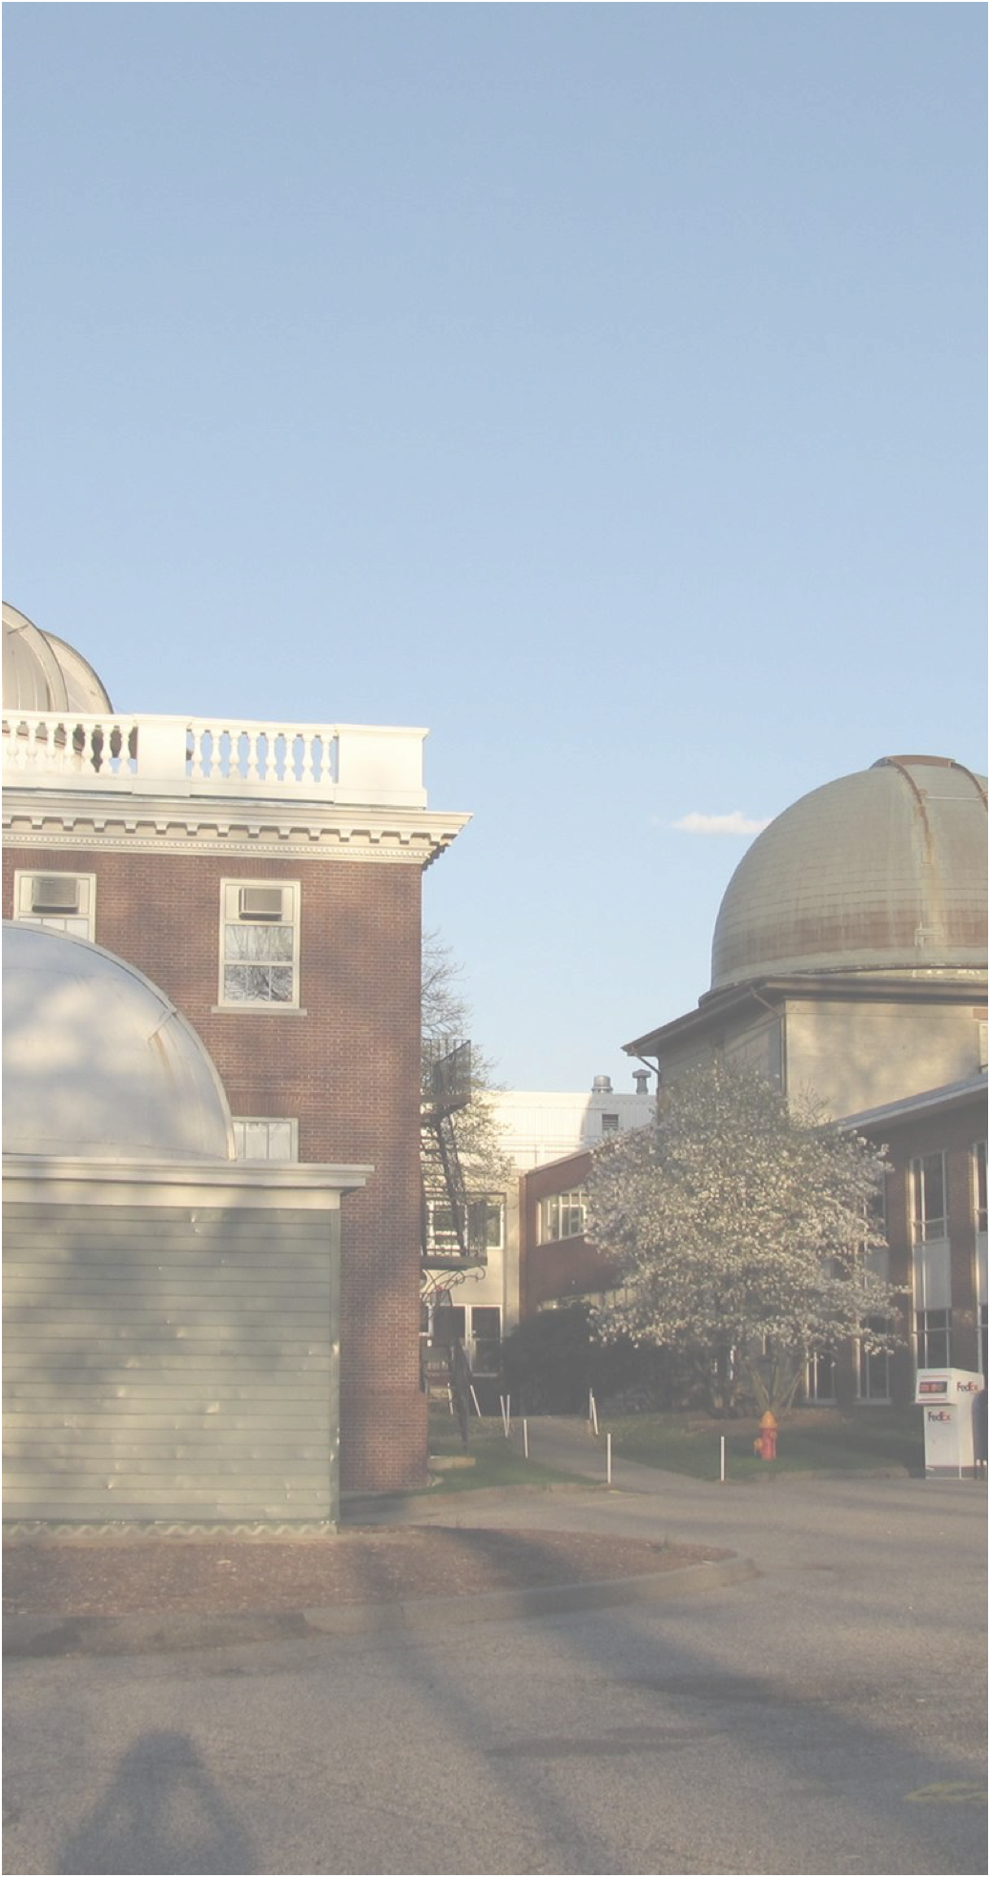


Minor Planet Center
2024 Update
Matthew Payne
Center for Astrophysics | Harvard & Smithsonian

Slide 2
Community Interactions

Slide 3
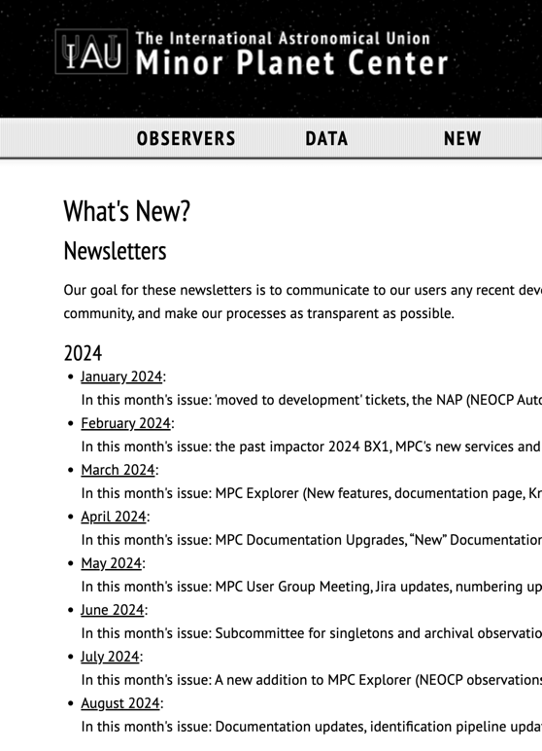
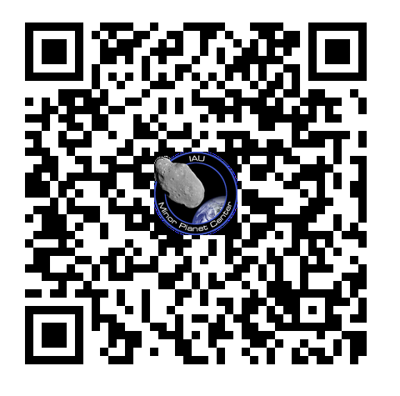
Newsletters
Monthly Newsletter
Announce new developments
Provide advice
Solicit community feedback
Download
URL:
https://minorplanetcenter.net/mpcops/new/newsletters/
QR Code
‹#›

Slide 4
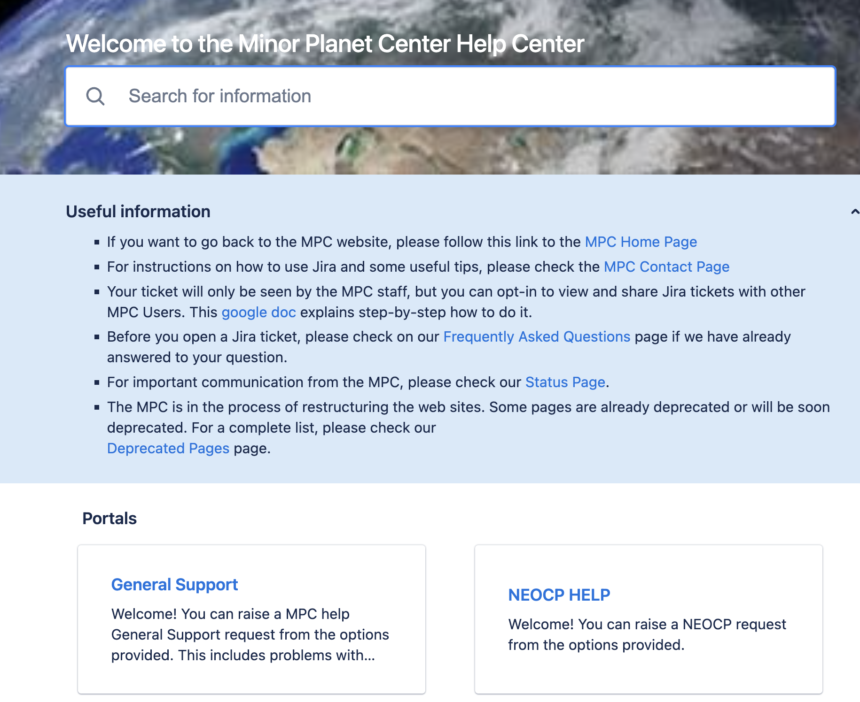
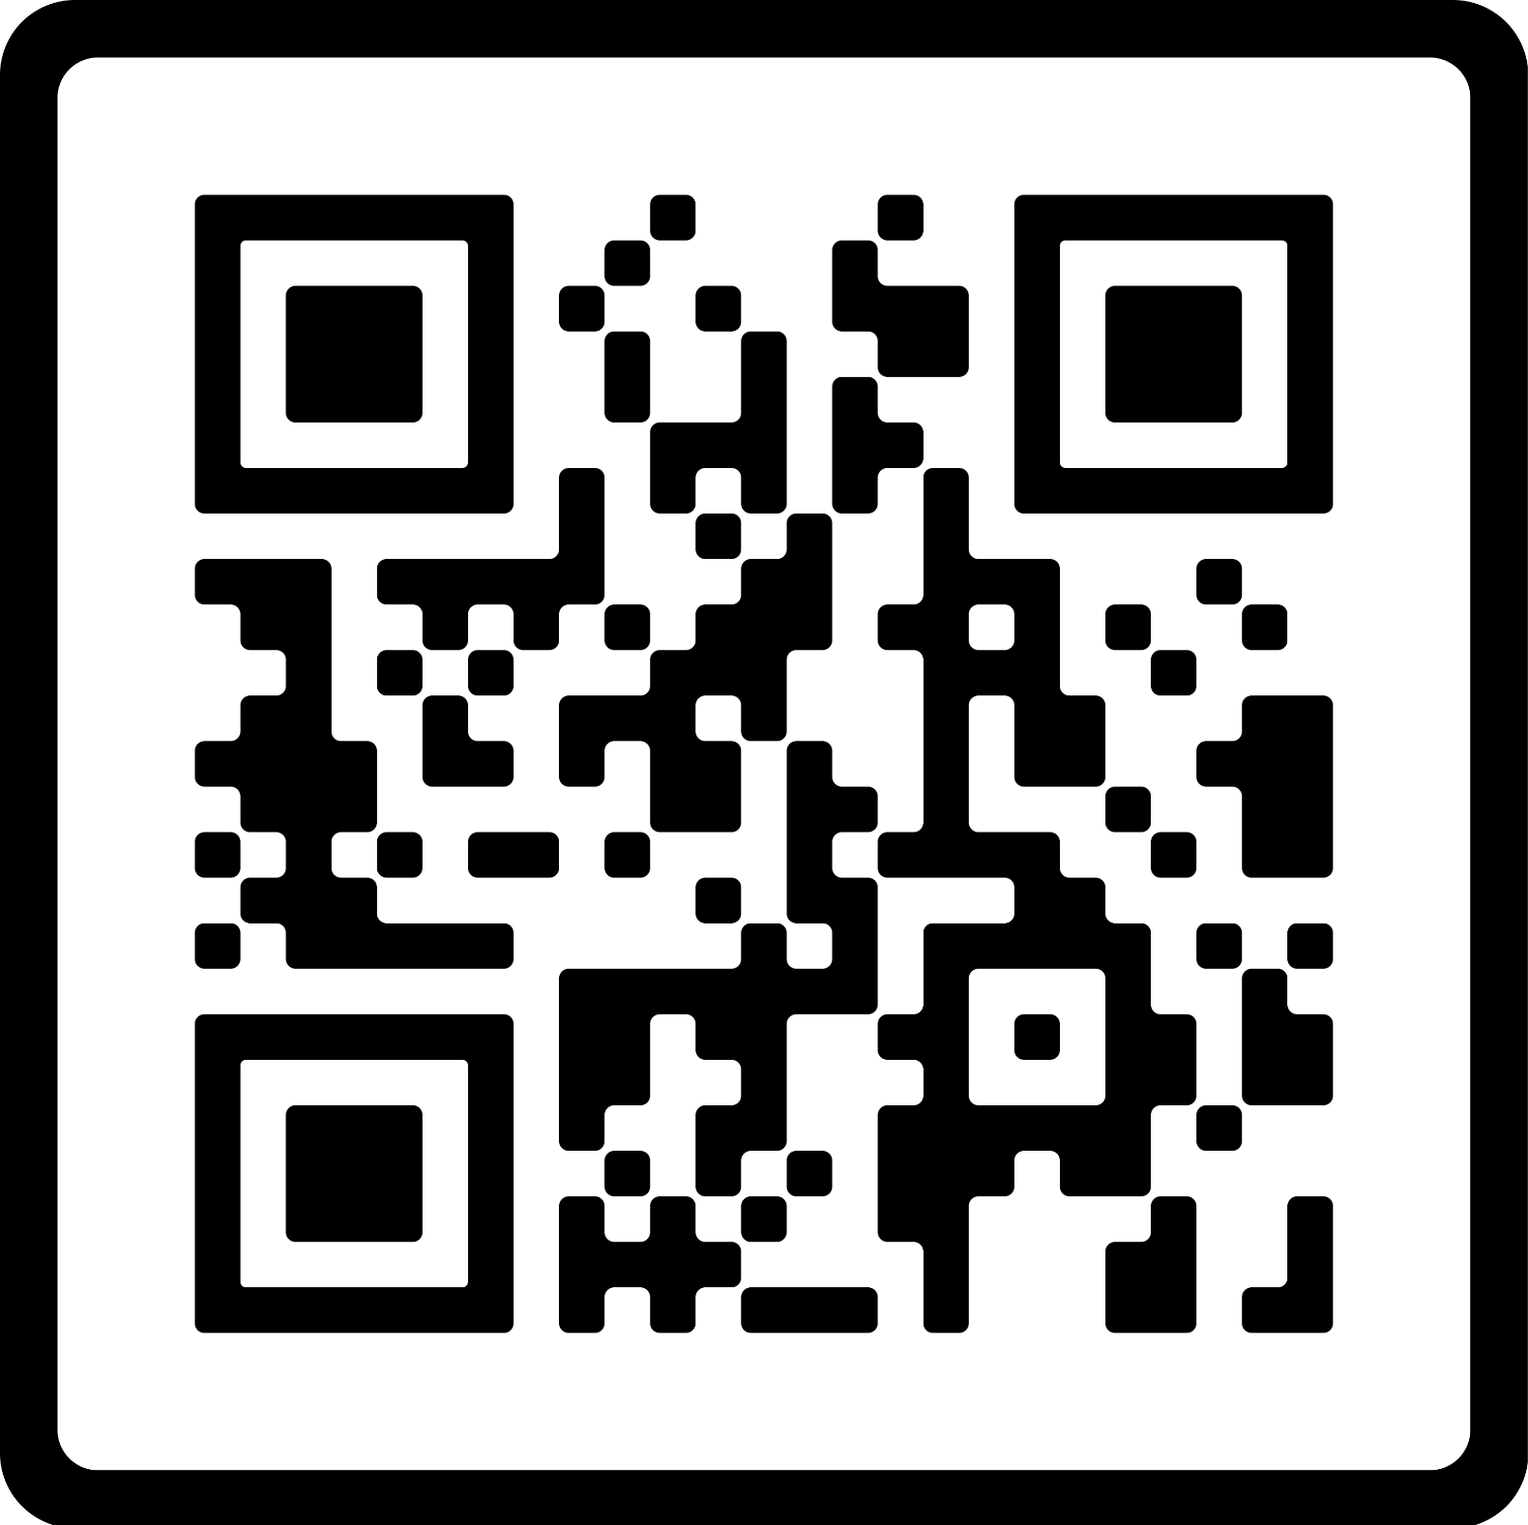
Jira Helpdesk
Jira Helpdesk
Dedicated help-desk functionality.
  Queries
  Bug reports
  Requests
Access
https://minorplanetcenter.net/contact
https://mpc-service.atlassian.net/servicedesk/customer/portals
‹#›

Slide 5
Archival Submissions Committee
Announced in June 2024 Newsletter
In reaction to concerns regarding occasional erroneous measurement of archival data.
Single measurements especially problematic when no other observations available in an opposition:
Can significantly change calculate orbit and impact probability.
The MPC and the MUG have formed a committee of impartial external experts to help review individual cases.
6 members: PanSTARRS, ATLAS, Catalina, and NEOWISE, one member with follow-up experience, and one non-NASA-funded astrometry expert
Committee members provide advice:
  To submitters regarding preferred methodology
  To MPC regarding accuracy of submitted data
Started to implement this new mechanism on a few test cases.
Committee members interact with the submitter via Jira ticket.
Postage-stamp images can be requested and analyzed
‹#›

Slide 6
Conferences/Meetings/Workshops
The MPC has put a lot of effort into increasing their presence during large conferences and medium or small meetings or workshops.
In the last two years (2023 and 2024), MPC’s staff members have attended or are going to attend the following large conferences:
PDC, April 2023, Vienna
ACM, June 2023, Flagstaff
DPS, October 2023, San Antonio
TNO meeting, June 2024, Taipei
IAU, August 2024, Cape Town
DPS, October 2024, Boise
We have also attended smaller size meetings, equally important for the NEO/Asteroid community, such as:
SBN User Group meetings
SBAG
IAWN
Radar
ADASS
NEOO
And workshops in preparation for V. Rubin and NEO Surveyor:
LSST Science Collaboration meetings
NEO Surveyor Science Workshop
In addition to that, we are also very active inside the CfA and for outreach events in Cambridge and outside the US.
Notes:
Remember to say why we think this is important

Slide 7
New Services and Data Products

Slide 8
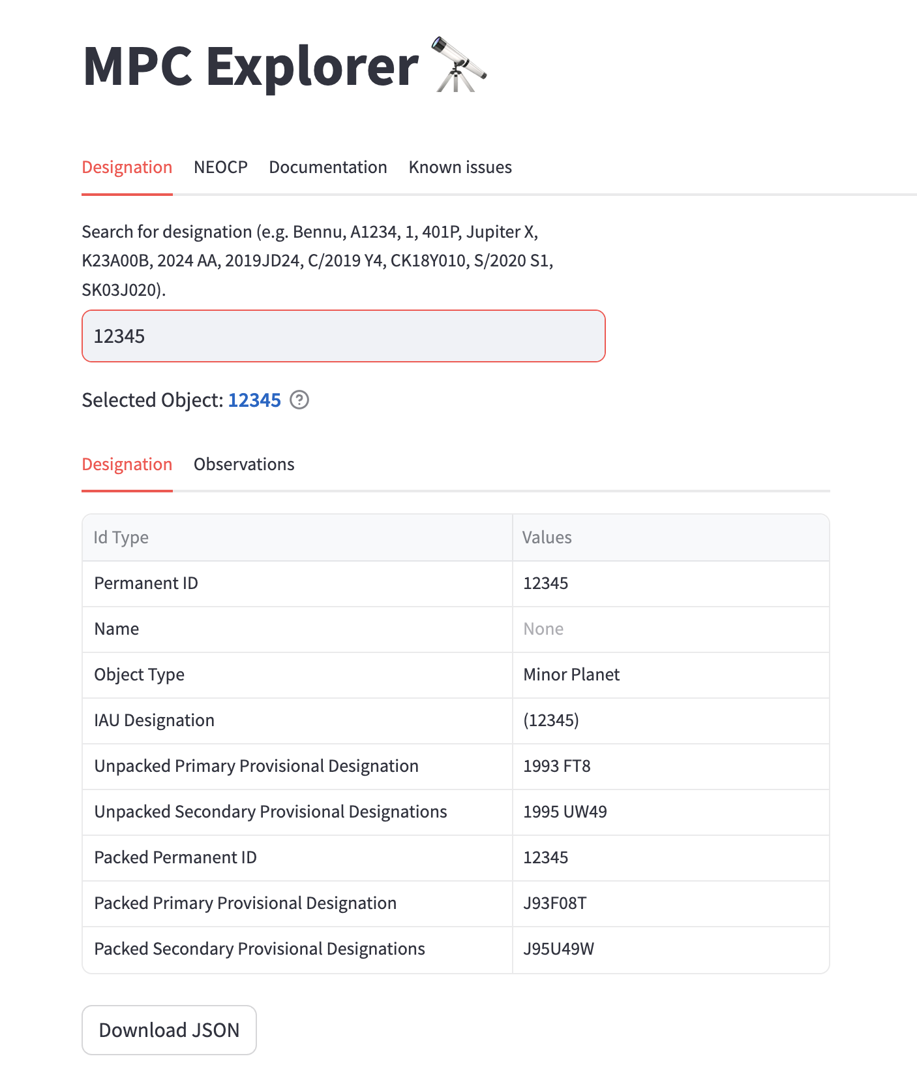
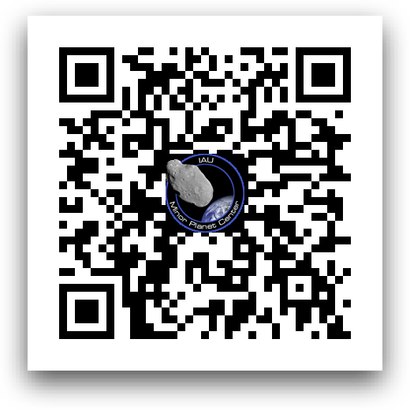
MPC Explorer
Replacement for our db_search functionality
Available Now
Designations and Identifications
Observations
NEOCP
Coming Soon
Orbits
Discovery Details
Access Methods
Web-forms
API
URL & QR-Code
https://data.minorplanetcenter.net/explorer/
‹#›

Slide 9
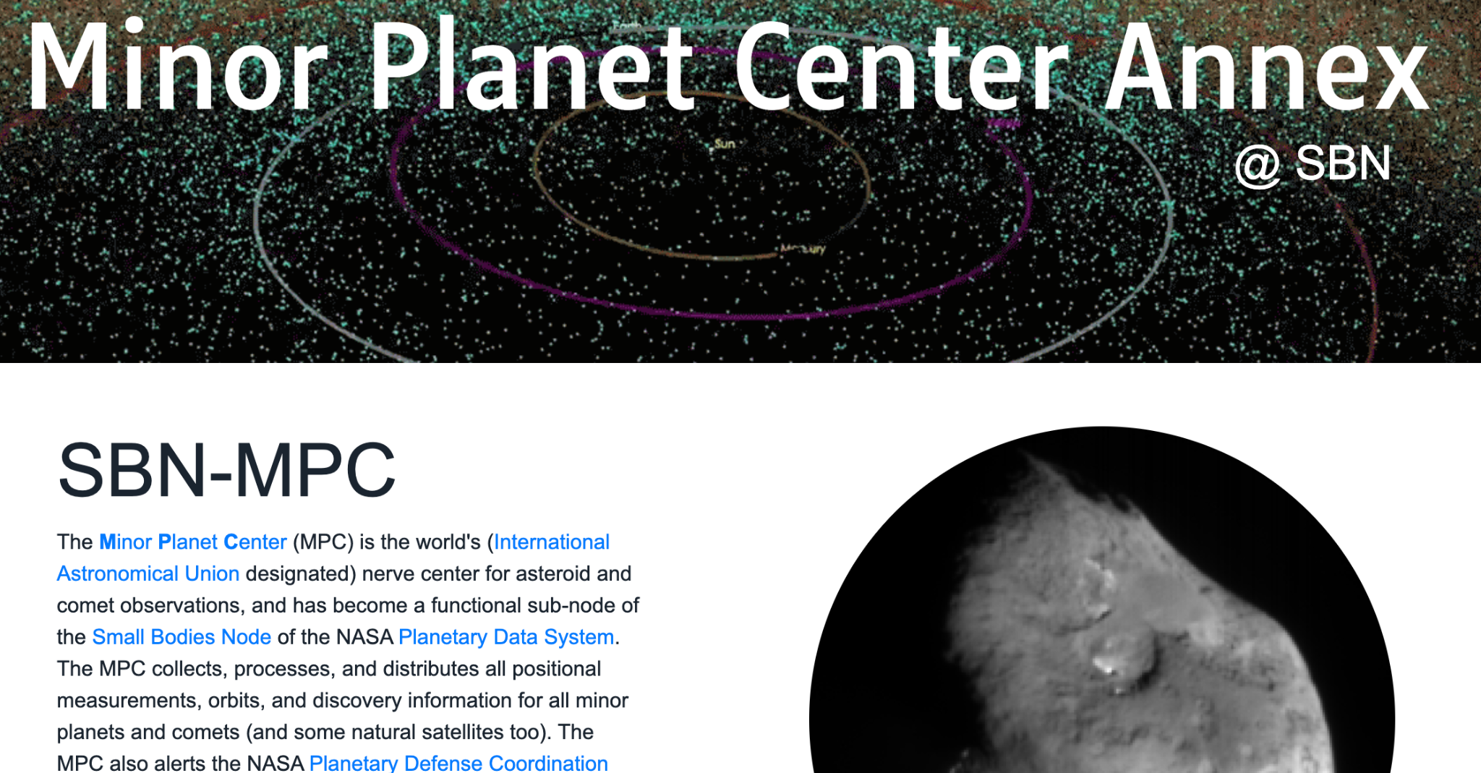
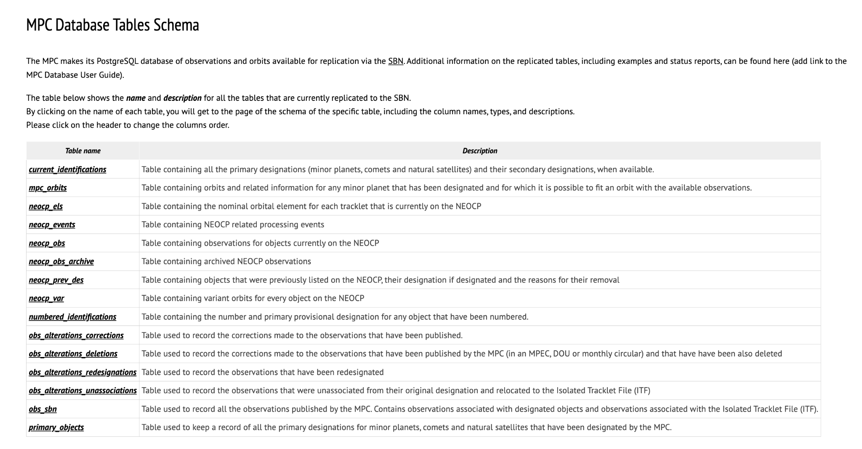
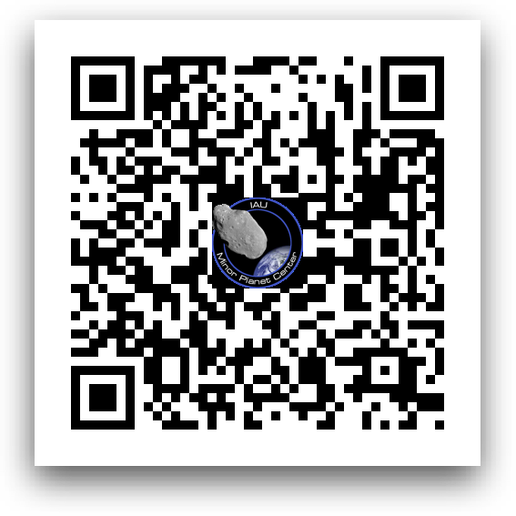
Database Replication
Multiple postgres database tables are now available for replication via the SBN
Available Now
Designations and Identifications
Observations
NEOCP
Orbits
SBN
MPCDB now distributed via AWS
  Increased redundancy
URL & QR-Code
https://sbnmpc.astro.umd.edu/
https://data.minorplanetcenter.net/mpcops/documentation/replicated-tables-schema/
‹#›

Slide 10
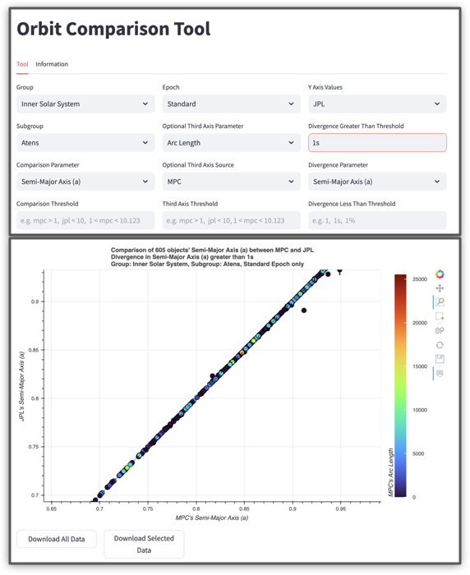
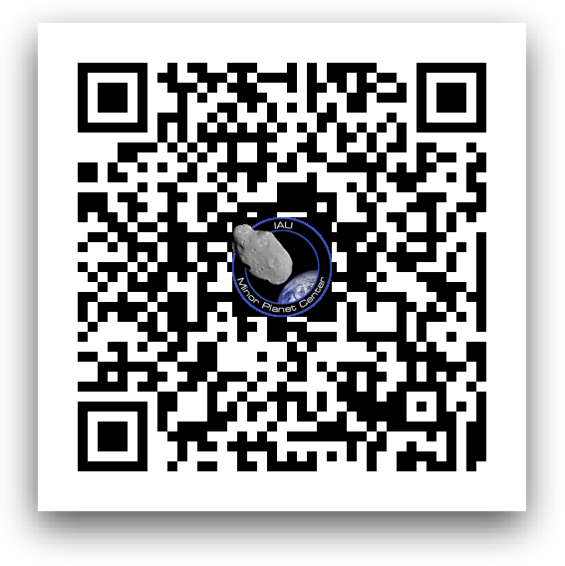
Orbit Comparison Tool
Compare the MPC’s orbit for an object with that calculated by another center.
Identify discrepancies
Available Now
JPL/CNEOS orbits
Coming Soon
NEOFixer orbits
URL & QR-Code
https://data.minorplanetcenter.net/comparison/index.html
‹#›

Slide 11
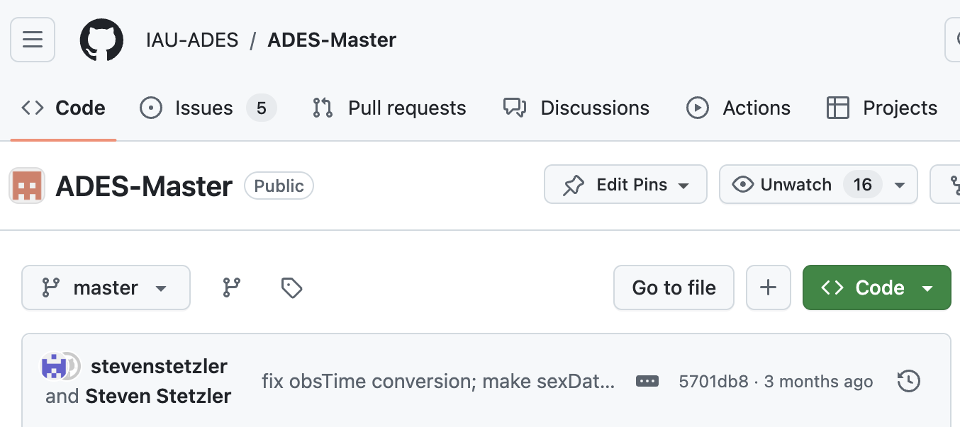
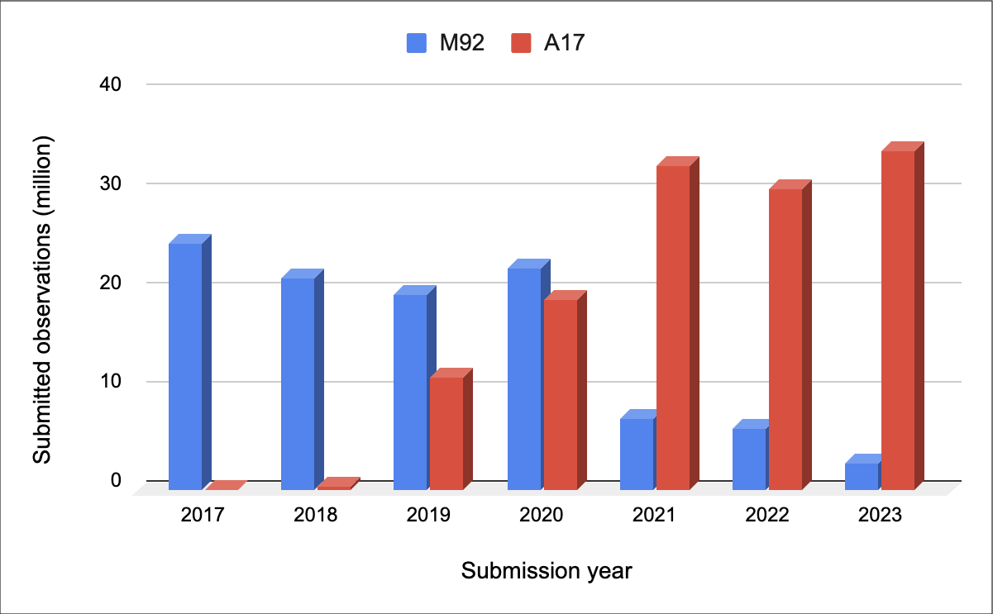
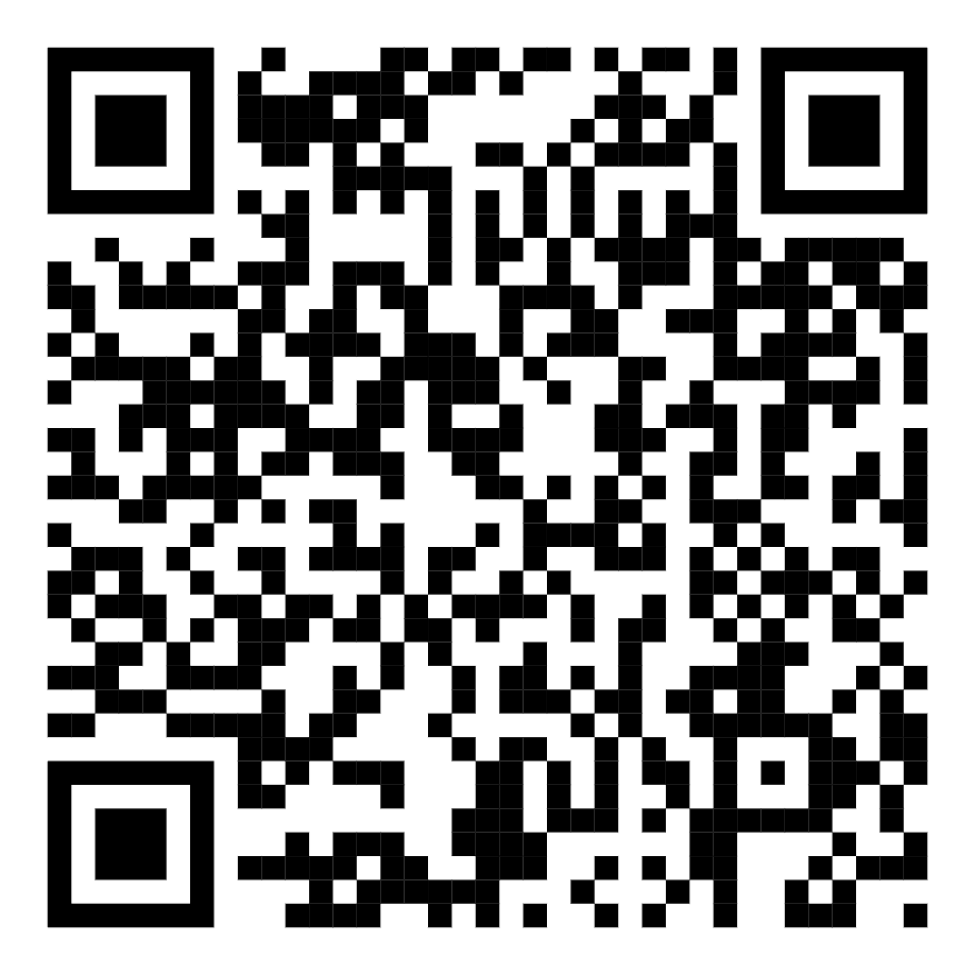
ADES
Preferred submission format
Preferred format for internal MPC processing
The GitHub repository containing the ADES code is continuously updated if fixes or improvement are needed:
Co-maintained by JPL & MPC
Available for public download
Available for public discussion of issues and improvements
URL & QR-Code
https://github.com/IAU-ADES/ADES-Master
‹#›

Slide 12
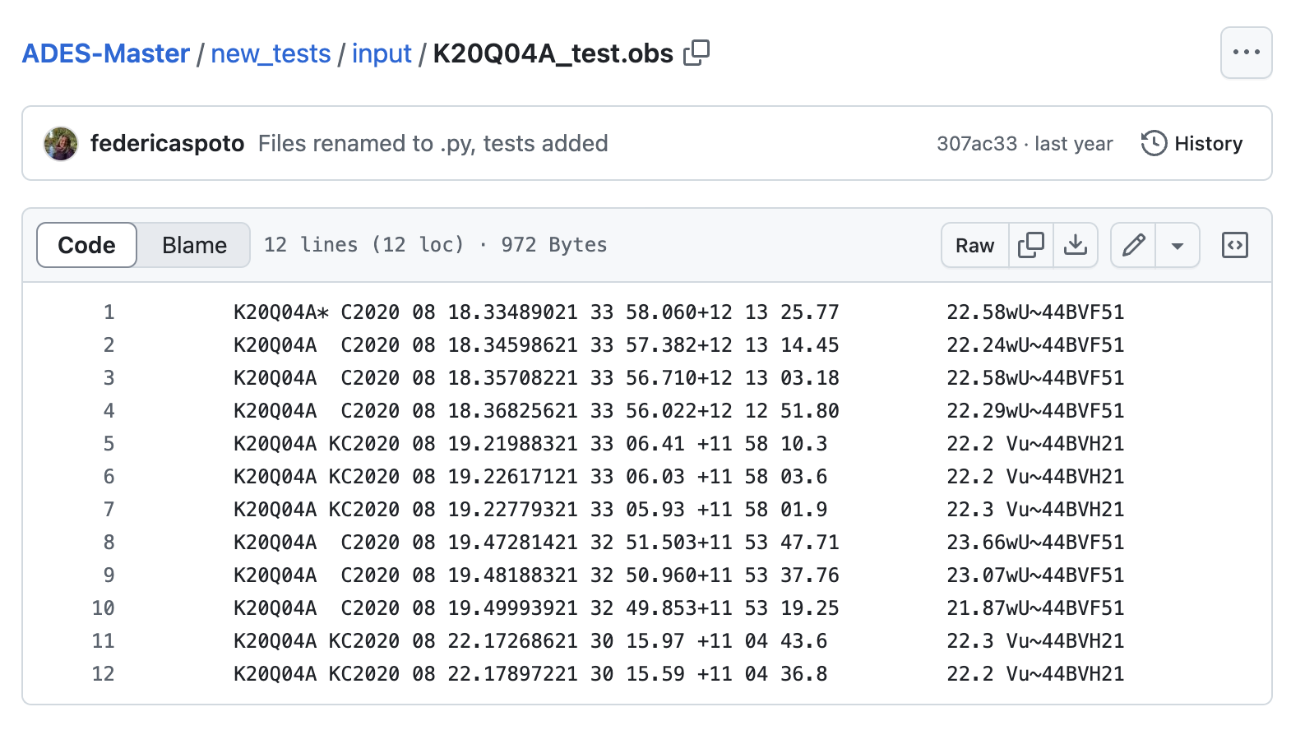
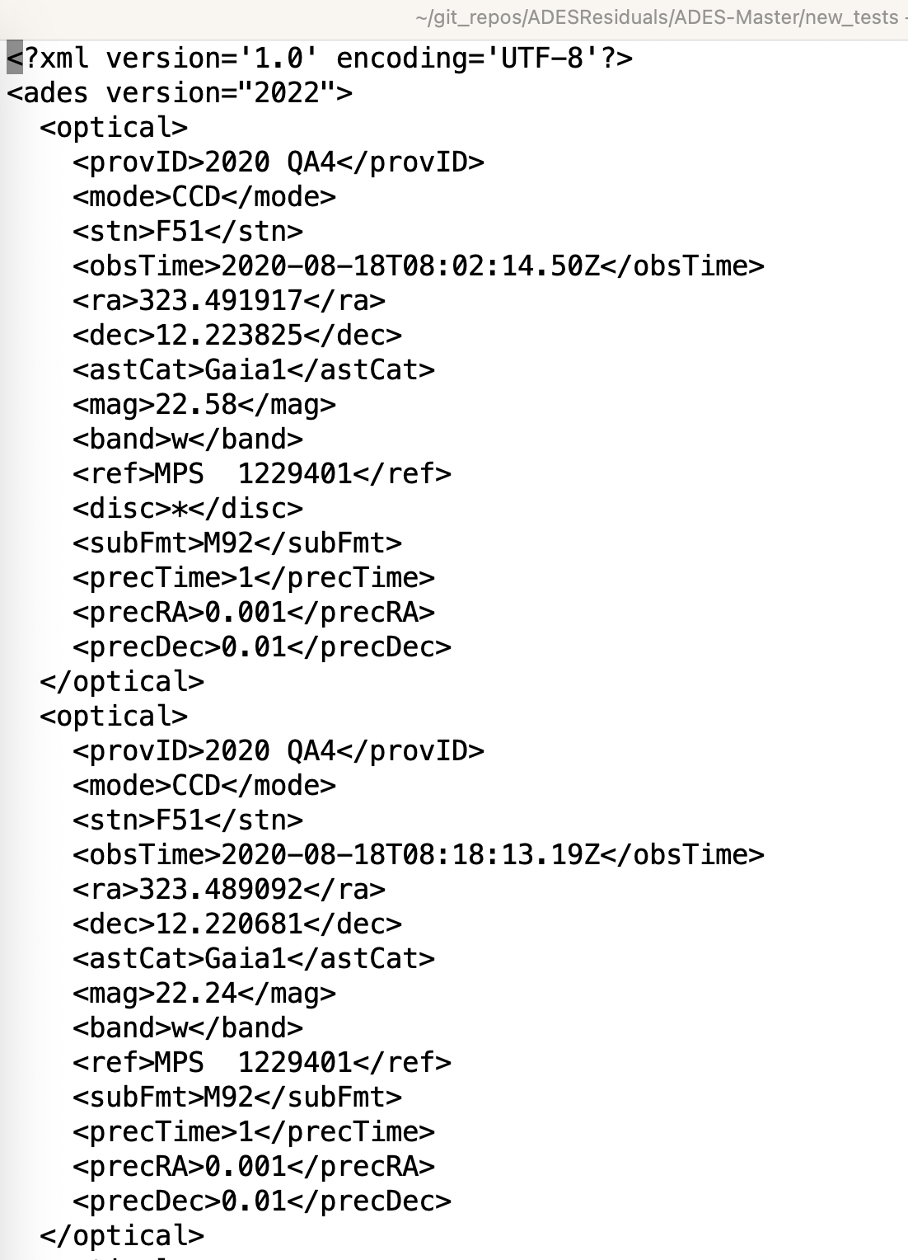
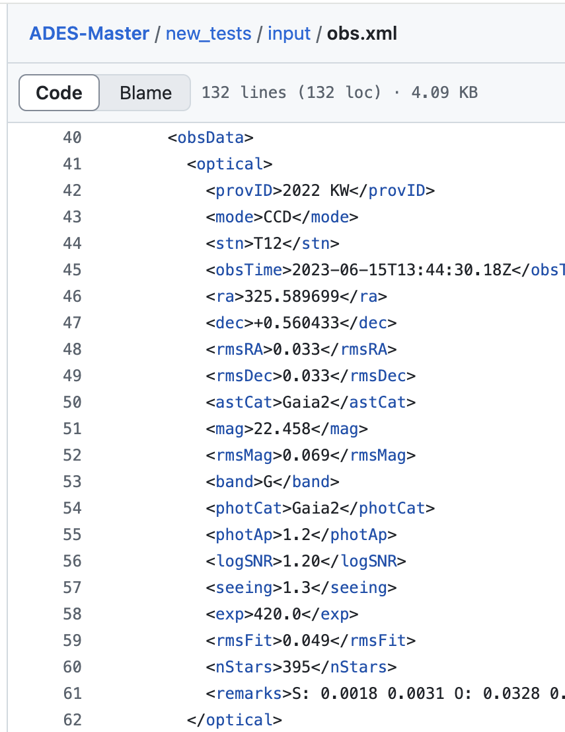
ADES
Switching to ADES
If you are still using the 80-character format, some help with switching can be found in the ADES repo.
There is code that converts 80-char to ADES format:
https://github.com/IAU-ADES/ADES-Master/blob/master/Python/bin/mpc80coltoxml.py
The above will just help get you underway …
You probably want to add uncertainties …
There are examples of data that include uncertainties
https://github.com/IAU-ADES/ADES-Master/blob/master/new_tests/input/obs.xml
‹#›

Slide 13
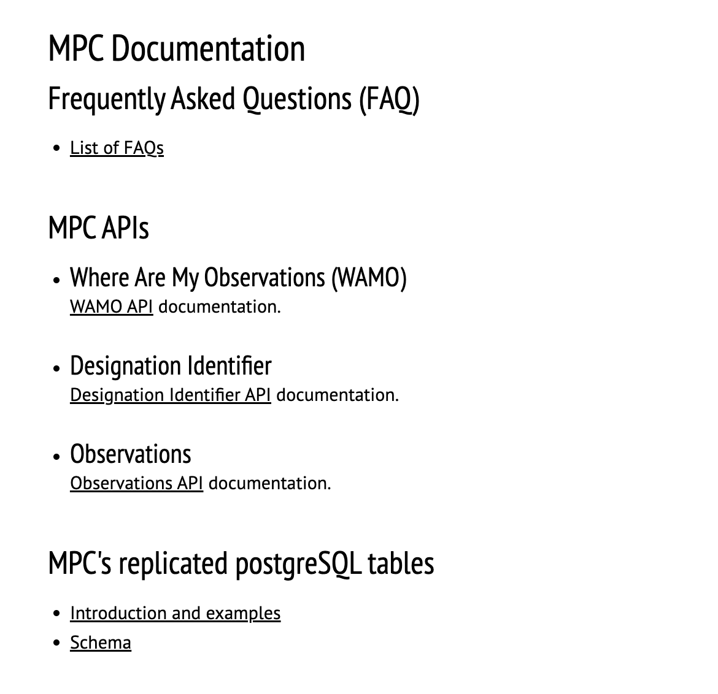
Documentation
Improvements to website documentation.
April 2024 Newsletter
Documentation Page
https://minorplanetcenter.net/mpcops/documentation/
API related documentation
PostgreSQL replicated table documentation

Slide 14
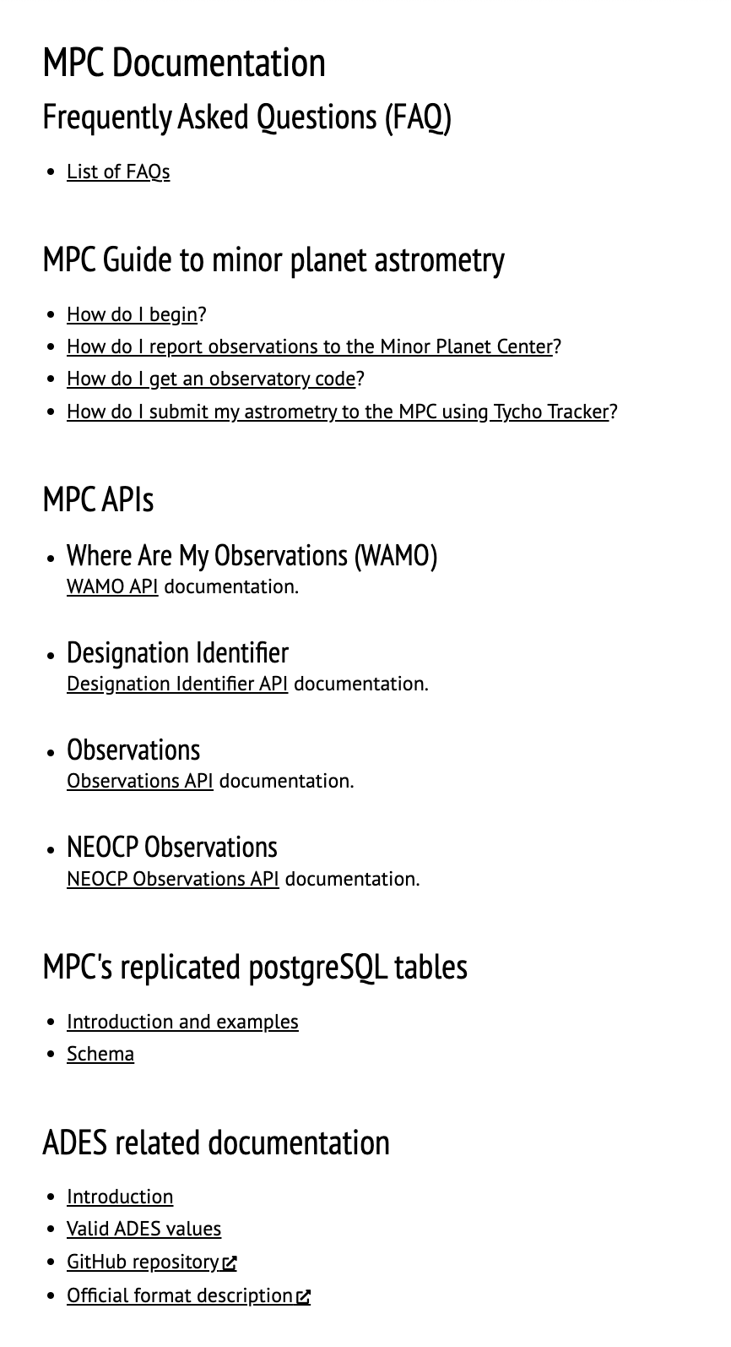
Documentation
Improvements to website documentation.
April 2024 Newsletter
Ongoing improvements
Reorganized & Updated Guide to Astrometry
Reorganized & Updated Guide to the ADES format
Our goal is to keep improving this documentation section
Reorganizing & Updating material from across the website.

Slide 15
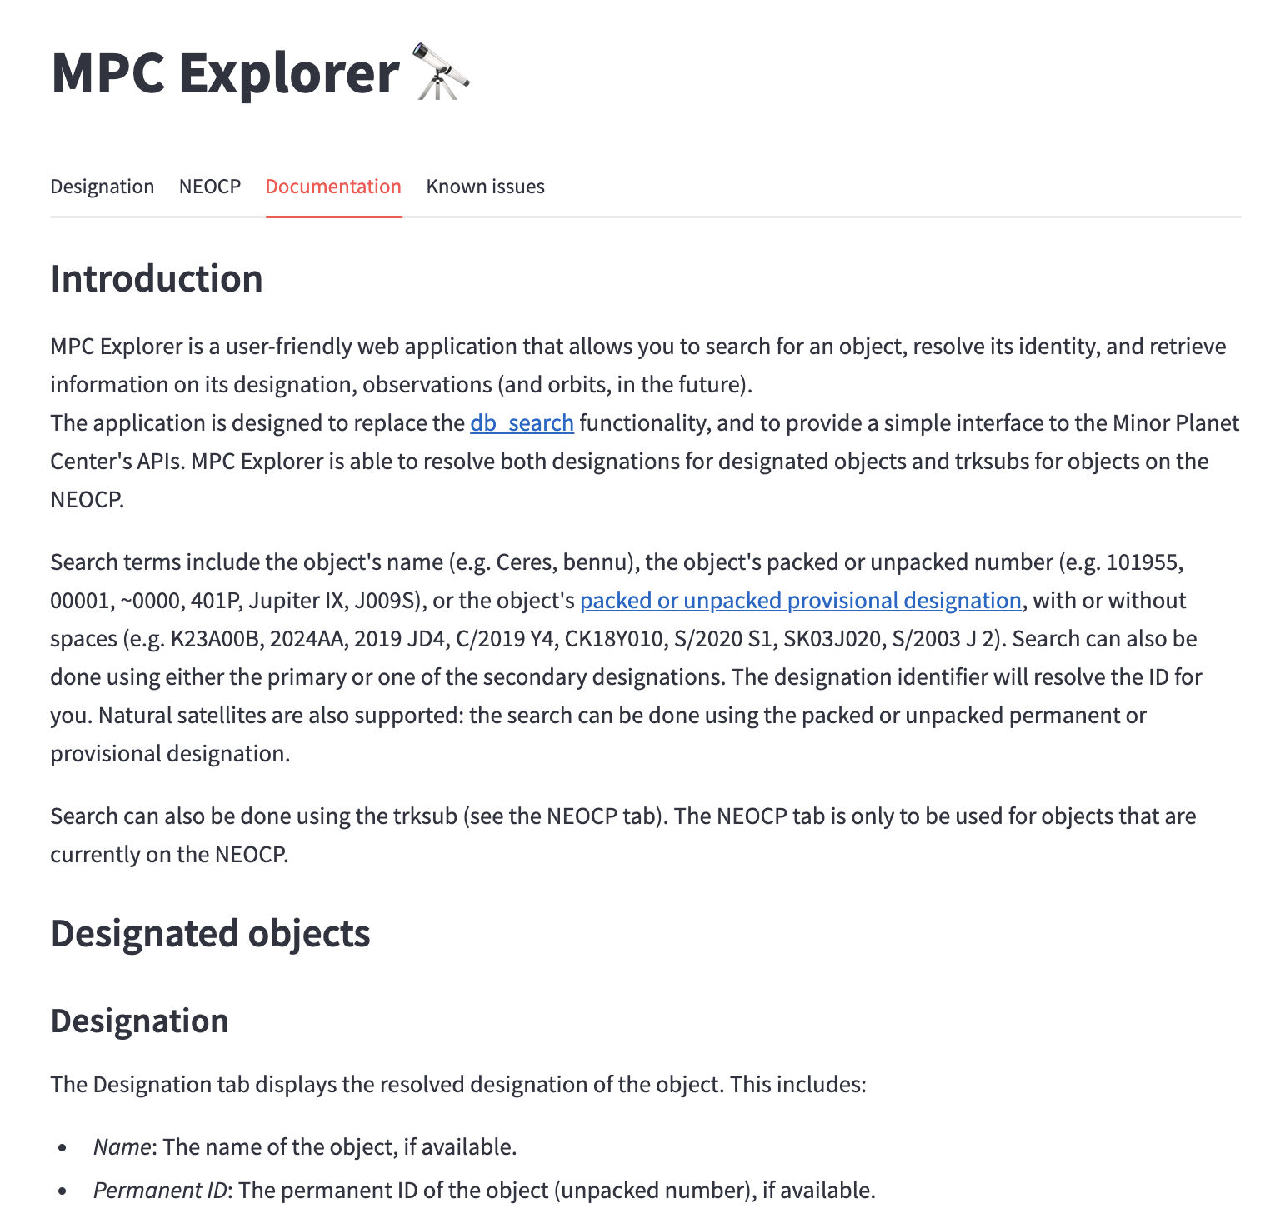
Documentation
Improvements to website documentation.
April 2024 Newsletter
Ongoing improvements
Reorganized & Updated Guide to Astrometry
Reorganized & Updated Guide to the ADES format
Our goal is to keep improving this documentation section
Reorganizing & Updating material from across the website.
Cross-linking to updated documentation
https://data.minorplanetcenter.net/explorer/

Slide 16
Infrastructure Updates

Slide 17
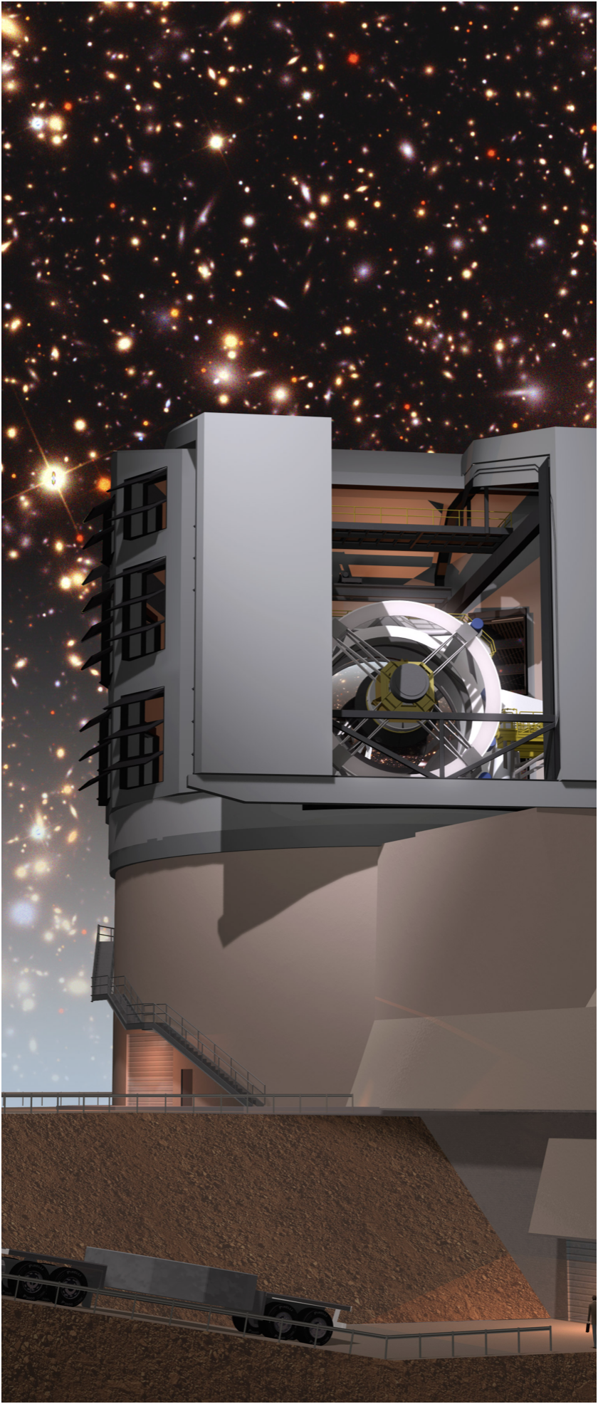
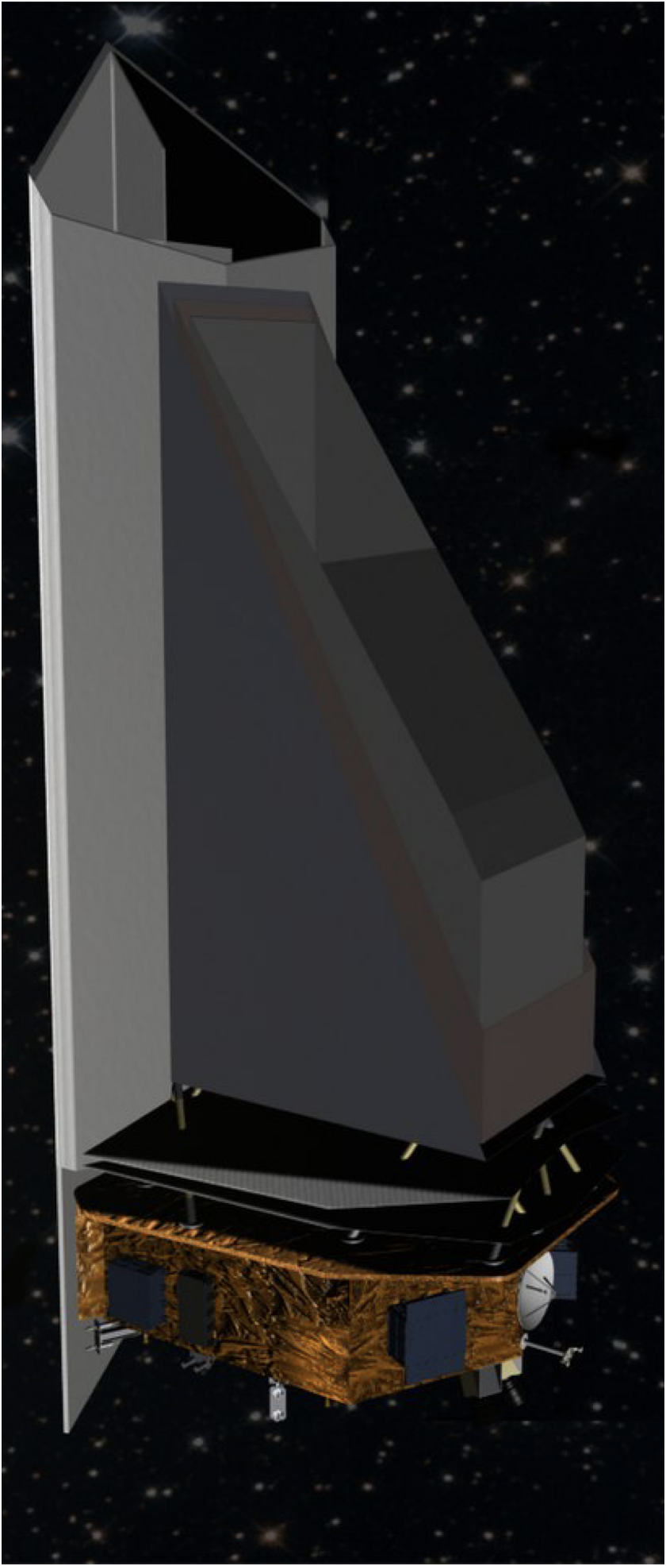
Preparing for the Future
The MPC’s infrastructure updates are centered around preparing for the Vera Rubin/LSST and the NEO Surveyor mission.

Slide 18


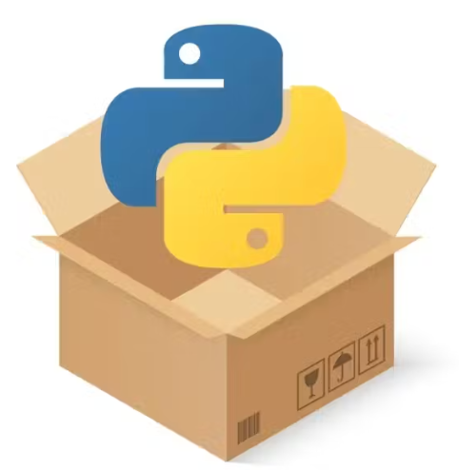





Software Management
MPC Staff are using modern software practices
Three full-time software engineers
Recently advertised additional positions for database & software staff
Entire team is comfortable with Jira
Branching training turning into adoption
Adopting latest Python packaging standards
More unit tests running in the cloud every commit
More Code Reviews and Human Testing

Slide 19
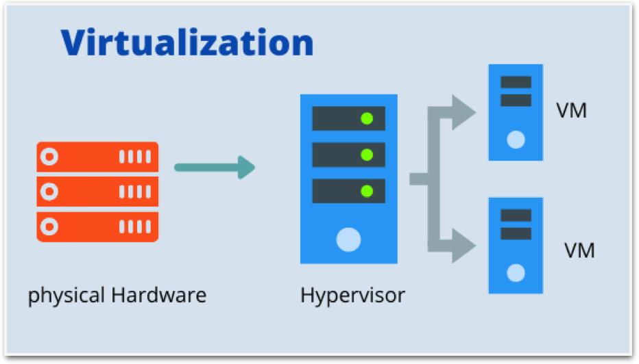
Hardware Virtualization
Created our own internal cloud system
  Multiple servers
  Large, modern storage
  Cluster: Software hypervisor
  Deploy multiple VMs and containers to the cluster
Efficient resource use
Faster processing times
Simple backup and upgrade paths
Faster disaster recovery

Slide 20
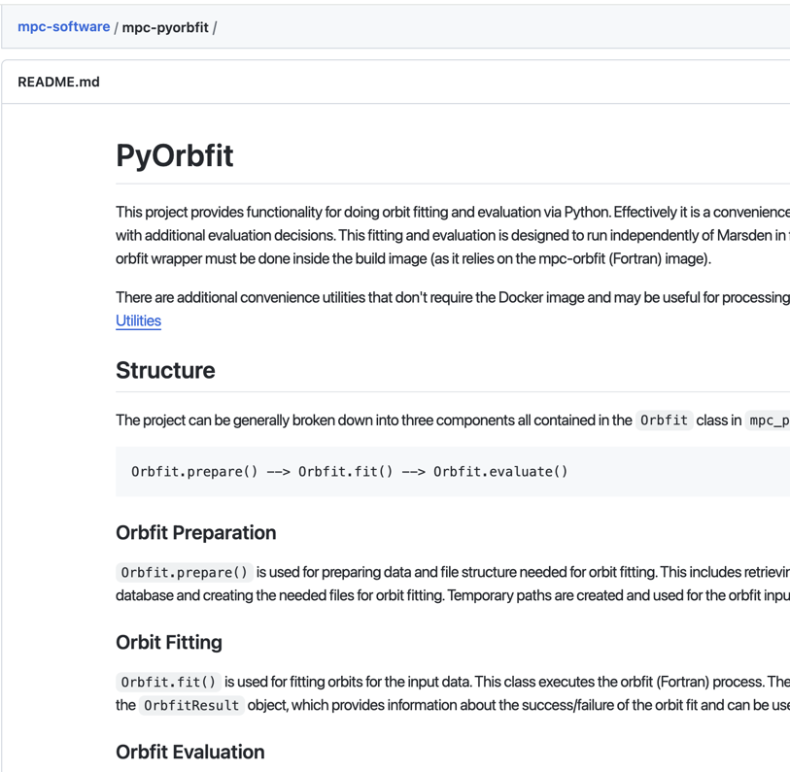
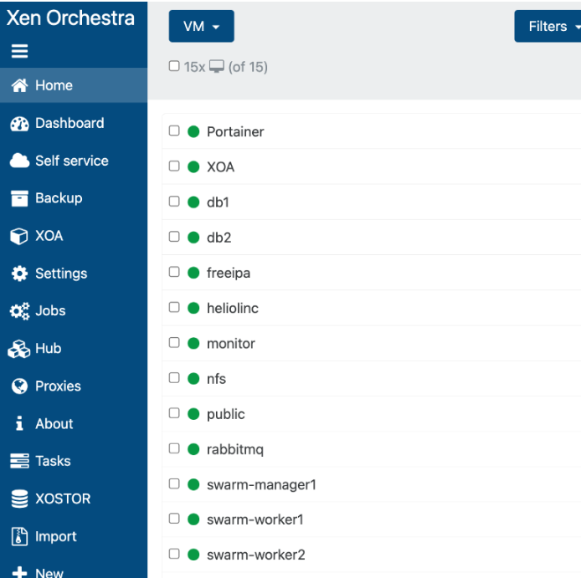
Orbit Fitting Containers
Orbit-Fitting
Group of containers orchestrated via Docker Swarm.
Deployed onto virtualized cluster
Multiple workers per container
Each worker is running orbit fitting jobs using the MPC’s `pyorbfit` wrapper around the `orbfit` fortran binary.

Slide 21
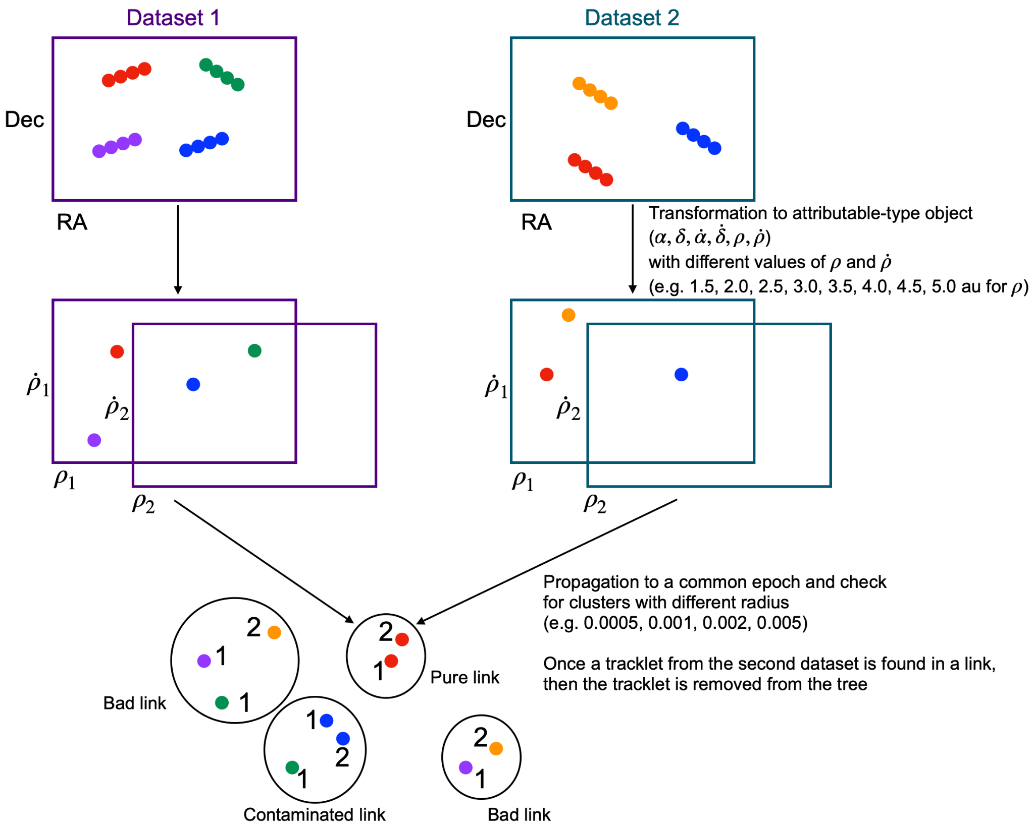
Heliocentric Linking
HelioLinc Algorithm
Guess/assert a distance (and radial velocity)
Transform tracklets to state-vectors
Propagate
Look for “Clusters”
If the assertion is true, tracklets from the same object will “cluster” at a common location after propagation.
If you see clusters, you have found an object with those (approximate) properties
Notes:
Remember to say that every clusters actually start from scratch (for now)

Slide 22
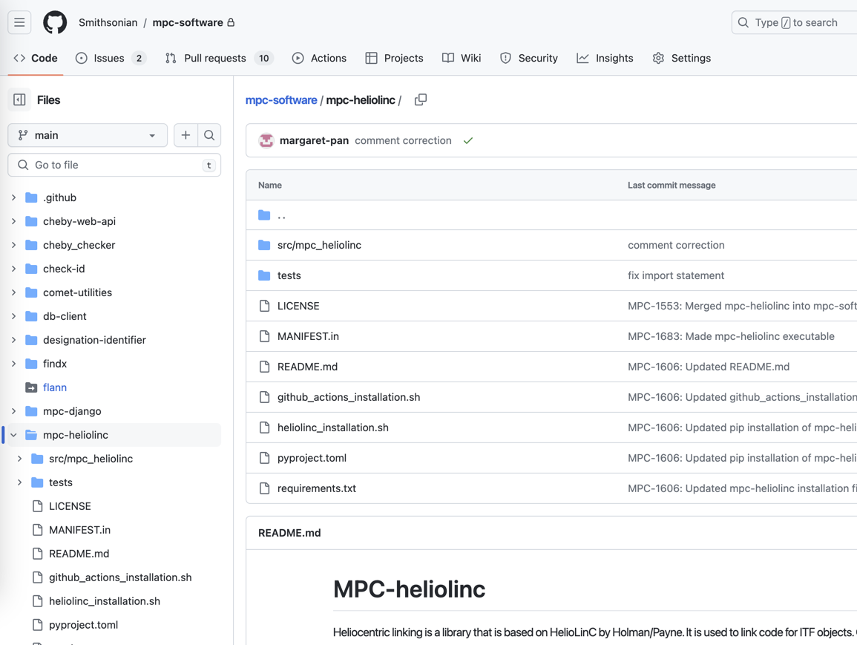
Heliocentric Linking
Linking Development
WIP to migrate the code to database-centered data format;
  Radiy Matveev
To be deployed to virtual machine
Integrate into the RabbitMQ-based queuing system …
‹#›

Slide 23
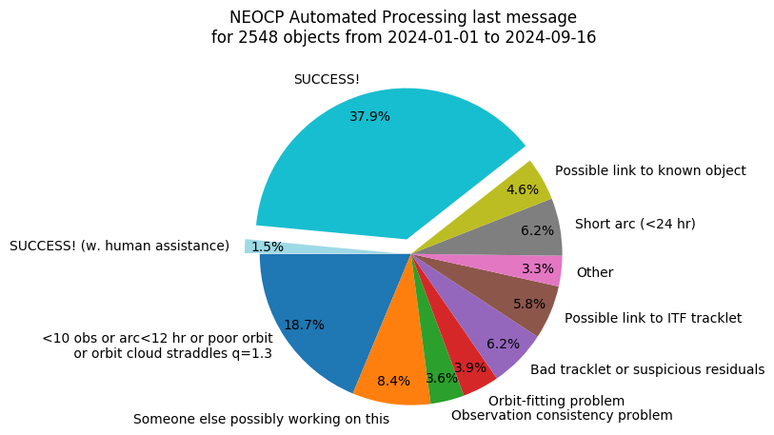
NEOCP Automatic Processing
NAP:
An automated script process and designate objects on the NEOCP
Regularly develop and improve: increase level of automation
Checks:
Objects are thoroughly vetted prior to publication: a Huge number of properties are checked
Recently added / improved checks include:
  Orbit uncertainties
  Differences in magnitude between the object and the possible ITF matches
  Geocentric score
  Singletons
WIP:
Increase Automation
‹#›

Slide 24
Negative Observations: WIP
Old (1): NEOCP Follow-up reports
Negative Observations
Allow users to report objects that could not be recovered.
Partial evidence against an orbit / variant-orbits
Difficult topic: many caveats around depth, completeness, etc.
But we want to start collecting information: hopefully something is better than nothing.
2024-02-20 12:59:16 UTC
I52 — Steward Observatory, Mt. Lemmon Station
K24D00Z
targeting - I52
691 — Steward Observatory, Kitt Peak-Spacewatch
Attempting recovery of K24C08N
Started recovery attempt for K24C08N on 2024 Feb 20 at approximately 1228 UT
2024-02-20 13:12:18 UTC
I52 — Steward Observatory, Mt. Lemmon Station
CA9CDD2
reported - R. A. Kowalski
https://www.minorplanetcenter.net/neocp_followup_reports/
‹#›

Slide 25
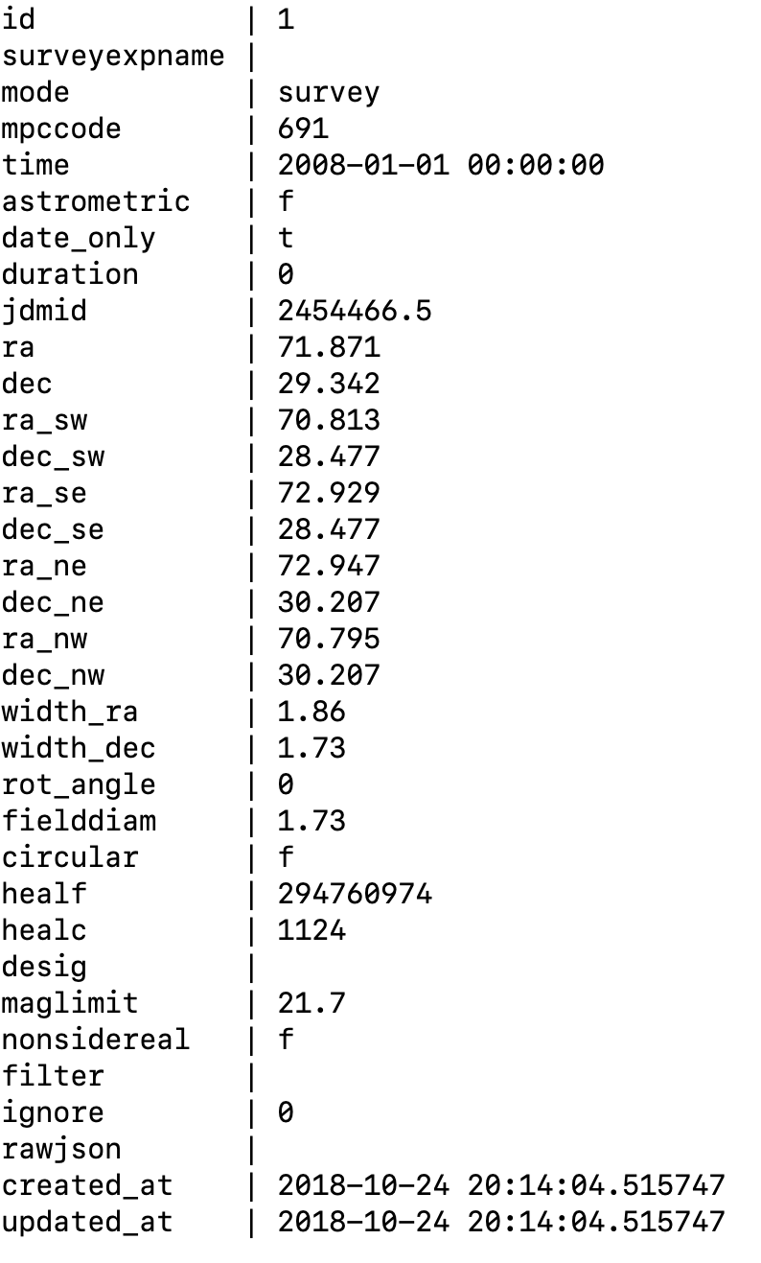
Negative Observations: WIP
Old (2): Pointings
Negative Observations
Allow users to report objects that could not be recovered.
Partial evidence against an orbit / variant-orbits
Difficult topic: many caveats around depth, completeness, etc.
But we want to start collecting information: hopefully something is better than nothing.
https://minorplanetcenter.net/pointings
‹#›

Slide 26
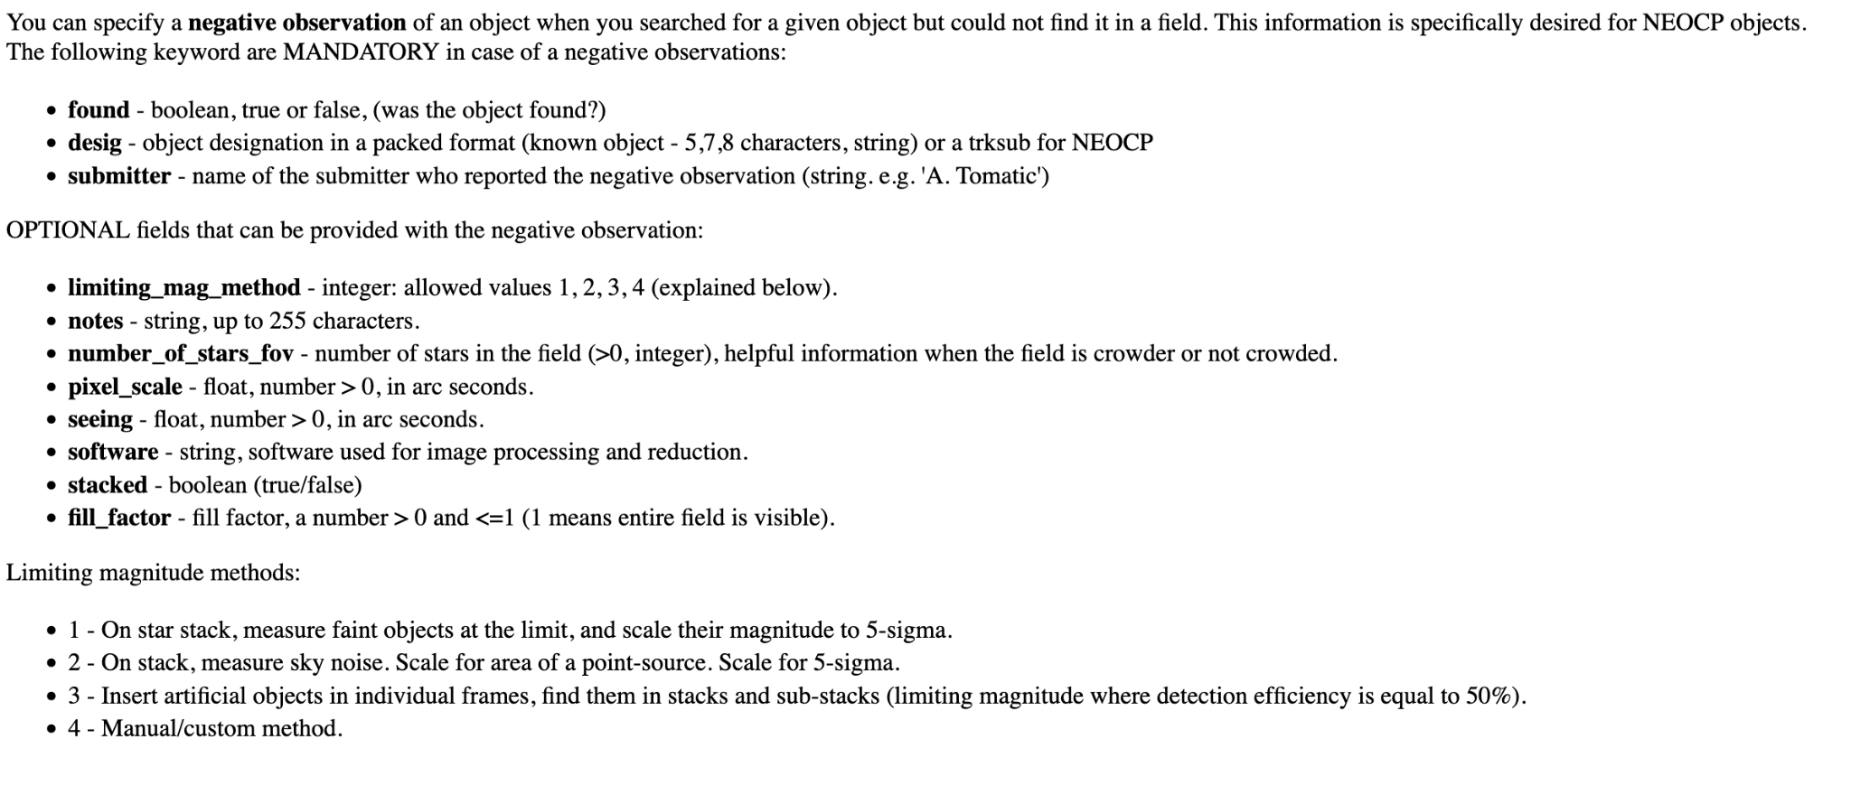
Negative Observations: WIP
New: Updated Pointings API → Negative Observations
‹#›

Slide 27
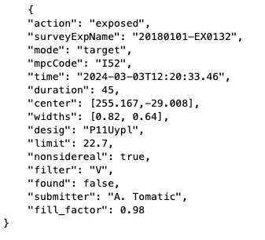
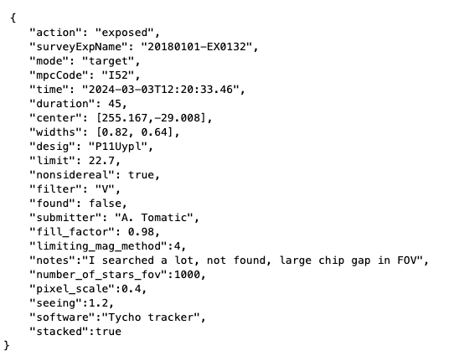
Negative Observations: WIP
New: Updated Pointings API → Negative Observations
Minimal Example
More Verbose Example
‹#›

Slide 28
Summary
Survey Preparations
LSST
  Main survey starts next summer
  Com-Cam data expected October 2024
Infrastructure developments
  Many pipeline upgrades
  Deploying “Sandbox Pipelines” in collaboration with LSST
NEO Surveyor
  MOUs & ICDs Signed
  Ongoing testing schedule
Community Wide Improvements
New Services and Data Products
  Database-Centric Data & Services
Improving Communication and Documentation
  Newsletters
  Helpdesk
  Talks/Conferences/Workshops
Let us know how we can help!
  Jira Helpdesk
  Open to suggestions!

